Slide 1
Request for Reimbursement Guidelines and Forms
January 4, 2024
10:00 AM
MS Teams (virtual)

Slide 2
Request for Payment Form
Use Same information
from your W-9

Slide 3
Request for Payment Form
This is from
your Grants Manager

Slide 4
Request for Payment Form
This is from
your application;
Expiration is Dec 31, 2026

Slide 5
Request for Payment Form
Keep a running track of each request sequentially; grant amount is what is on your PO

Slide 6
Request for Payment Form
This is a running total of your cumulative request amounts before this request over the period of performance

Slide 7
Request for Payment Form
This is equal to B – (D+E)

Slide 8
Request for Payment Form
Check this box

Slide 9
Request for Payment Form
There is a dropdown for each
fiscal year on the form.

Slide 10
Request for Payment Form
Check these boxes.

Slide 11
Request for Payment Form
Make sure this section is signed by your
CFO/Fiscal Agent
and by your Liaison in the Grant
Agreement or authorized signatory
authority

Slide 12
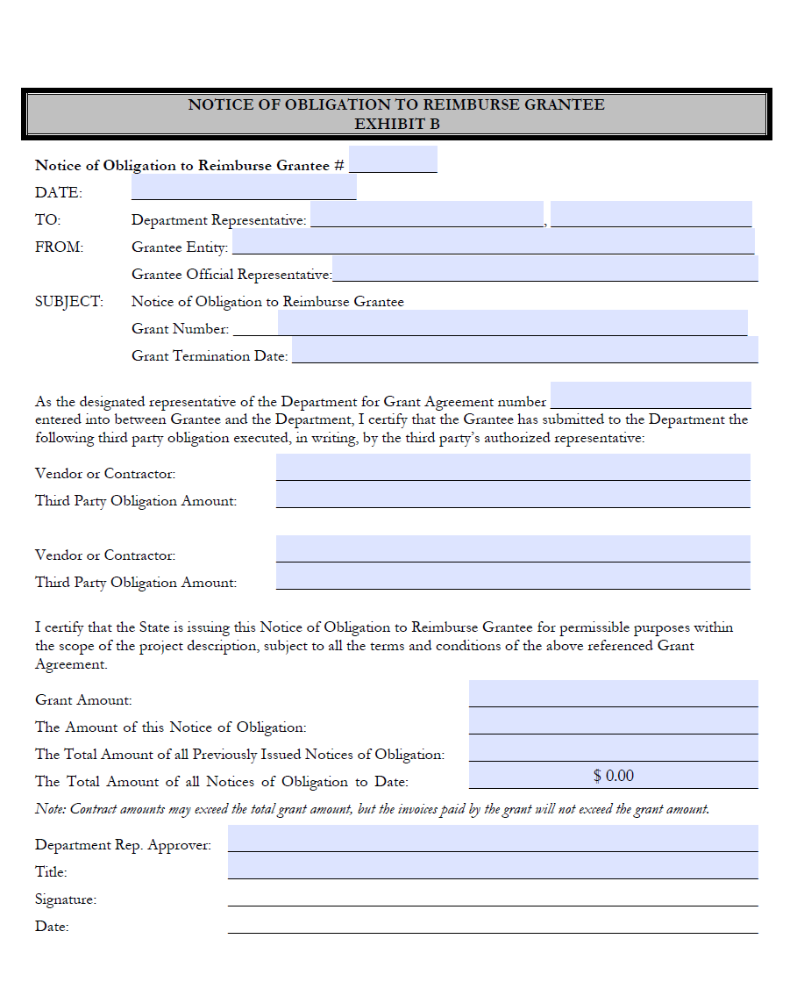
Notice of Obligation to Reimburse Form

Slide 13
Notice of Obligation to Reimburse Form
Same info as Request
for Payment Form; the To: line
Will be the Project Manager for
Your project

Slide 14
Notice of Obligation to Reimburse Form
Use a separate line for
each vendor/amount

Slide 15
Notice of Obligation to Reimburse Form
Same as Request for
Payment – keep a
running total of all
Notices of Obligation;
sign and date to be
completed by liaison
or authorized rep.

Slide 16
Summary Report Template
Use the included template as a guide
Attach this to your request for reimbursement packet for review and approval

Slide 17
Request for Payment Checklist
See attachment in supporting documentation
Make sure all items are present in the packet
Submit packet to All.Vendors@doit.nm.gov

Slide 18
Frequently Asked Questions
How frequent can we request reimbursement?
No more frequently than monthly, but quarterly is preferred.
Are we expected to pay cash match first or can we carry match percentage over the life of the grant?
It is best to carry over the life of the grant and is easiest for all parties to track this way. Note your grant-cash match percentage breakdown in your summary report.
How do we support payroll reimbursement?
Timesheets, queries from your financial system that designate personnel, and similar which does not violate personal identifiable information rules and regulations will be required to support any payments for reimbursements involving personnel. This may come up in a future audit, and you will need to be able to produce this timely.
Sample: Position, approved hourly rate, hours worked, summary of tasks completed
Where can I go for questions on the program, to request a copy of this and future presentations, and future recordings?
You can check the website: https://connect.nm.gov/arpa-compliance.html
You can reach Lee directly: lee.gagnon@connect.nm.gov
You can use the shared mailbox: broadbandpilot@connect.nm.gov

