Slide 1
Broadband Access and Expansion Regional Engagement

Slide 2
Introductions
Kelly Schlegel - Director of the Office of Broadband Access and Expansion
Joaquin Alvarado – Community Engagement Facilitator

Slide 3
Agenda
9:00 am – 10:00 am Welcome, Introductions and Updates
10:00 am – 10:15 am Break
10:15 am – 11:40 am BEAD and Digital Equity Review
11:40 am – 12:00 pm Next Steps
12:00 pm – 1:00 pm Working Lunch and Community Roundtable
Survey completion time

Slide 4
Enabling Legislation
Senate Bill 93 and House Bill 10 created the Office of Broadband and the Connect New Mexico Council in 2021
The enabling legislation establishes the “Connect New Mexico Fund” and structure for the Council and OBAE to receive funding for grant distributions to build out broadband infrastructure
Amended in 2023 as HB 262 and SB 452, the updated legislation clarifies the Council’s advisory role for program planning and grant distribution
The legislation requires an annual report to the governor in the form of a Three-year plan and statewide plan
The legislation further directs that OBAE will provide technical assistance to Tribes and local governments for planning purposes
The enacted law requires OBAE to develop broadband maps, set standards for quality and broadband speeds, and coordinate with local, state and federal agencies

Slide 5
Mission and Vision of Office of Broadband
Mission: Passionate leadership to drive bold, equitable, and inclusive broadband solutions
Vision: Achieve bold, affordable broadband solutions for New Mexicans that honor the state’s rich heritage and elevate quality of life for all
Values: Seven values defining OBAE’s people, processes, planning, and programs: 1) bold; 2) honest; 3) curious; 4) innovative; 5) respectful; 6) collaborative; 7) analytically rigorous
Four major goals
Universal Broadband Availability
Broadband Adoption and Meaningful Usage
Statewide Next Generation Networks
Program Stewardship
These Goals are foundation of the 3-yr Plan submitted Jan 01, 2023 that describe strategic priorities, initiatives and actions to accomplish each goal

Slide 6
Accomplishments for 8 months have included all goals
Goal: Universal Broadband Availability
All Federal application deadlines met for IIJA funding: July 11, July 18, Aug 15, Sept 30, Nov 18, Jan 15, Jan 30, March 15, April 30
Stood up CNMC Pilot grantmaking for federal ARPA funds
Completed rule making for CNMC state grants
Awarded 9 ARPA grants: $35M in Wave 1 and $17M in Wave 2 to help approx. 30 rural communities
Received $5.7M in planning funds from NTIA; Hired CTC for 6 Broadband Plans
Increased connectivity to several Presbyterian health rural health care clinics
Contract for Phase 1 of the SEN in process
Learned Best Practices by attending NTIA and NTTA conferences; state broadband leaders and tribal leaders

Slide 7
Accomplishments for 8 months have included all goals
Goal: Broadband Adoption and Meaningful Usage
Submitted Data Collection Report on Oct 01, 2022
Community Engagement - over 150 community events; 9 tribal events
Planning several focused engagements to collect correct data for 2023: regional, statewide and tribal
Increased ACP enrollment to 142K+
Attended Digital Equity Conference
Technical assistance to several tribes and communities

Slide 8
Accomplishments for 8 months have included all goals
Goal: Statewide Next Generation Networks
Completed RFI Campaign to ISPs
Worked with Finley Engineering to create a Statewide Middle Mile Plan
Submitted Middle Mile Application Sept 30 to NTIA
Supported other Middle Mile Applications
98% complete Contract for Phase 1 of the SEN in process
Attended NTIA conferences; broadband leaders and tribal leaders

Slide 9
Accomplishments for 8 months have included all goals
Goal: Program Stewardship
Submitted 3-year Broadband Strategic Plan on Jan 01, 2023
Staffed the office to the operating budget
Successfully asked LFC for more budget to staff the office to meet our mission
Determined draft org chart
JPA/MOU with PSFA (SB 93 - Section 3H): JPA/MOUs between agencies; SEN is part & parcel of Middle Mile
Completed 9 contracts including RESPEC for mapping support
Helped get 6/7 broadband bills passed so that we can do our work
Coordinating with FCC for accurate maps; submitted in fabric and availability and met all deadlines

Slide 10
Broadband Technology Overview
An introduction to broadband infrastructure and technologies for communities and local policymakers

Slide 11
Acronyms
ACP: Affordability Connectivity Program
ARPA – American Rescue Plan Act of 2021
BSLs: Broadband Serviceable Locations
BEAD – Broadband Access Equity and Deployment
CNMC - Connect New Mexico Council
DE - Digital Equity
FTTH/FTTP – Fiber to the Home/Fiber to the Premise
HB – House Bill
IIJA - The Infrastructure Investment and Jobs Act (IIJA)
ISP: Internet Service Provider
JPA- Joint Powers Agreement
MOU - Memorandum of Understanding
NM: New Mexico
NTIA- National Telecommunications and Information Administration
OBAE: Office of Broadband Access and Expansion
PSFA: Public School Facility Agency: PSFA
SEN: Statewide Education Network
PEN: Pueblo Education Network
RDOF: Rural Digital Opportunity Fund
RFP: Request for Proposal RFP
SB - Senate Bill
SLO: State Land Office
TAP: Technical Assistance Program
USDA - US Dept of Agriculture

Slide 12
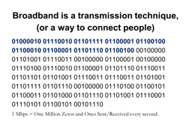
What is broadband?
Broadband refers to high-speed internet access.
Broadband includes several high-speed technologies such as fiber, cable modem, wireless, and DSL.
https://www.fcc.gov/general/types-broadband-connections

Slide 13
DEFINITIONS AND CONCEPTS: BITS AND BYTES
These two are frequently confused but are distinct – both are measures of digital information, but one refers to speed and the other refers to amount of data
BITS PER SECOND (SOMETIMES SHORTENED TO “BITS”)
A “BYTE” IS EQUAL TO 8 BITS
Used to describe a measure of speed – how fast data travel across a network (“bandwidth”)
The number of bits per second tells us how fast the communication is moving on the network
In a roads analogy, “bits per second” is analogous to a car’s miles per hour
Megabit = 1,000,000 bits
Gigabit = 1,000 megabits
“My internet speed is really fast – it’s up to a gigabit per second.”
Used to describe the amount of data stored (memory capacity)
The number of bytes tells us how much information is involved
In a roads analogy, “bytes” is analogous to the number of cars on the road
Megabyte = 1,000,000 bytes
Gigabyte = 1,000 megabytes
“My data plan with T-Mobile lets me send or receive a total of five gigabytes a month.”

Slide 14
FEDERAL AND NEW MEXICO BROADBAND SPEED TARGETS
The FCC’s definition is 25 megabits per second down and 3 megabits per second up (25/3 Mbps)
Congress set a new 100/20 Mbps standard in the American Rescue Plan Act and Infrastructure Investment & Jobs Act

Slide 15
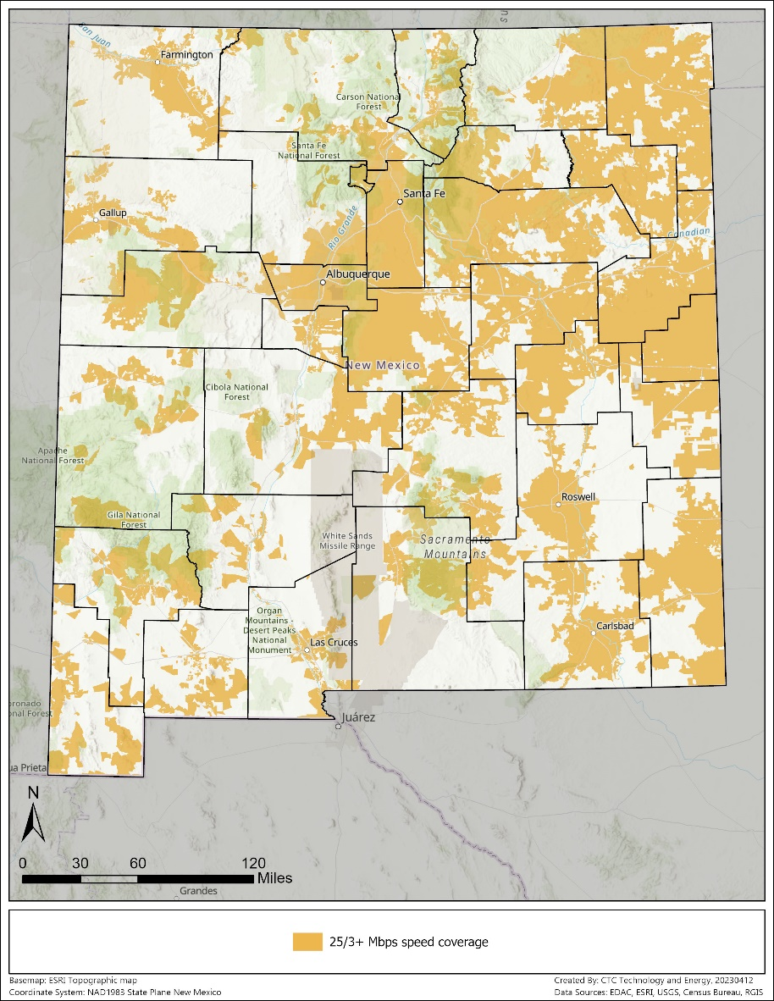
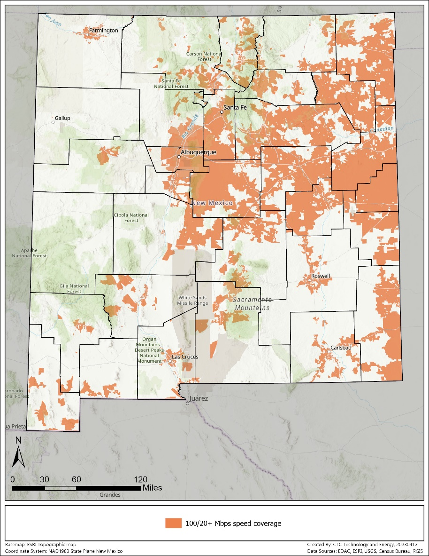
Broadband Maps
25/3 Mbps speed coverage
100/20 Mbps speed coverage

Slide 16
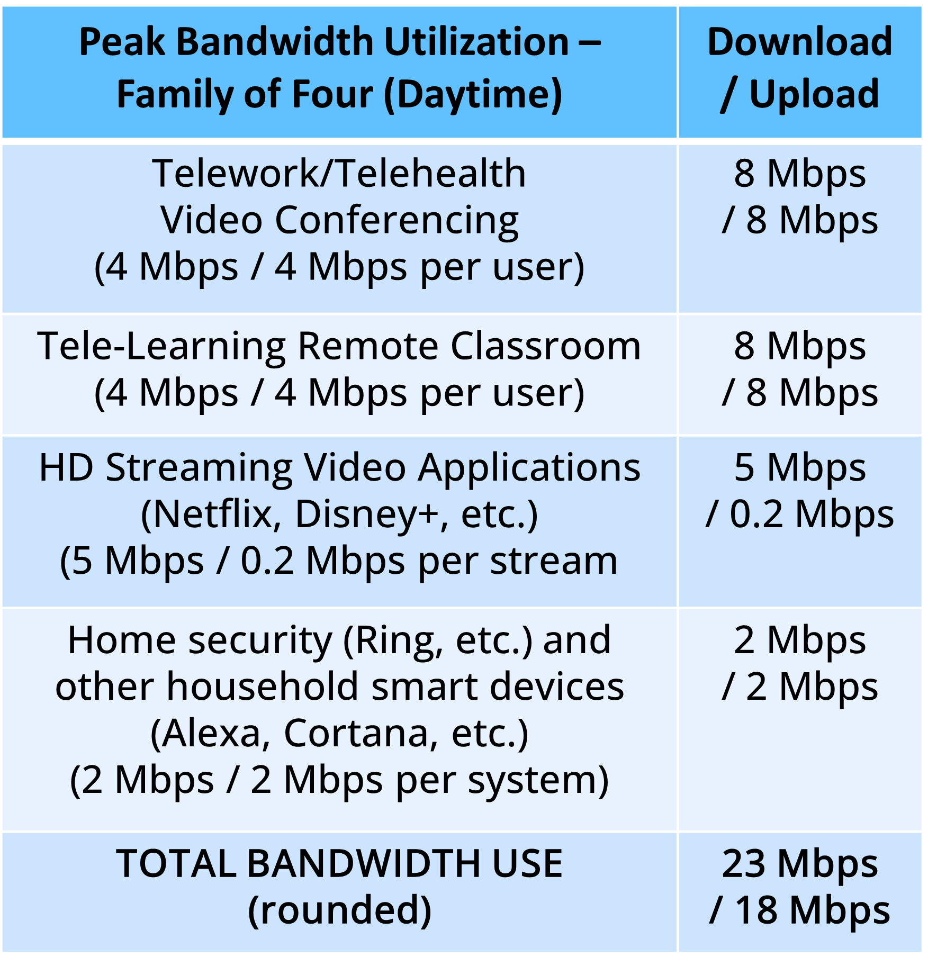
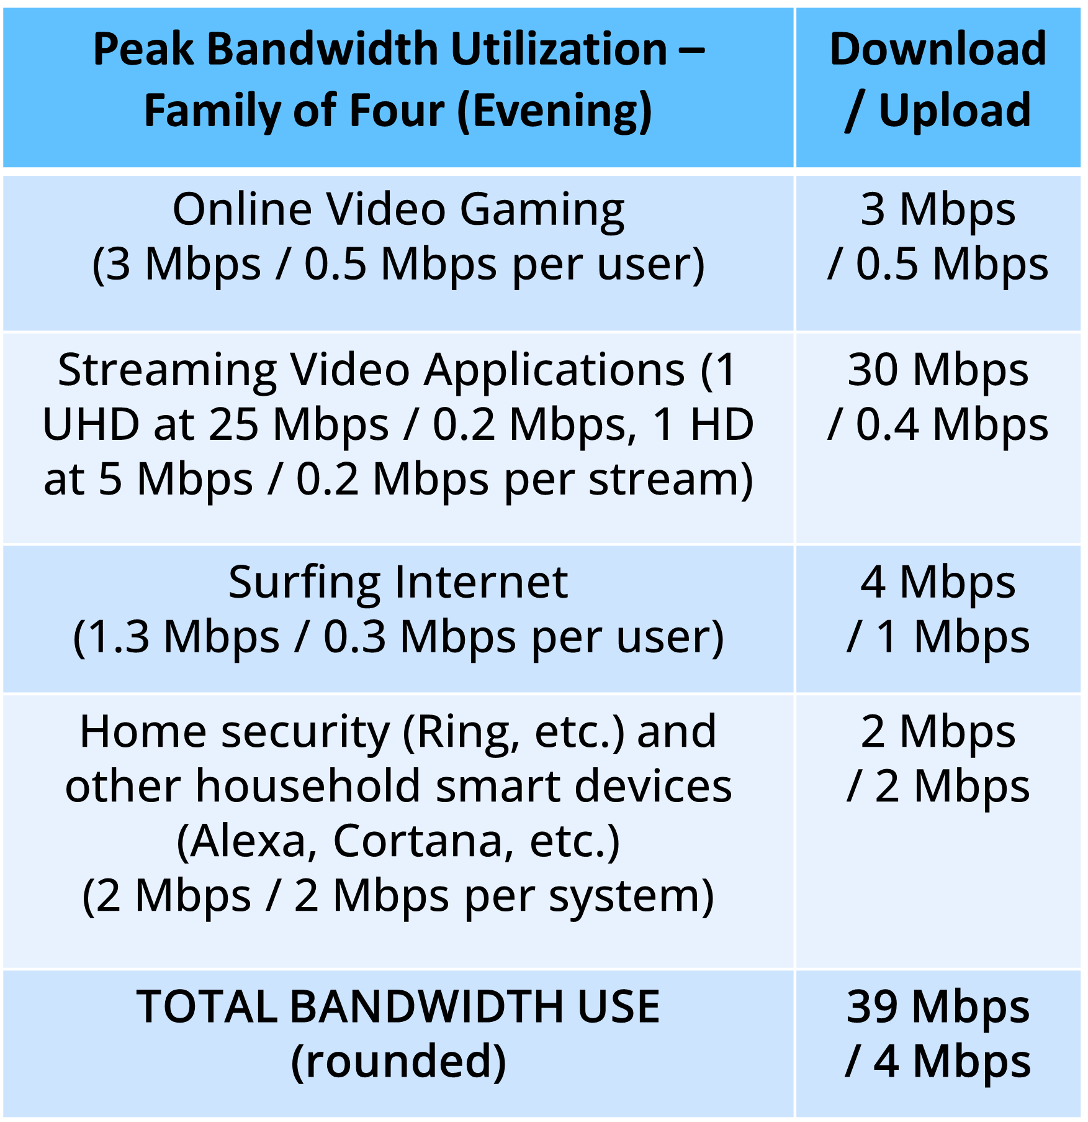
TYPICAL NEEDS OF A FAMILY OF FOUR

Slide 17
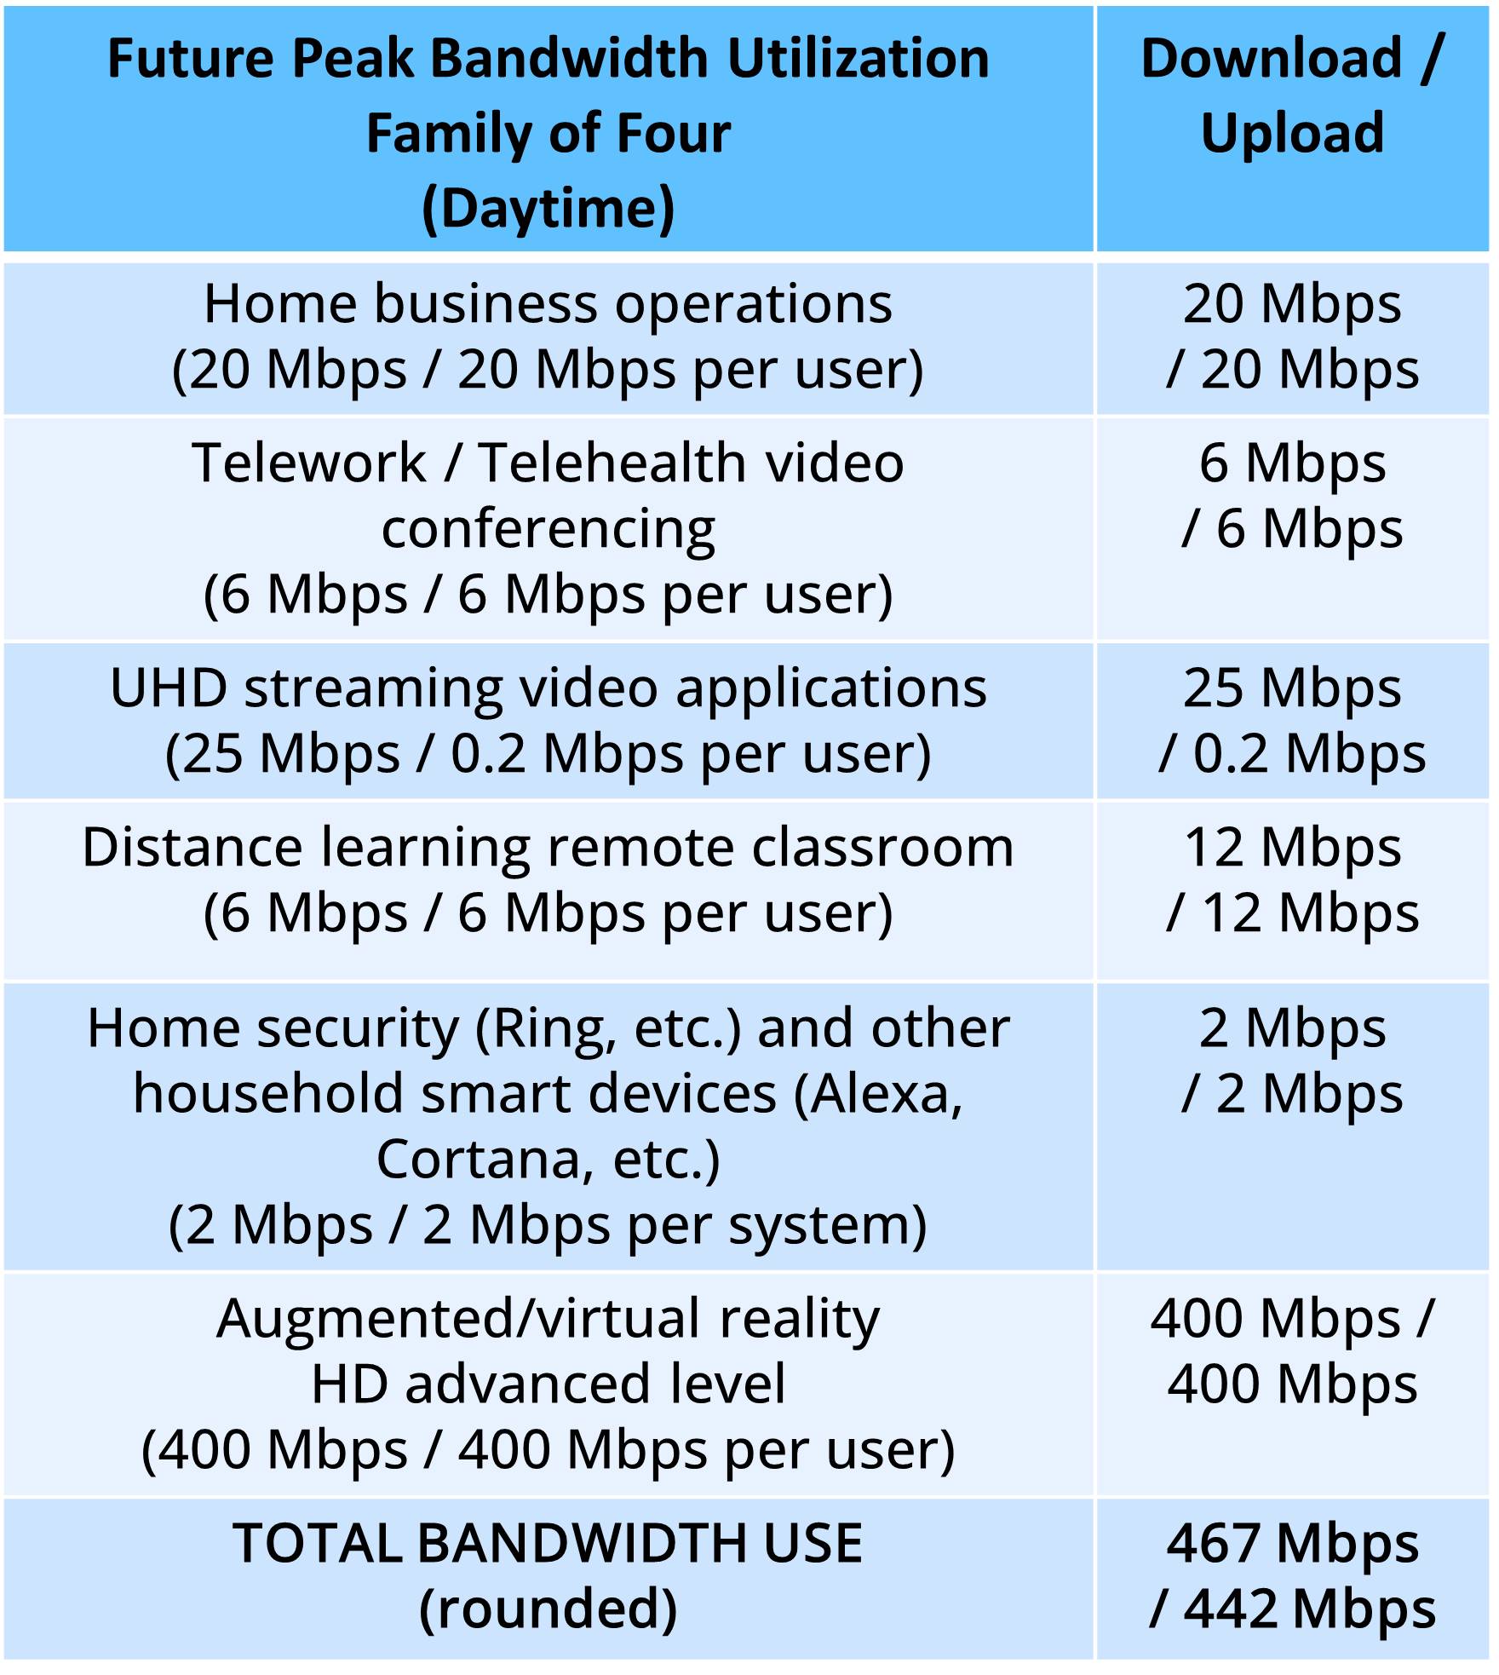
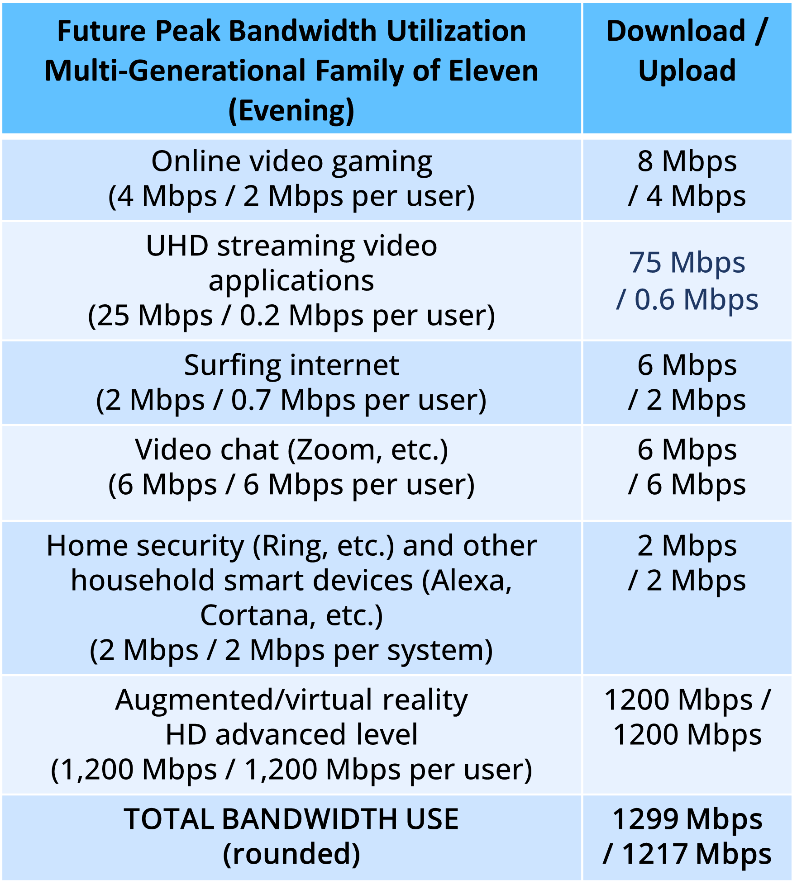
FUTURE NEEDS WILL BE MUCH HIGHER

Slide 18
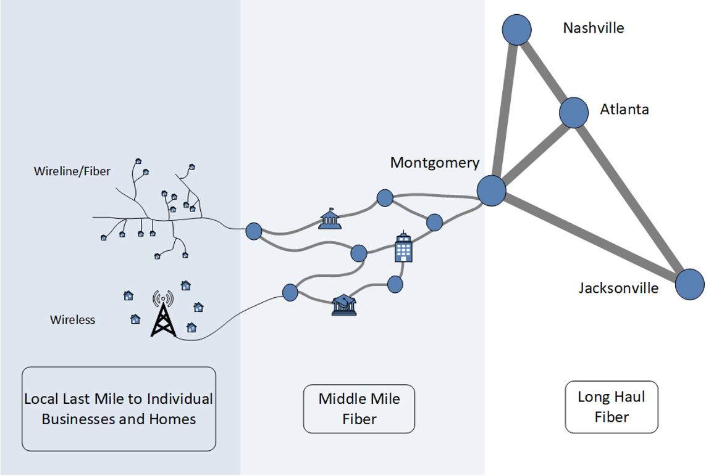
THE ELEMENTS OF A BROADBAND NETWORK
Long haul fiber
Middle mile fiber
Last mile (wireline or wireless)
Albuquerque
Santa Fe
Wireline/
Fiber
Las Cruces
Phoenix
Wireless
Local Last Mile to Homes and Businesses
Middle-Mile Fiber
Long Haul Fiber

Slide 19
TYPES OF BROADBAND INFRASTRUCTURE
Hybrid fiber-coaxial (cable)
Fiber-to-the-premises
Digital Subscriber Line (DSL) frequently not at broadband speeds
Fixed wireless sometimes not at broadband speeds
Mobile wireless (4G and 5G)

Slide 20
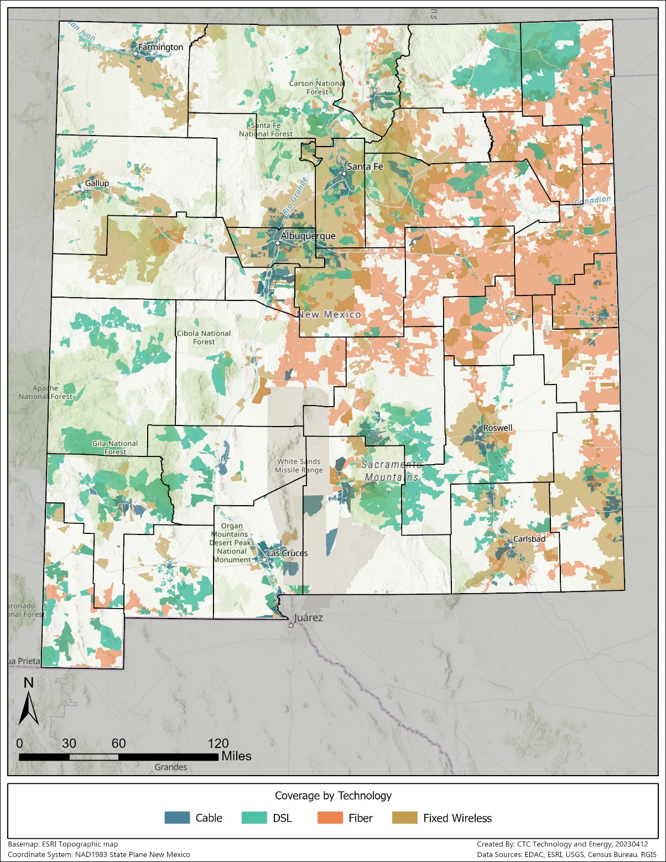
New Mexico broadband coverage by technology

Slide 21
WHAT IS “DIGITAL OPPORTUNITY AND EQUITY”?
Generally, experts have identified five elements of digital opportunity and equity:
Broadband Access:
Affordable, accessible, and reliable high-speed home internet service is available for all individuals
Accessible and Inclusive Content:
Public online content is inclusive and accessible by all individuals
Devices and Tech Support:
Individuals have access to computers or tablets and technical support
Privacy and Security:
Individuals can protect their data privacy and online security
Digital Literacy and Skills:
Individuals have digital skills to support their ability to meaningfully use the internet in their daily lives

Slide 22
Discussion on BEAD
What broadband connectivity issues does your community face?
What do you hear from your partners and the public about their challenges with broadband access and opportunity?
What broadband infrastructure-related activities have been undertaken in the county and/or region? By who?
Notes:
Notes for Joaquin
Does your community experience issues during events of extreme weather?
Do you feel like your community’s broadband connection is sufficiently robust? Do you have a lot of outages?

Slide 23
Broadband Funding and Programmatic Opportunities
Funding overview and timeline

Slide 24
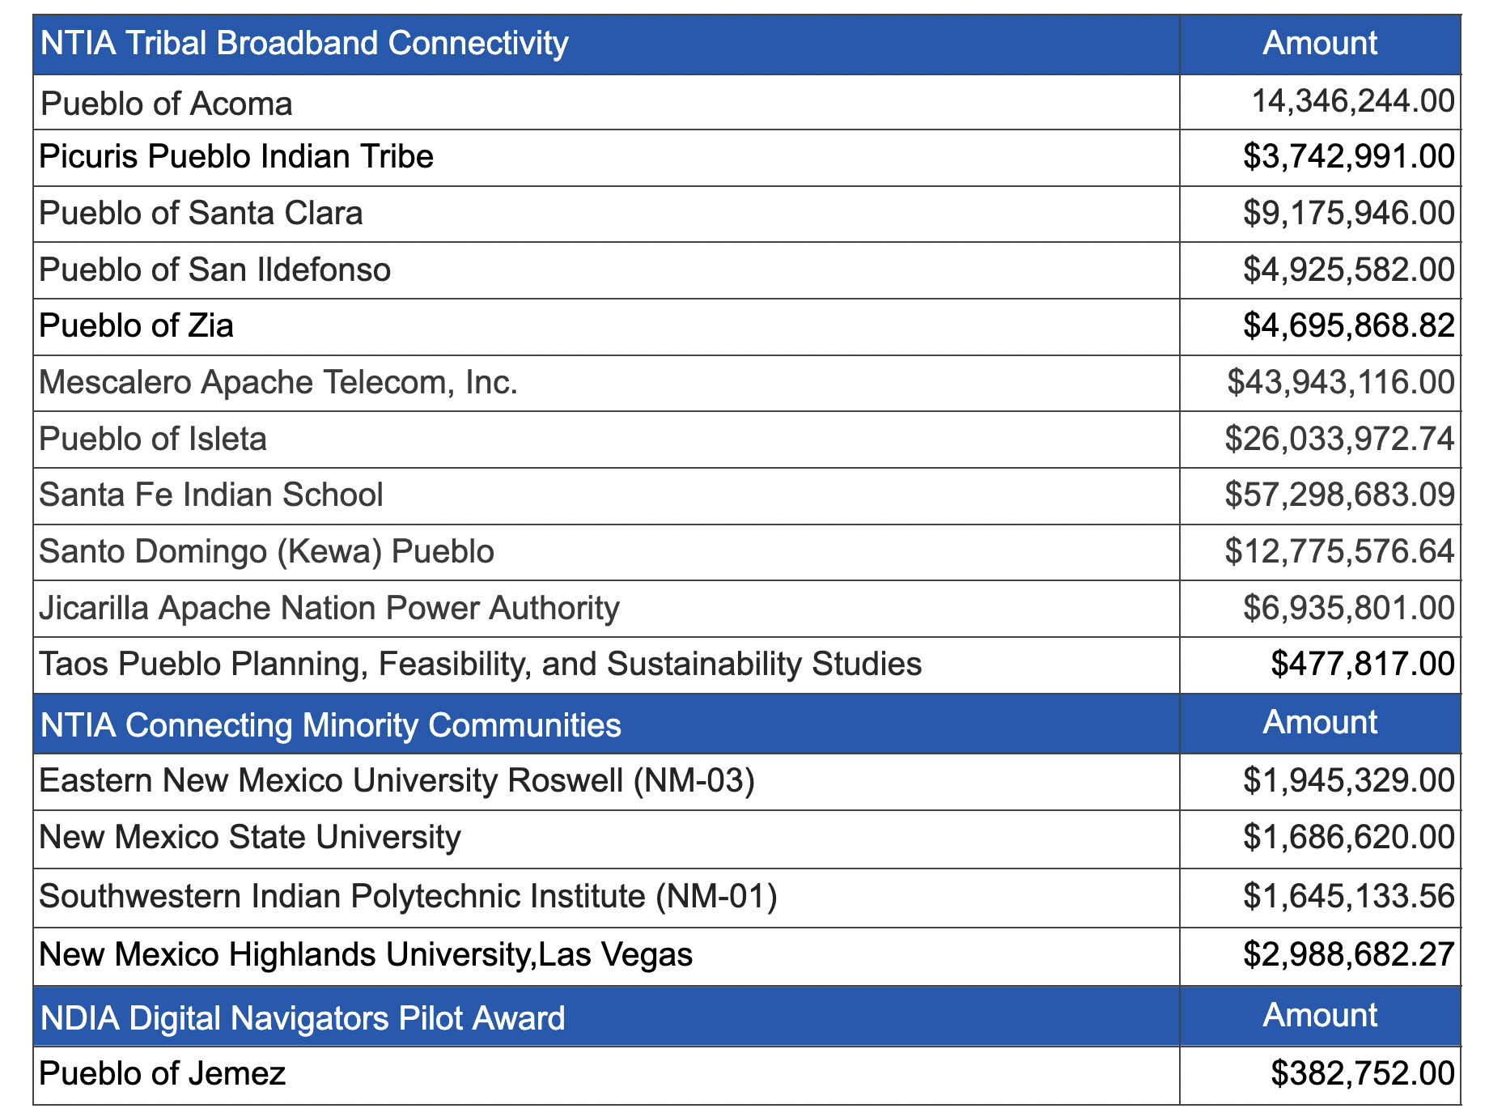
$702,111,562.52 in 71 NM Broadband Awards and Projects in Process

Slide 25
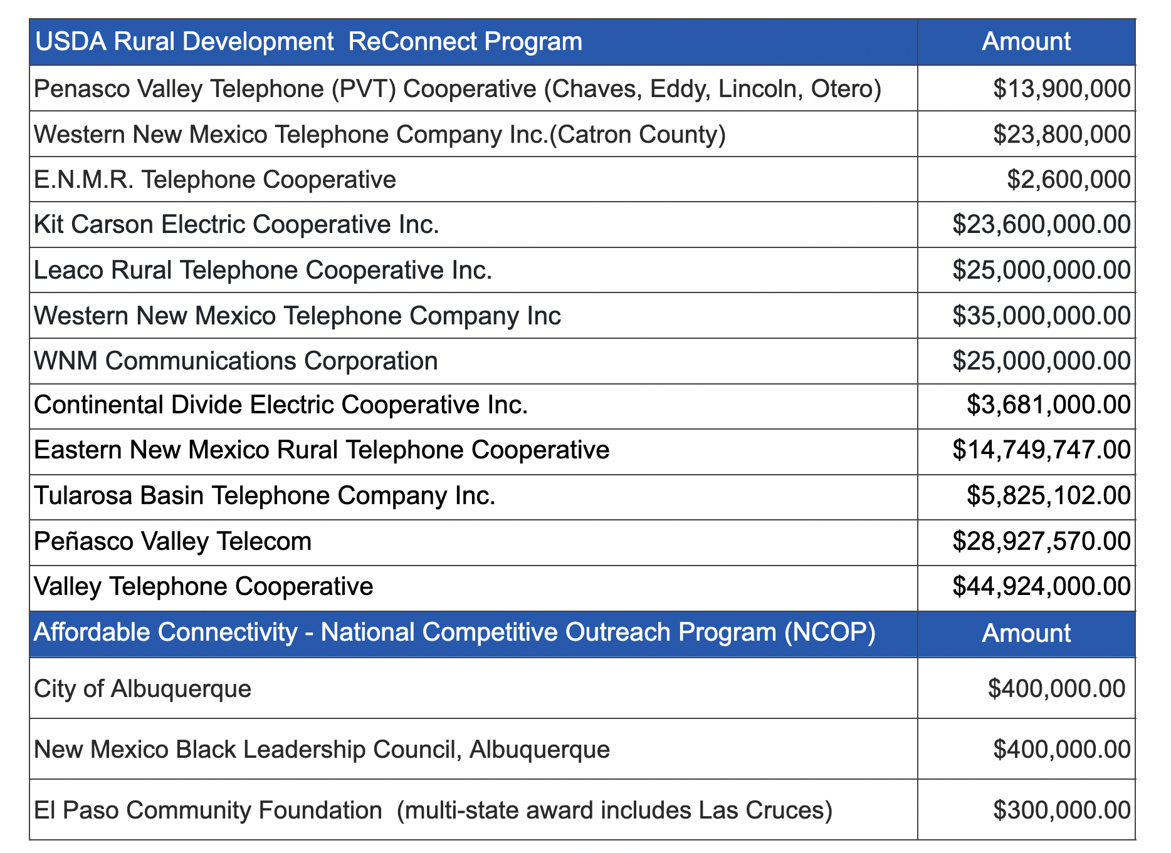
$702,111,562.52 in 71 NM Broadband Awards and Projects in Process (continued)

Slide 26
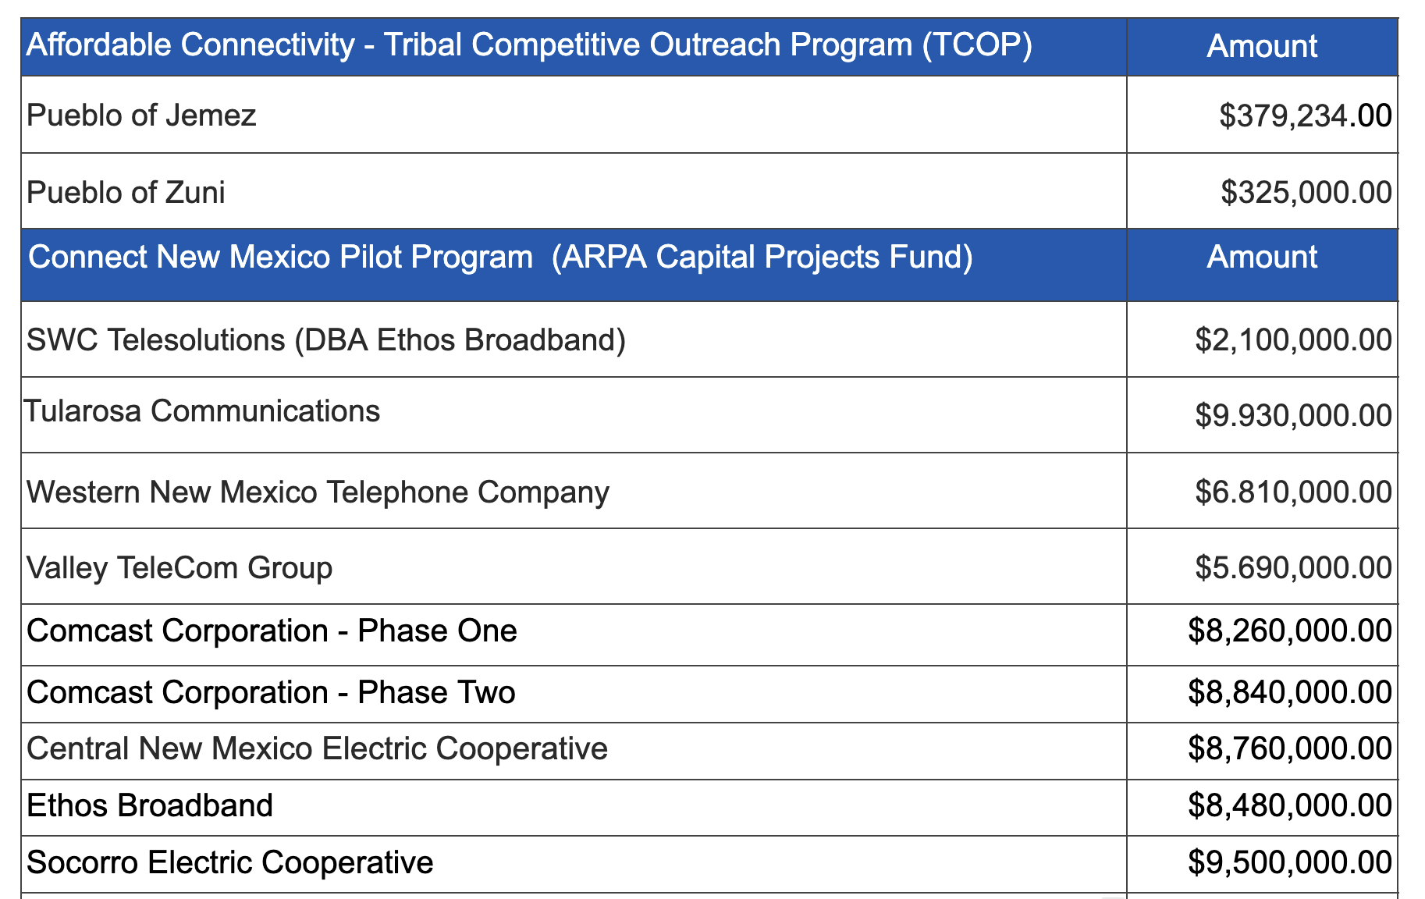
$702,111,562.52 in 71 NM Broadband Awards and Projects in Process (continued)

Slide 27
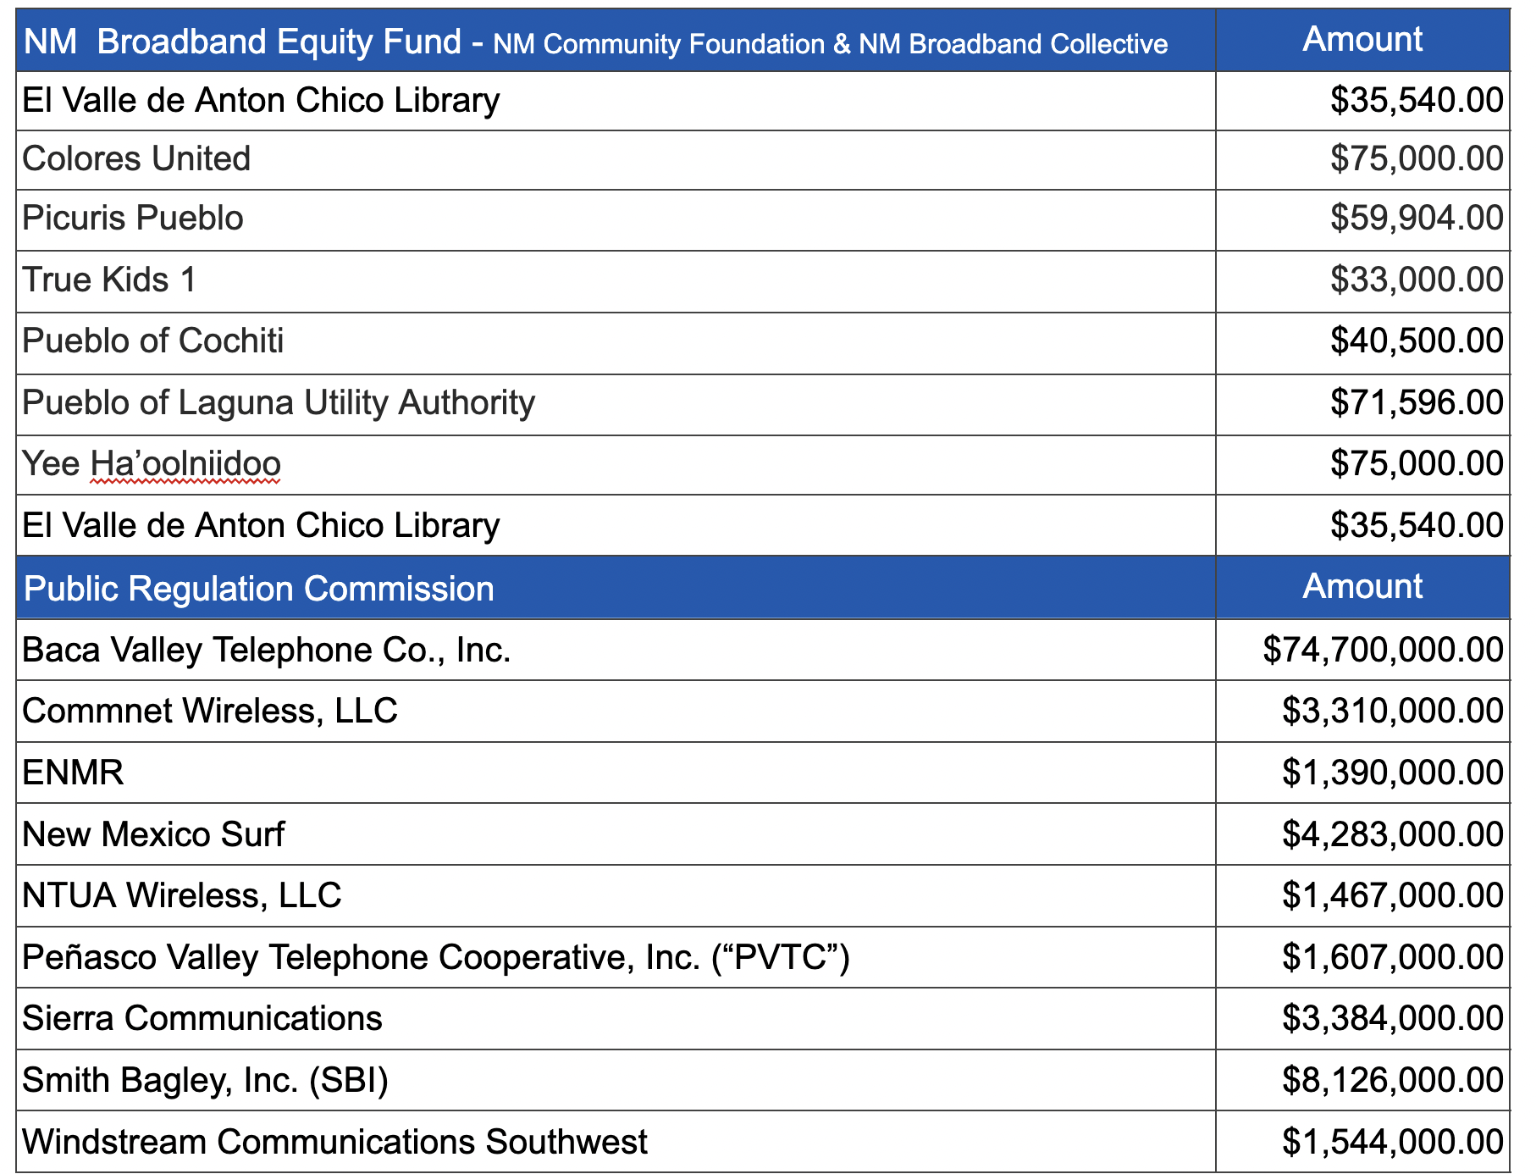
$702,111,562.52 in 71 NM Broadband Awards and Projects in Process (continued)

Slide 28
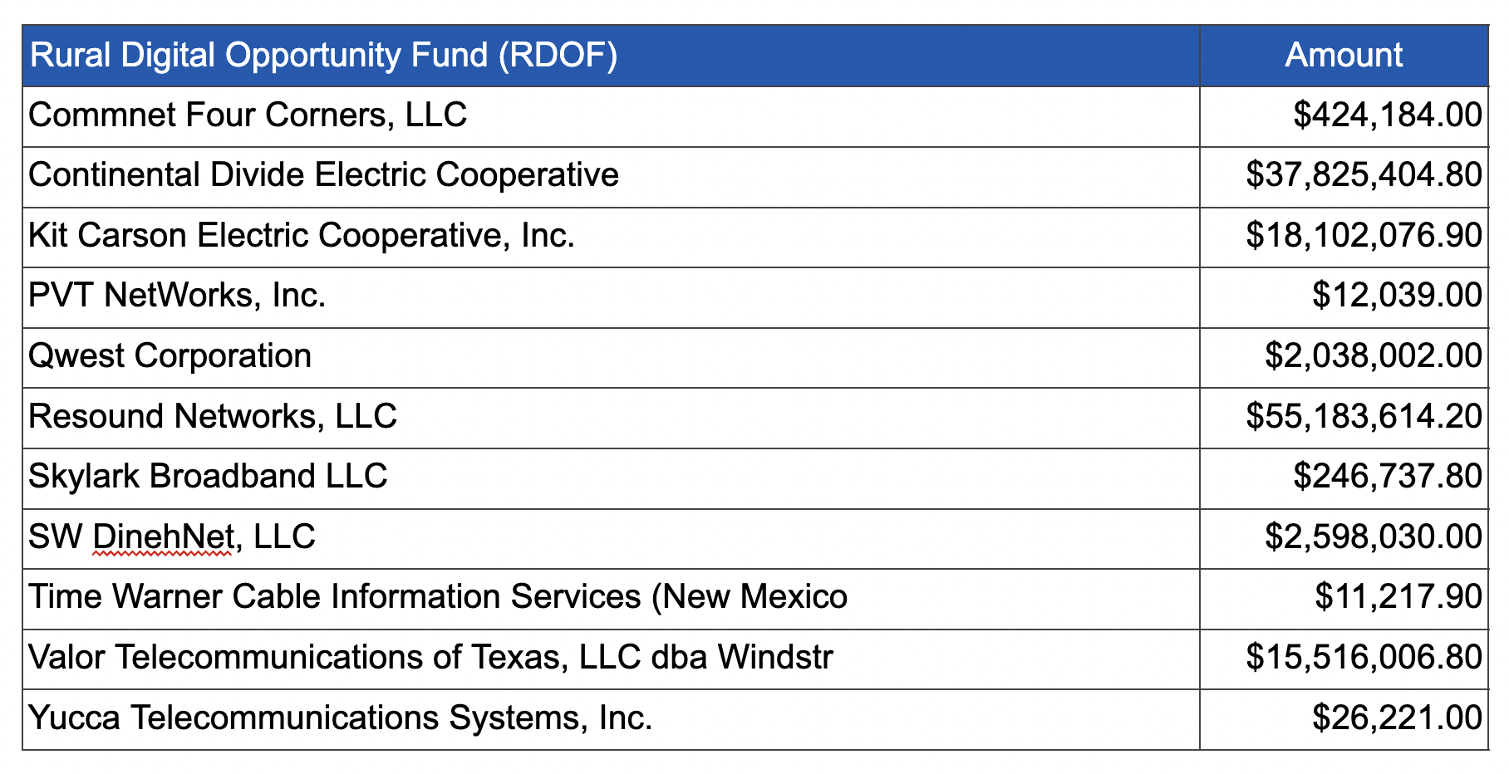
$702,111,562.52 in 71 NM Broadband Awards and Projects in Process (continued)

Slide 29
2023 Look Ahead
Initiative progress and tracking
CNMC grant making
Release ARPA grants Wave 2b and 3
Mature NM maps and technical assistance with Broadband projects - Ongoing
Increase Community, Agency, ISP and Tribal engagement; incorporate data and needs into BEAD Plan - Ongoing
State DE Plan - August 1, 2023
NTIA 5-year BEAD Strategic Plan - August 28, 2023
NTIA DE Plan - September 2023
State Data Collection Report - October 1, 2023
BEAD Initial Proposal - December 2023
BEAD Final Proposal – 2024
SEN Phase 1 and SEN Phase 2
Expand rural health care clinic connectivity – Federal grants: https://www.usac.org/rural-health-care/healthcare-connect-fund-program/

Slide 30
100% Connectivity: >$1B Funding Enables BB Buildout
Submitted plan July 12. Released $740K Planning Funds Nov 30, 2022
Engaged SME contractors for community + tribal outreach and Digital Equity (DE) Planning
Outreach and detailed planning December 2022 - December 2023
Submit detailed plan December31, 2023. Releases DE implementation funds
Implement DE Plan Dec 2023 - 2025
$30M+*
NTIA Digital Equity Funds
Submitted GOV Letter of Intent (LOI) July 18.
Submitted plan August 15. Released $5M planning funds Nov 30, 2023
Submit detailed plan August 2023. Releases broadband infrastructure funds
Award grants when funding released
Implement Last Mile 2024+
$$100M- 600M*
NTIA BEAD
Funds
Architected State-Coordinated Statewide MM Plan. ISP or ISP coalitions may submit independently.
Submitted September 30 . Releases middle mile infrastructure funds.
Award Grants when funding released
Implement Middle Mile 2023+
$$50M -100M*
NTIA MM Funds
*estimates

Slide 31
100% Connectivity: >$1B Funding Enables BB Buildout (continued)
Council members appointed, Interim Chair Selected and Established Six Working Groups
Allocated $100M by Legislature for MM and Last Mile deployment
Rulemaking in process; ECD Feb 2023
Award Grants 2023+
Connect NM Council
$$100M*
Developed Pilot Grant Program, application and scoring criteria
Announced Notice of Funding for Week of August 8
Awarded Round 1 of grants in Nov, 2022 $37M to 5 applicants; Round 2 scoring in process;
Implement Middle Mile/Last Mile 2022+
ARPA
$$123M*
Tribal Connect Fund
Announcement of Round 1 August 11 $164M – 10 applications awarded
Round 2 – Spring/Summer 2023
Implementation 2023+
$$200M*
USDA Funds
Six NM Awardees announced for loans and grants
Implementation 2022+
$$57M*
*estimates

Slide 32
Discussion on Digital Equity (DE)
What kinds of challenges/obstacles have you experienced accessing and having effective usage of affordable highspeed internet?
Which institutions and organizations are already engaged in DE programs? What are the programs?
Are there strategies for engaging more community members in DE that you can share?

Slide 33
LEVERAGE THE AFFORDABLE CONNECTIVITY PROGRAM
FCC subsidy program helps household better afford internet service and devices
Up to $30 per month subsidy for internet service
Up to $75 per month subsidy for internet if enrolled in certain Tribal support programs
One-time discount up to $100 for a device
Many low-cost service plans can be entirely subsidized by ACP enrollment
Eligibility determined by household income and federal assistance programs*
Partner outreach to eligible households and application support can help increase enrollment
*To apply for ACP, see https://www.affordableconnectivity.gov/

Slide 34
The Affordable Connectivity Program
an essential resource
Overview
How to enroll
Outreach Strategies

Slide 35
Taking Action On Connectivity In Your Community
Next steps for your community:
Signup for mailing list at https://connect.nm.gov
Follow the website
May 4 ABQNOG conference
State-wide convening May 24 at Buffalo Thunder
13 Webinars over 6 weeks
Let’s get Going Bootcamps June 28 and June 29
Affordability Connectivity pgm Sign-ups
Form MOUs- Example County and local ISPs to create a connect the county plan

Slide 36
Assist OBAE by completing surveys!
By filling out the following surveys, you can help New Mexico in its data collection efforts. Complete relevant surveys and tell us about digital equity programs, infrastructure, workforce development, and more.

Slide 37
Stakeholder Surveys
State & Local Government Asset Inventory
Community Anchor Connectivity
ISP Workforce Preparedness
Workforce Programs Inventory
Digital Equity Program Inventory
Barriers & Obstacles for Covered Populations
Infrastructure-related assets that may help facilitate or reduce the cost of broadband deployment in the state
Barriers and obstacles to clients, facility access, criticality of internet to mission and program capacity
Sources for hiring, workforce programs, ACP, internet skills and adoption, collaboration in community, deployment approaches,
disaster recovery plans
Workforce programs profile, barriers to developing
diverse & skilled workforce, ISP workforce-related questions
Program details, planned program types & areas of focus, broadband impacts on programmatic outcomes
Internet, computer & content access, digital skills, data security, barriers & obstacles, broadband impacts on programmatic outcomes

Slide 38
Contacts & Online Resources
Website: https://connect.nm.gov
Local planning guide: https://connect.nm.gov/local-planning-guide.html
Social Media presence
LinkedIn: www .linkedin.com/company/new-mexico-office-of-broadband-access-and-expansion
Facebook: New Mexico Office of Broadband Access & Expansion
Sign up for email, newsletter and press release information:
https://connect.nm.gov/mailing-list.html

