Slide 1
NM SEN PHASE2 RFP Pre-proposal Meeting Jan. 4th, 2024 @ 10:00AM OBAE / BDCP Team

Slide 2
Meeting Agenda
Introductions
Review of the RFP Requirements
Review of the Scope Of Work
Questions – Only written questions please!
Adjourn

Slide 3
Introductions
Richard Govea – Procurement Manager
Socorro Salazar – Protest Manager
Eric Moores – OBAE Project Manager III
Paulo Pedreschi – BDCP Project Manager
Ovidiu Viorica
Offerors/Vendors
Virtually (MS Teams) – collect information for file

Slide 4
RFP Purpose:
Build on the NM Statewide Education Network work to date (Phase1)
Select one or multiple vendors who can provide best value L2 circuits between nodes/participants - SEN
Additional locations for the SEN (participants/nodes)
Contract for three years (with extension(s) possible)
Contract between vendor and the Office of Broadband Access and Expansion (OBAE)

Slide 5
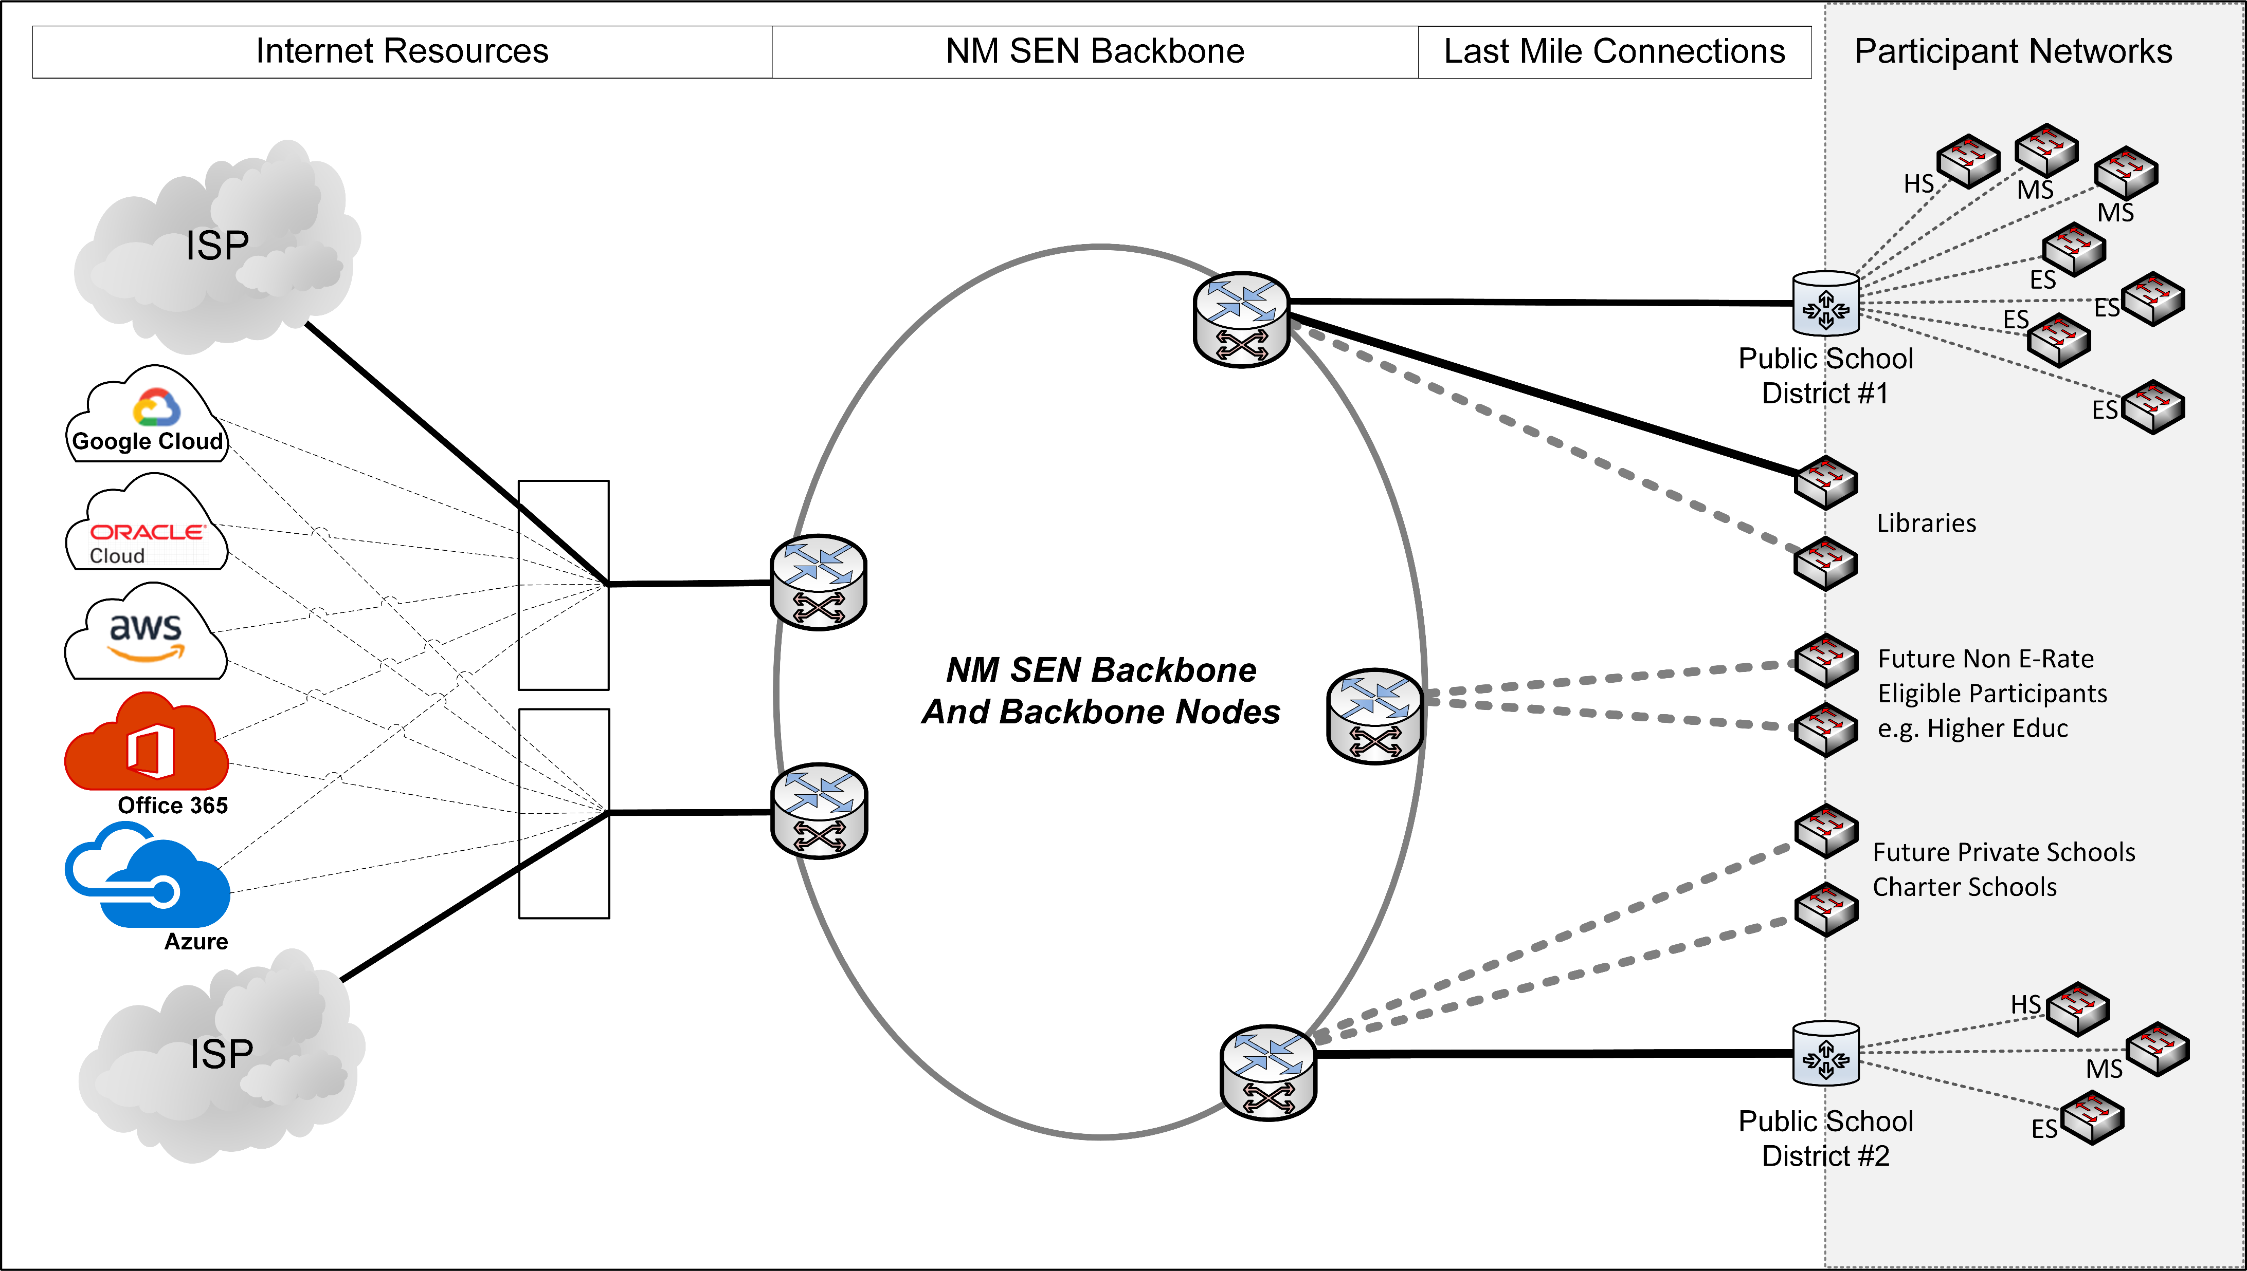
Statewide Education Network (SEN)

Slide 6
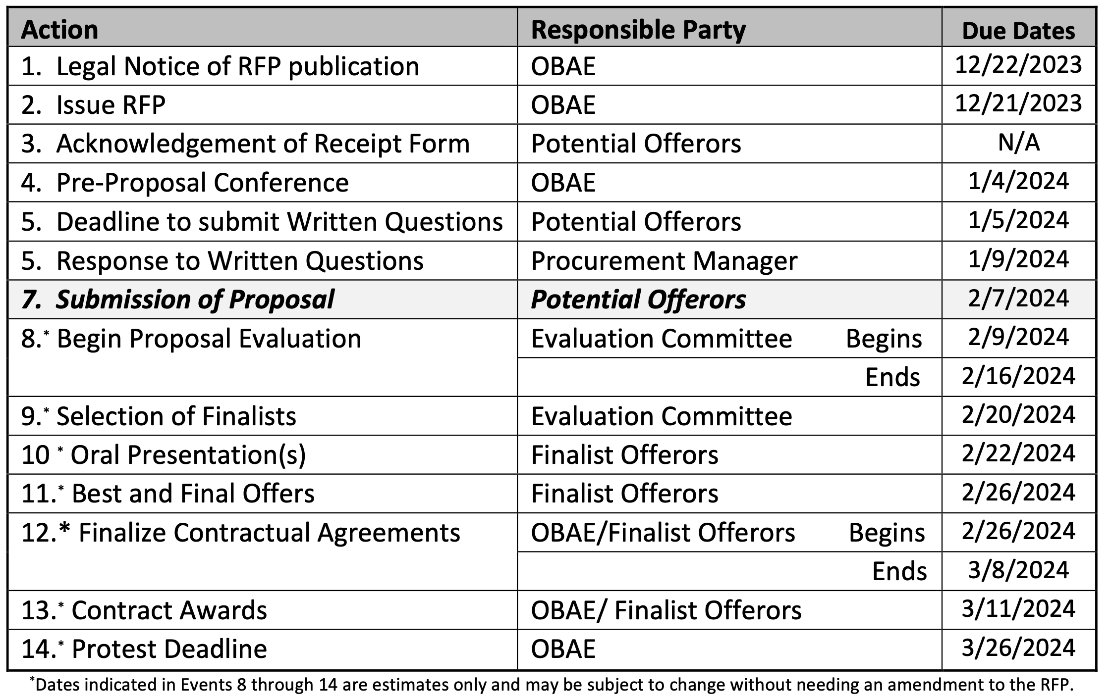
RFP Requirements / Important Dates:

Slide 7
RFP Requirements / Important Dates:
Questions deadline (1/5 - Friday)
To Procurement Manager, in writing.
Response to Written Questions (1/9 – Next Tuesday)
Proposals Due: 2/07 @ 3:00PM (e-mail only! Careful with delivery / confirmation)
Oral Presentations (if held): 2/22
Mark calendars: just in-case.
Awards: 3/11 (tentative)

Slide 8
RFP Requirements / Proposal Submission:

Slide 9
RFP Requirements:
Prevailing wages
Bonding (IF construction involved)
New Mexico / Veteran preference – Not Applicable (E-rate Funding)
Scoring Criteria

Slide 10
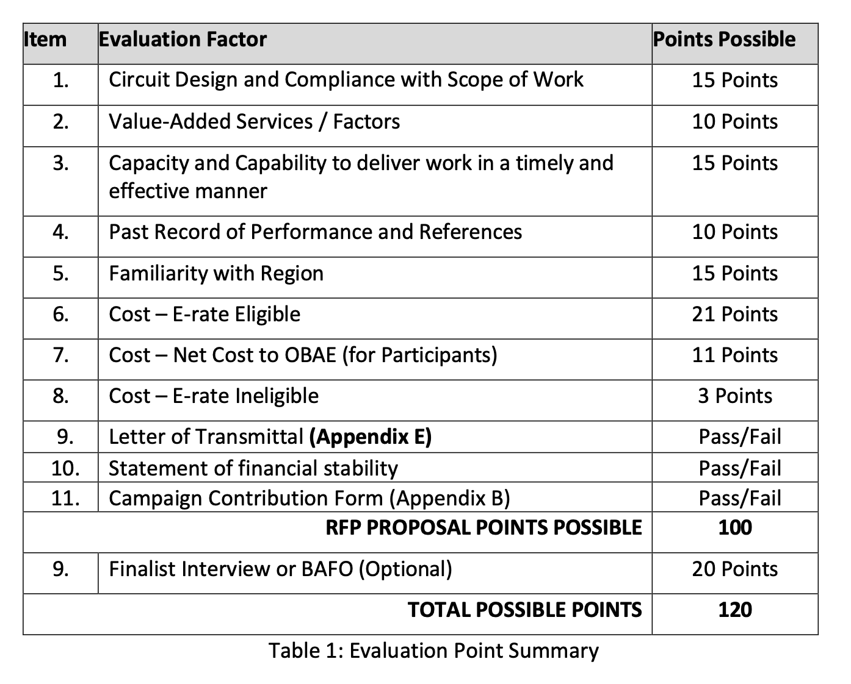
Scoring Criteria:

Slide 11
RFP Requirements/Format:
Letter of Transmittal
List Subcontractors
Campaign Contribution (Mandatory)
Bonding (construction portion)
Technical Proposal (Separate file from Cost)
Cost Proposal – on Price sheet (Separate from Technical)

Slide 12
RFP Requirements/Format:
Letter of transmittal: Pass/Fail
Financial Information: Pass/Fail
Evaluation Scoring
Scope Of Work – Target operations: July 1, 2024

Slide 13
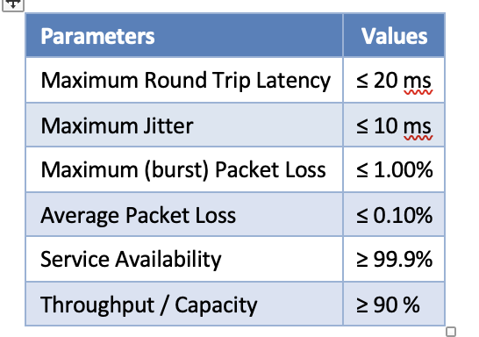
Scope Of Work
Locations
Nodes
Circuit Info
Service Specs (Layer2)
Performance Metrics
Operations
SLA Management

Slide 14
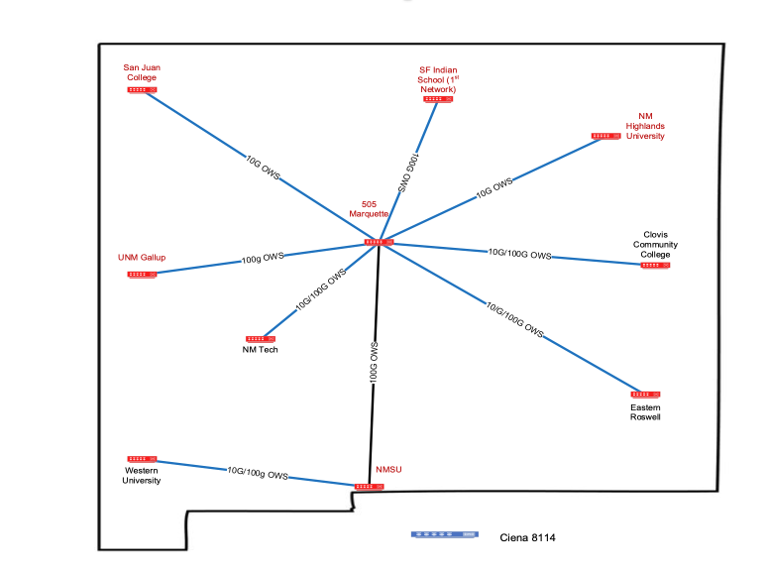
SEN
SEN 100G Wave (Lumen)
Yah Ta Hey
Proposed / Optional Node
NTU Crownpoint
New SEN Participant
New SEN Phase2 Circuit
New SEN Phase2 Circuit to Optional/New Node
ABC Schools
See Price Sheet for capacity(ies)
NMJC Hobbs

Slide 15
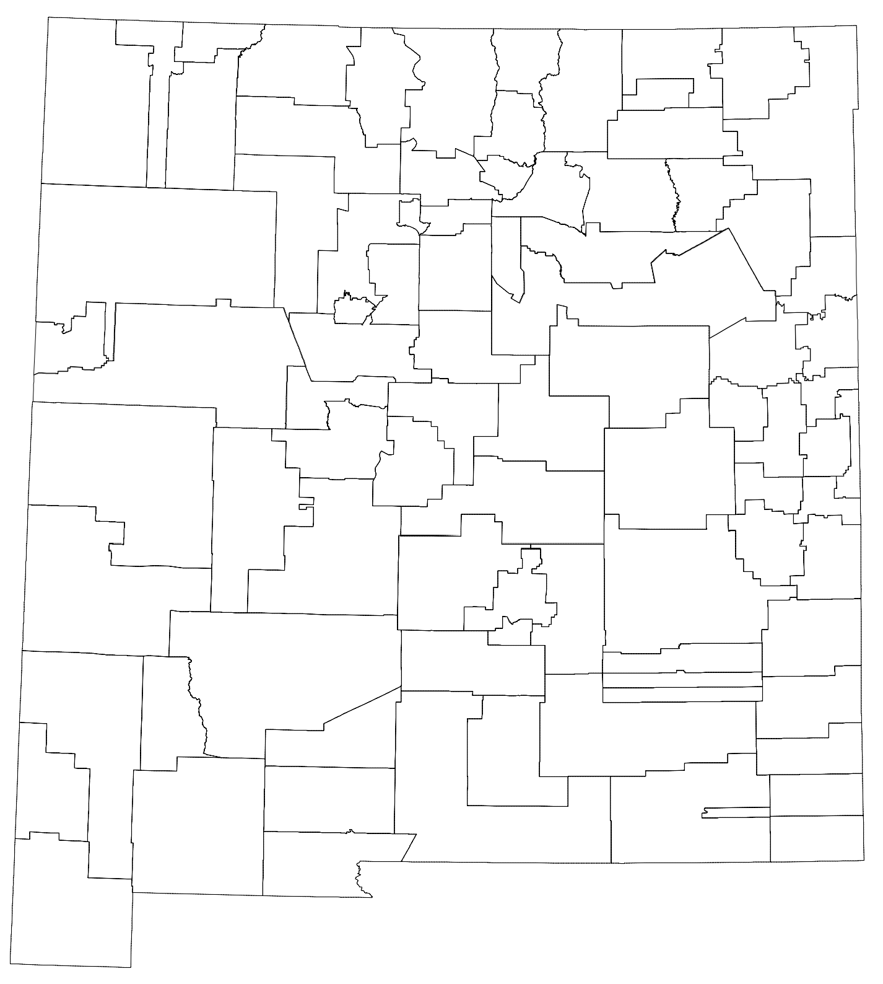
Phase 2 Participants (From Appendix D)
1 |  | Albuquerque Sign Language Academy |  | 29 |  | Jemez Valley (NCC)
2 |  | Amy Biehl High School |  | 30 |  | Las Cruces Public Schools
3 |  | Cien Aguas International School |  | 31 |  | Lordsburg Municipal Schools
4 |  | Cottonwood Classical Preparatory School |  | 32 |  | Magdalena Elementary School
5 |  | Gordon Bernell Charter School |  | 33 |  | Magdalena Library
6 |  | Health Leadership High School |  | 34 |  | MESD Network Operations
7 |  | La Academia De Esperanza |  | 35 |  | Middle College High School
8 |  | Los Puentes Charter School |  | 36 |  | Mosaic Academy
9 |  | New Mexico International School |  | 37 |  | New America School - Las Cruces
10 |  | Technology Leadership High School |  | 38 |  | New Mexico School For The Deaf
11 |  | Alamogordo Public School District |  | 39 |  | Pojoaque Central Office
12 |  | Carlsbad Municipal Schools |  | 40 |  | Quemado Independent School District
13 |  | Carrizozo Municipal Schools |  | 41 |  | Questa High School
14 |  | Cimarron Mun School District |  | 42 |  | Raices del Saber Xinachtli Community School
15 |  | Cloudcroft Mun School District |  | 43 |  | Reserve Independent Schools
16 |  | Clovis Municipal Schools |  | 44 |  | Reserve Library
17 |  | Cobre Consolidated School District |  | 45 |  | Rio Rancho Public Schools
18 |  | Corona Public Schools |  | 46 |  | Roy Municipal Schools
19 |  | Deming Cesar Chavez Charter High School |  | 47 |  | Ruidoso High School
20 |  | Deming Data Center |  | 48 |  | Silver Consolidated Schools
21 |  | Dexter School District |  | 49 |  | Socorro Data Center
22 |  | Diné College Tribal Library |  | 50 |  | Taos Academy Charter School
23 |  | DEAP |  | 51 |  | Tierra Encantada Charter School
24 |  | Glenwood Library |  | 52 |  | Tularosa Municipal School District
25 |  | Hagerman Municipal School District |  | 53 |  | Vista Grande High School
26 |  | Hobbs Municipal School District |  | 54 |  | Wagon Mound Public Schools
27 |  | Hondo Valley School District |  | 55 |  | West Las Vegas School District
28 |  | Jemez Mountain (NCC) |  | 56 |  | Zuni Public School District

Slide 16
Cost Sheet

Slide 17
Questions?

