Slide 1
Statewide Education Network Advisory Committee March 21st, 2024

Slide 2
Agenda
Brief Introductions of new members
Presentation – Technology Planning / Future Ready Schools
Tom Murray, Director of Innovation
Statewide Education Network (SEN): Design, Status & Timeline
School Participants – Transition Process and Transition Plan
Other Items

Slide 3
Future Ready Schools
Tom Murray – Director of Innovation

Slide 4
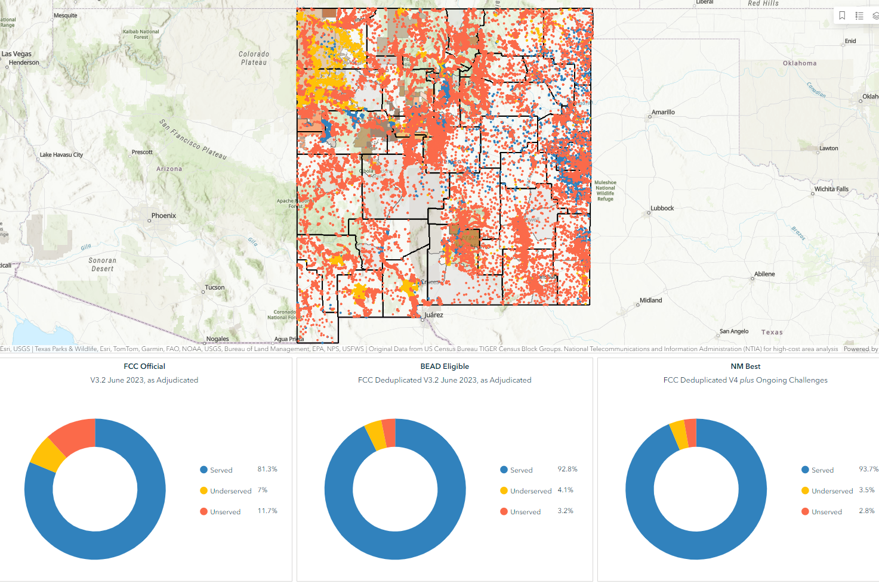
Broadband Updates

Slide 5
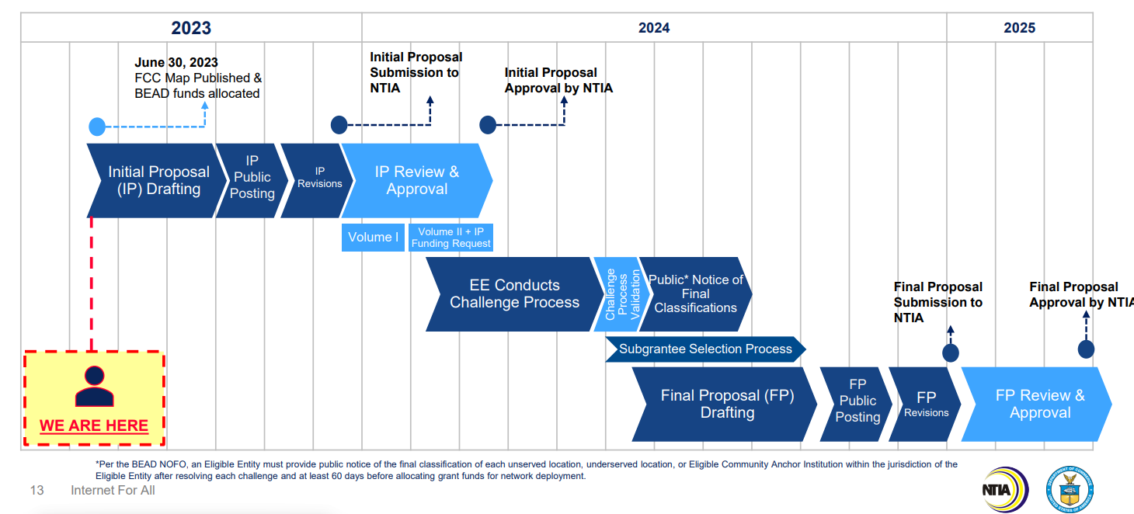
Broadband Updates - BEAD

Slide 6
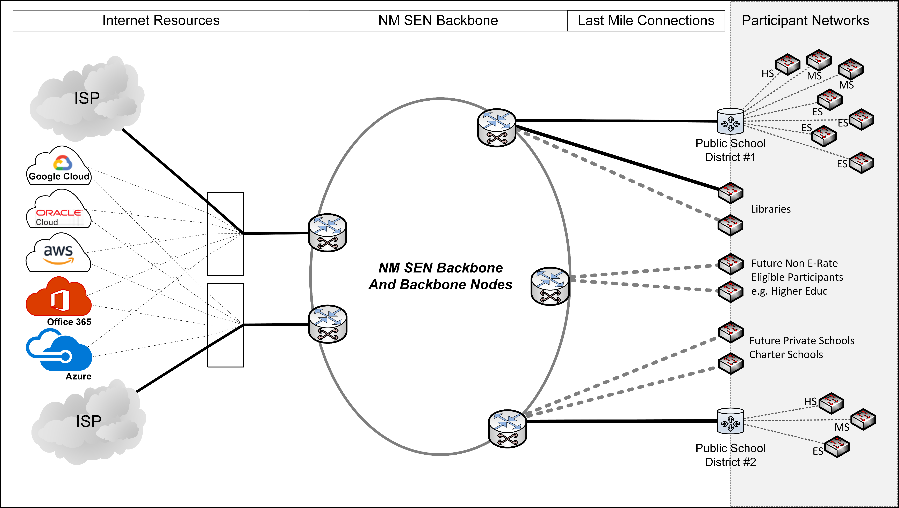
SEN Phase 1 Overview

Slide 7
What is the Statewide Education Network (SEN)?
https://youtu.be/WgdkZjFmVUY
Network coordinated by the state, leveraging Internet Service Providers’ existing broadband infrastructure and services.
Will connect all public schools (K12) who participate together and to secure internet. Voluntary participation.
Other entities could participate: libraries, HigherEd, museums, state parks…
Will serve as the foundation for other connectivity needs: students, telehealth/rural health, courts, municipalities etc… for the incremental cost.

Slide 8
SEN Benefits:
Educational: Support EdTech. Allow sharing of instructional and professional resources between all the participants.
Administrative: reduce burden of planning, procurement, contracting, E-rate paperwork, billing…
Cost reduction: reduction or elimination of schools’ share (after E-rate).
Technical support: provide specialized resources to (small) schools.
Cybersecurity risk reduction.

Slide 9
E-Rate Implications (March 27th):
E-Rate Central will be filing the Form 471 on behalf of the SEN.
For the first year SEN participants should continue to file a Form 471 for Internet access.
The Connect New Mexico and E-Rate Central team will support you with any questions on your application.
USAC may ask whether you are requesting duplicative services if this happens contact E-Rate Central for assistance.
Please call E-Rate Central’s New Mexico helpline (505) 456-4400 for support.

Slide 10
The SEN Team
OBAE / BDCP team
Integrity Network Solutions (INS) / Ciena
Lumen / Zayo / Conterra / Comcast / Plateau / UPN / Windstream / Others
UNM / UNM Gallup / NMSU / NMT / SantaFe Indian School / SanJuan College / Highlands University / Clovis CC / Eastern NM Roswell / Western NM University

Slide 11
Stewards of the SEN
John Osmon – Architect/Network Engineer
Jake Khuon – Architect/Network Engineer
Tyler Brown – Architect/Network Engineer
Paul Blasquez – Operational Support System Arch

Slide 12
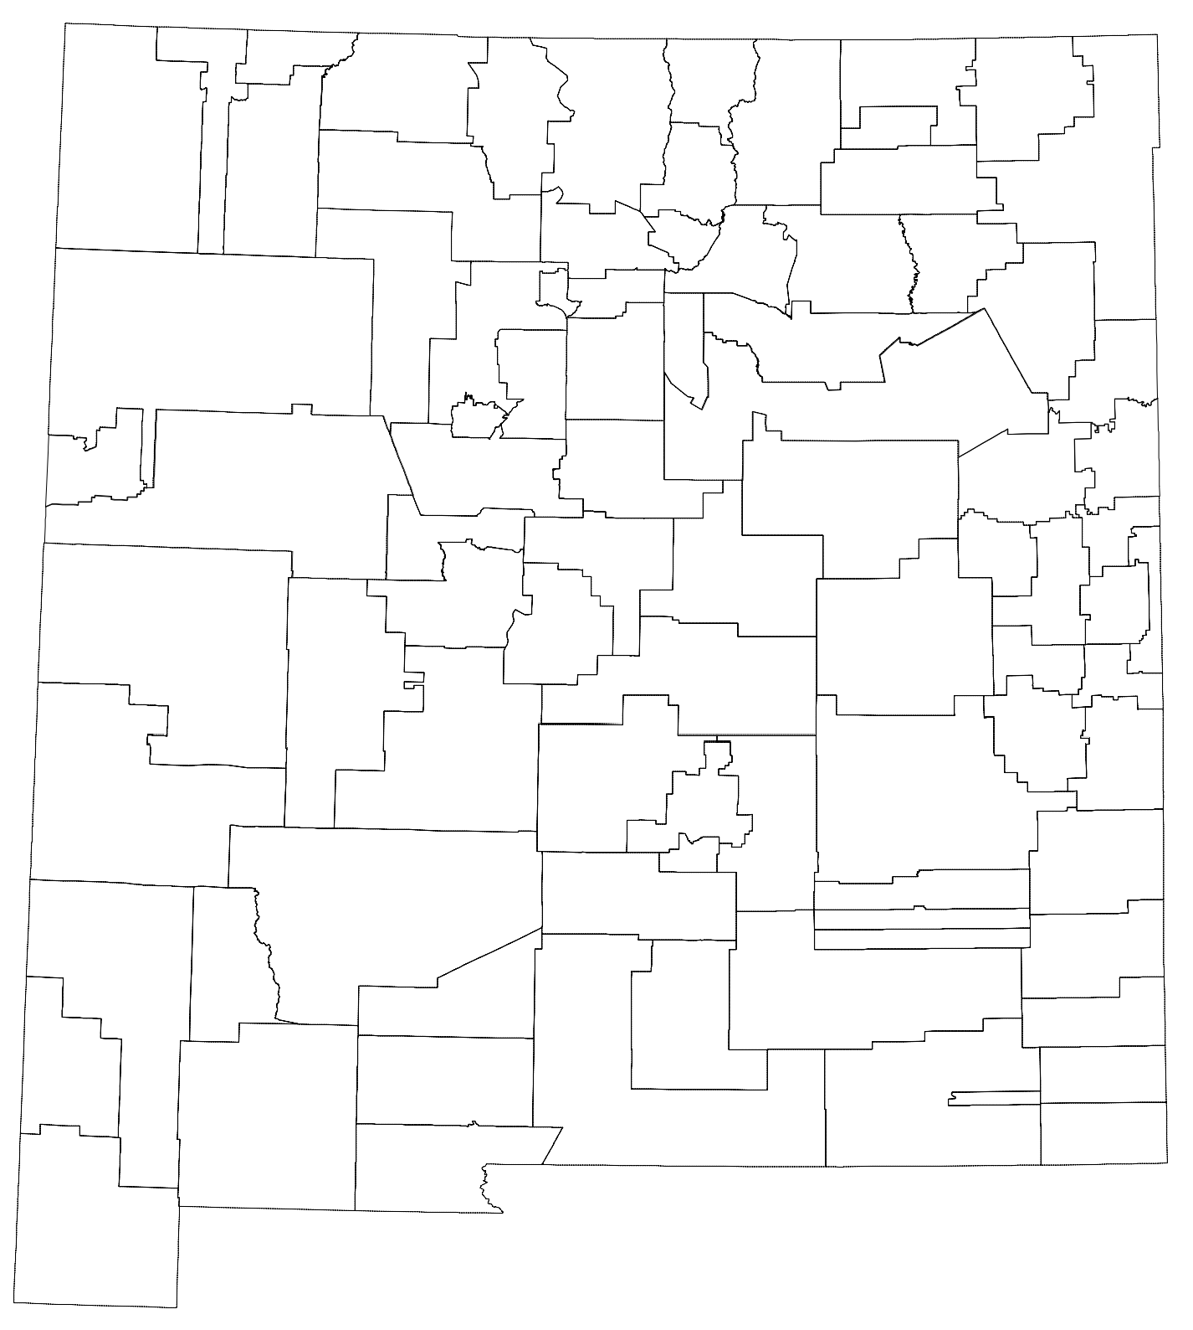
Last mile Participants
Phase 1
1 | Dorn Charter School | 7 | Mountain Mahogany Cmty School | 13 | Truth or Consequences Data Center
2 | Mark Armijo Academy | 8 | Monte Del Sol Charter School | 14 | Hatch Valley Schools
3 | APS Data Center | 9 | Santa Fe Public Schools | 15 | Santa Rosa Schools
4 | Coral Cmty Charter School | 10 | Farmington District Office | 16 | Gadsden Administrative Center
5 | Albuquerque School of Excellence | 11 | Las Vegas City Schools Data Center | 17 | Belen Schools
6 | 21st Century Public Academy | 12 | Capitan Schools | 18 | Los Alamos Schools
Phase 2
1 | Albuquerque Sign Language Academy | 20 | Deming Data Center | 39 | Pojoaque Central Office
2 | Amy Biehl High School | 21 | Dexter School District | 40 | Quemado Independent School District
3 | Cien Aguas International School | 22 | Diné College Tribal Library | 41 | Questa High School
4 | Cottonwood Classical Prep School | 23 | DEAP | 42 | Raices del Saber Xinachtli School
5 | Gordon Bernell Charter School | 24 | Glenwood Library | 43 | Reserve Independent Schools
6 | Health Leadership High School | 25 | Hagerman Municipal School District | 44 | Reserve Library
7 | La Academia De Esperanza | 26 | Hobbs Municipal School District | 45 | Rio Rancho Public Schools
8 | Los Puentes Charter School | 27 | Hondo Valley School District | 46 | Roy Municipal Schools
9 | New Mexico International School | 28 | Jemez Mountain (NCC) | 47 | Ruidoso High School
10 | Technology Leadership High School | 29 | Jemez Valley (NCC) | 48 | Silver Consolidated Schools
11 | Alamogordo Public School District | 30 | Las Cruces Public Schools | 49 | Socorro Data Center
12 | Carlsbad Municipal Schools | 31 | Lordsburg Municipal Schools | 50 | Taos Academy Charter School
13 | Carrizozo Municipal Schools | 32 | Magdalena Elementary School | 51 | Tierra Encantada Charter School
14 | Cimarron Mun School District | 33 | Magdalena Library | 52 | Tularosa Municipal School District
15 | Cloudcroft Mun School District | 34 | MESD Network Operations | 53 | Vista Grande High School
16 | Clovis Municipal Schools | 35 | Middle College High School | 54 | Wagon Mound Public Schools
17 | Cobre Consolidated School District | 36 | Mosaic Academy | 55 | West Las Vegas School District
18 | Corona Public Schools | 37 | New America School - Las Cruces | 56 | Zuni Public School District
19 | Deming Cesar Chavez High School | 38 | New Mexico School For The Deaf

Slide 13
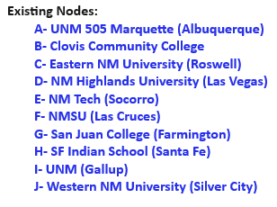
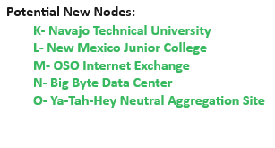
SEN Nodes

Slide 14
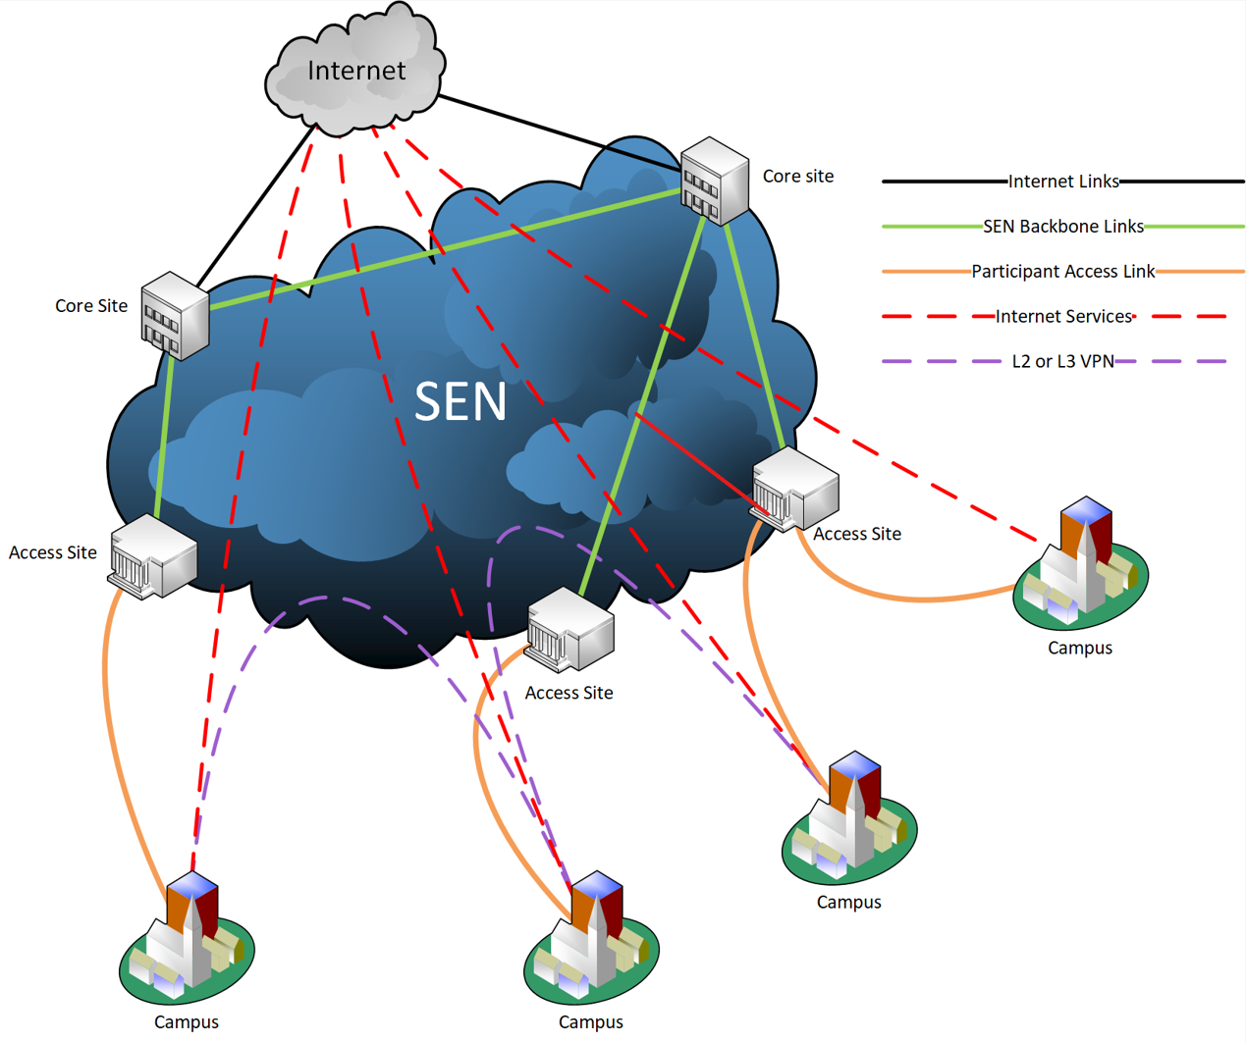
SEN

Slide 15
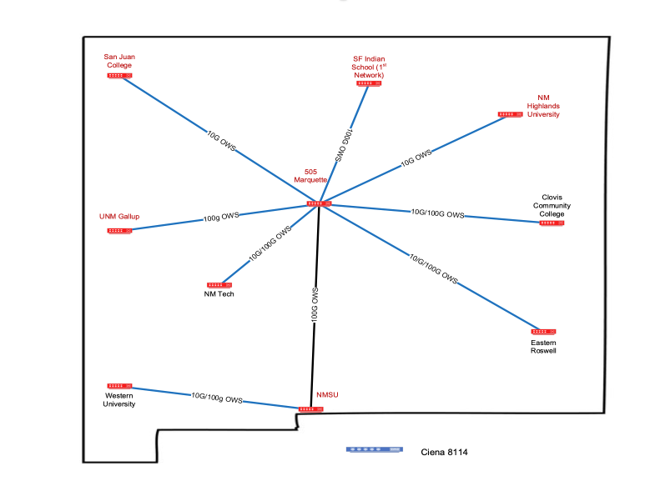
SEN
SEN 100G Wave (Lumen)
Future State-Coordinated XXXG Wave (YY Vendor) Alternative Path(s)

Slide 16
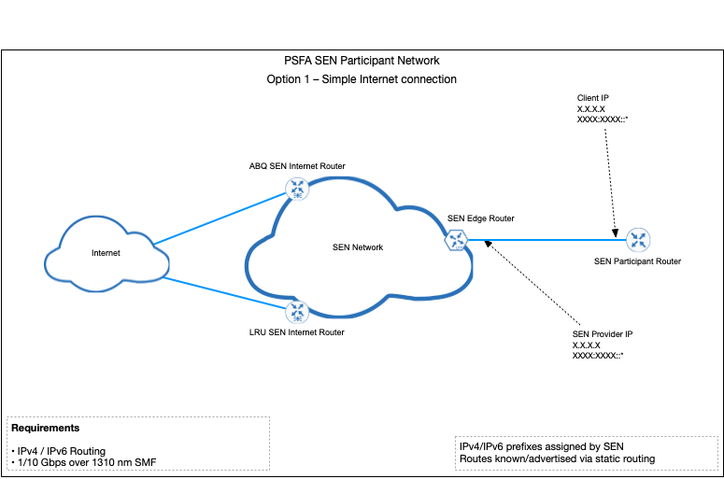
Connection Options

Slide 17
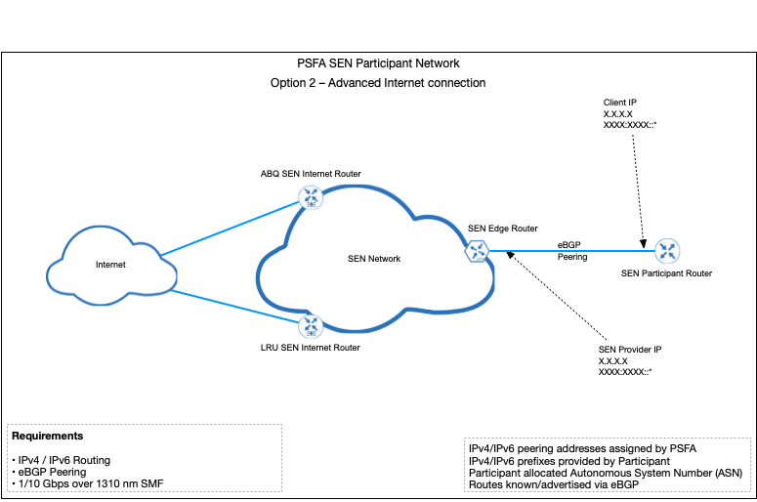
Connection Options

Slide 18
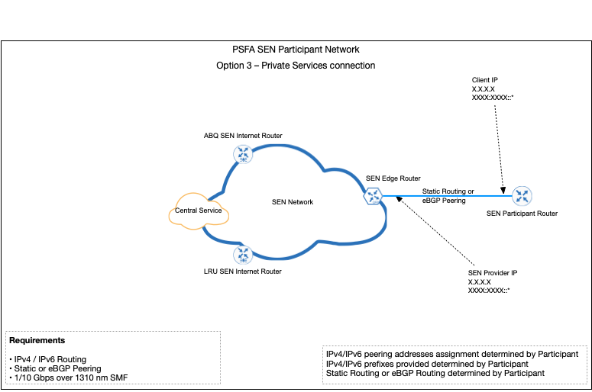
Connection Options

Slide 19
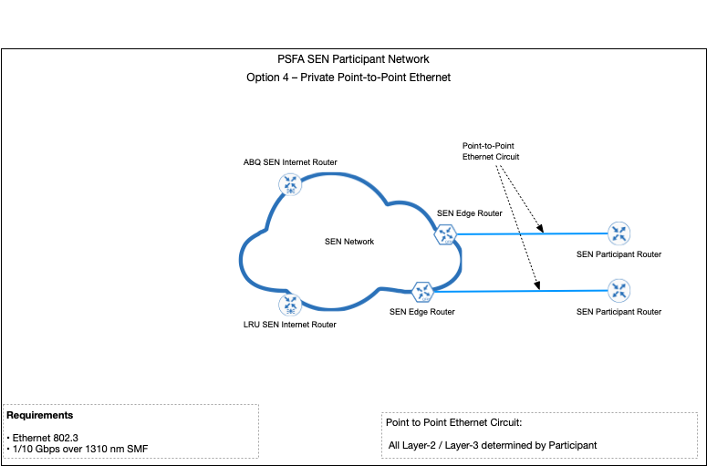
Connection Options

Slide 20
SEN Timeline
Internet circuits turnup Albuquerque (Zayo) & Las Cruces (Conterra): April
Backbone circuit turnup Albuquerque - Las Cruces: April
SEN Equipment Installation & Testing – Albuquerque & Las Cruces: April / May
Other Backbone circuits: May / June / As needed
SEN Equipment Installation: May / June
March / April / May:
Schedule individual meetings with all Phase1 participants
Assign PM / Single point of contact
Fill out survey / configuration sheet
Develop switchover plan
Memorandum Of Agreement
June / July: Schedule switchover
Availability
Special events
July 1, 2024 SEN Operational

Slide 21
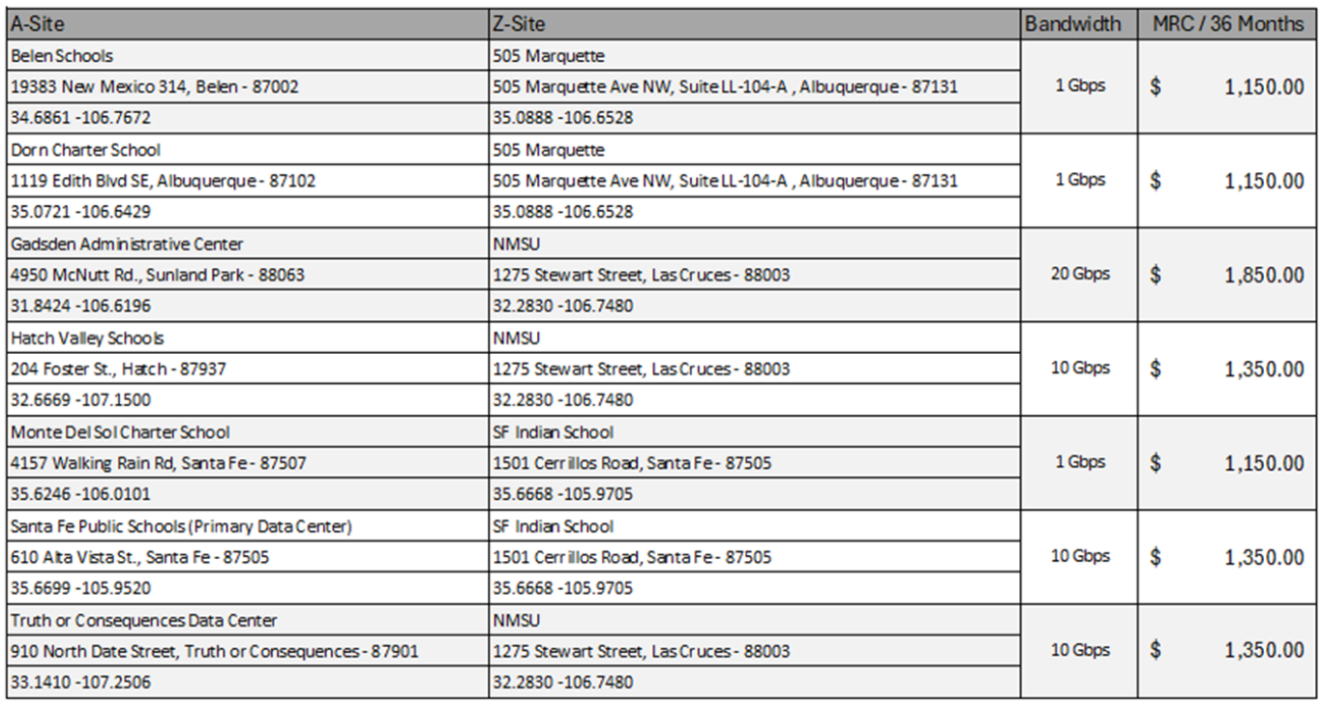
SEN Phase1 Participants

Slide 22
SEN Services (Networking / Security):
Internet (IPv6 First / IPv4), BGP Peering, Central Service, Private Point To Point
DDoS Protection, IDPS, NOC / SOC, Helpdesk: 833-999-4SEN
Near Future: Internet2, content filtering, managed firewall, secure DNS, Disaster Recovery…?

Slide 23
Questions?

Slide 24
Thanks for your support!

