Slide 1
Tesuque Broadband Bootcamp
Christopher Mitchell
Director, Community Broadband Networks
Institute for Local Self-Reliance
June 28, 2023
@CommunityNets
CommunityNets.org

Slide 2
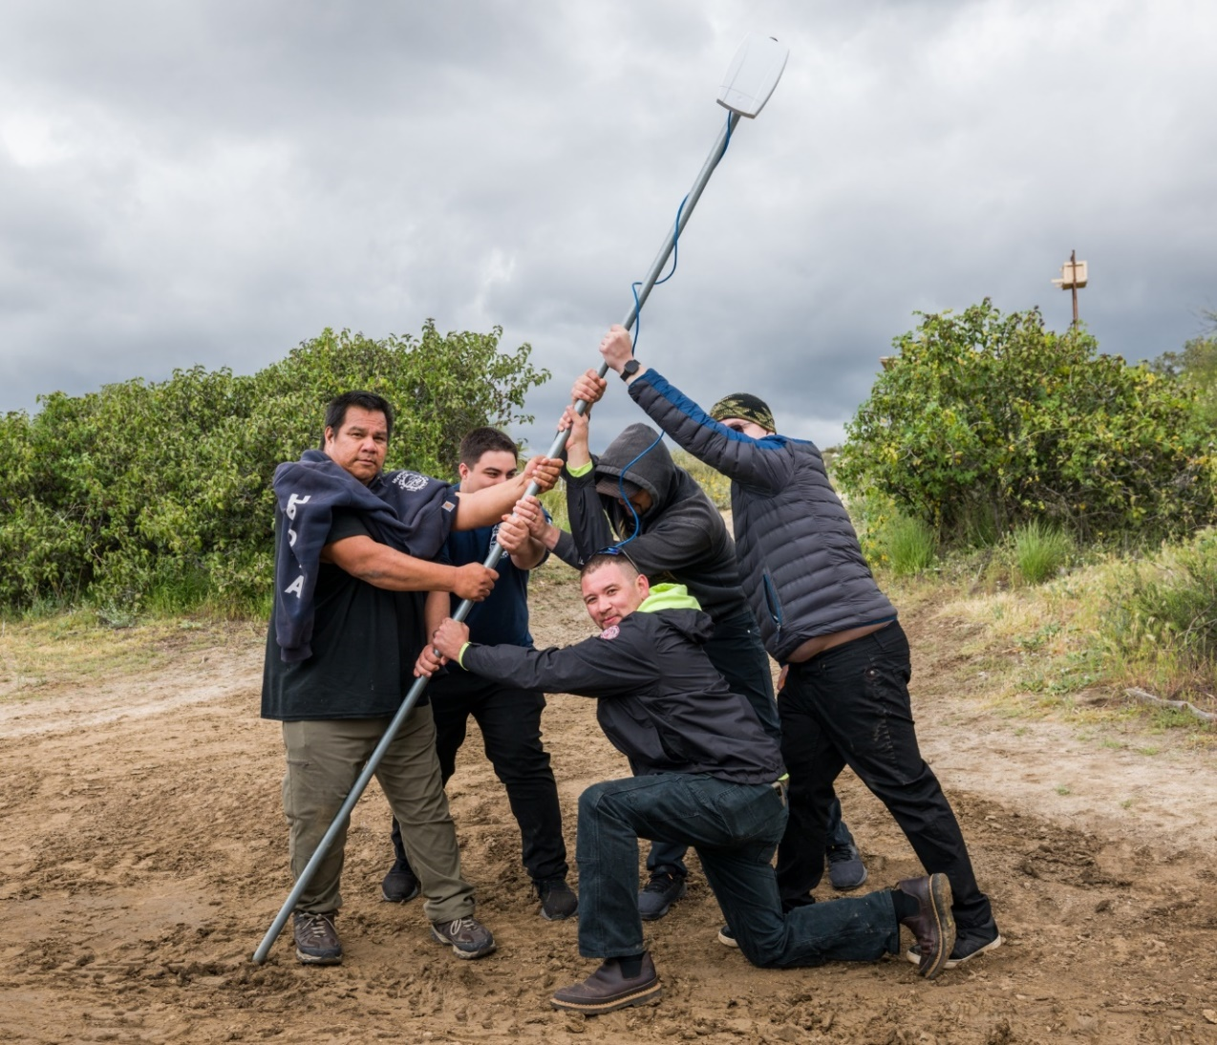
What are we doing here?
Build Confidence
Demystify Technology
Build Community
Be Aggressively Informal
Broadband Bootcamp Overview
Introductions!

Slide 3
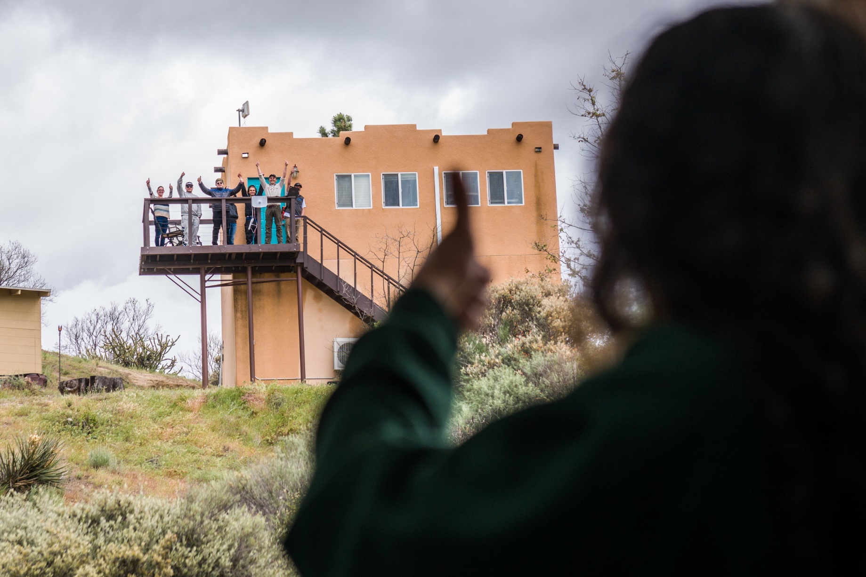
TribalBroadbandBootcamp.com

Slide 4
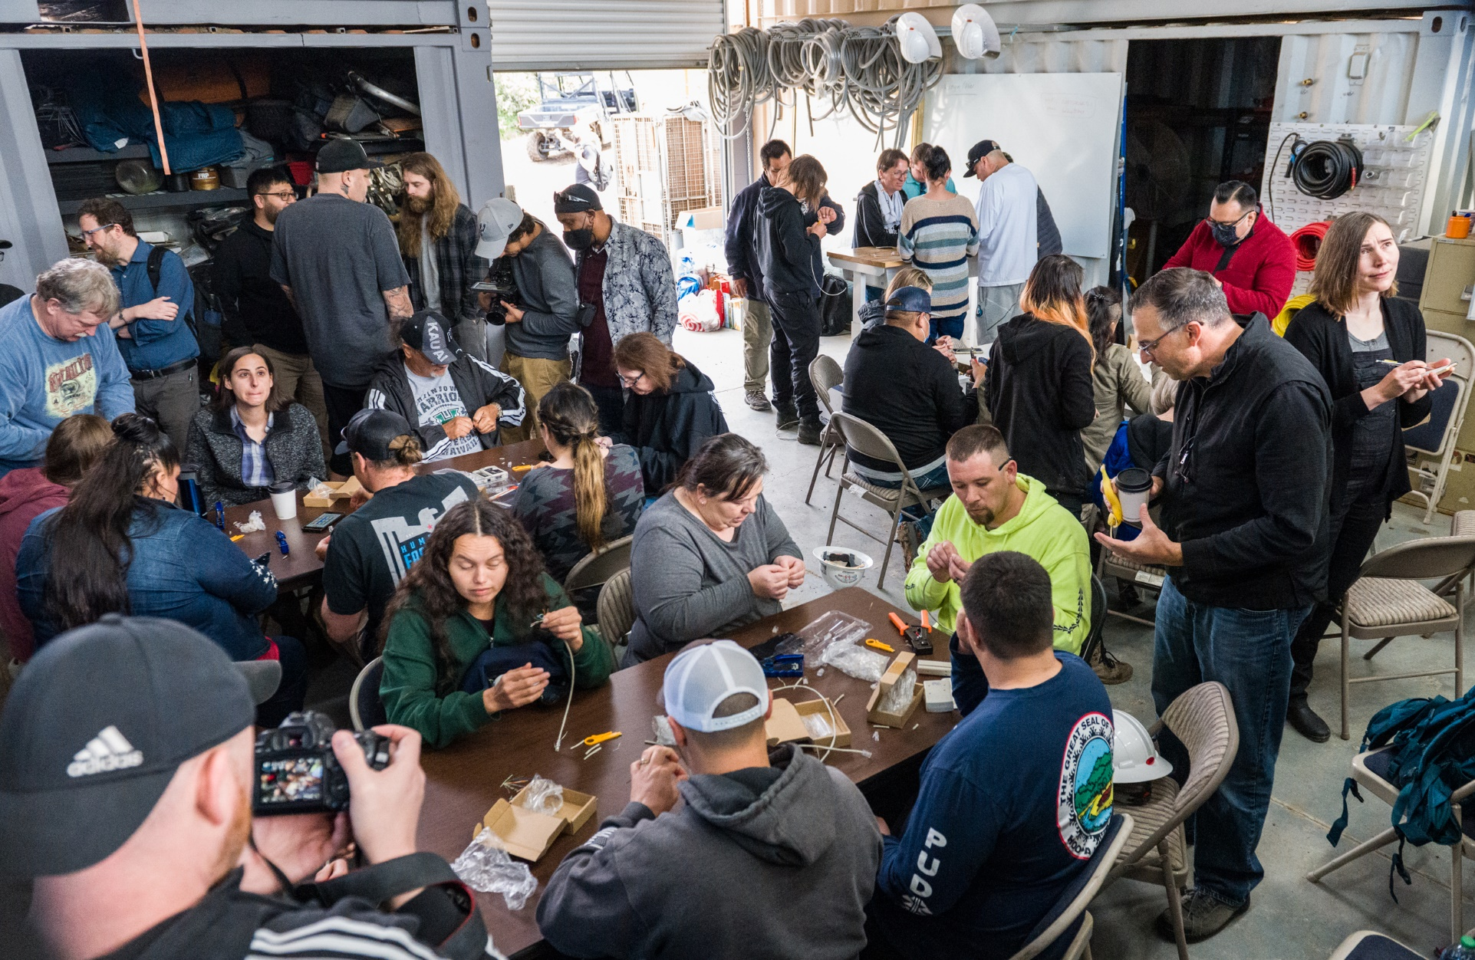
TribalBroadbandBootcamp.com

Slide 5
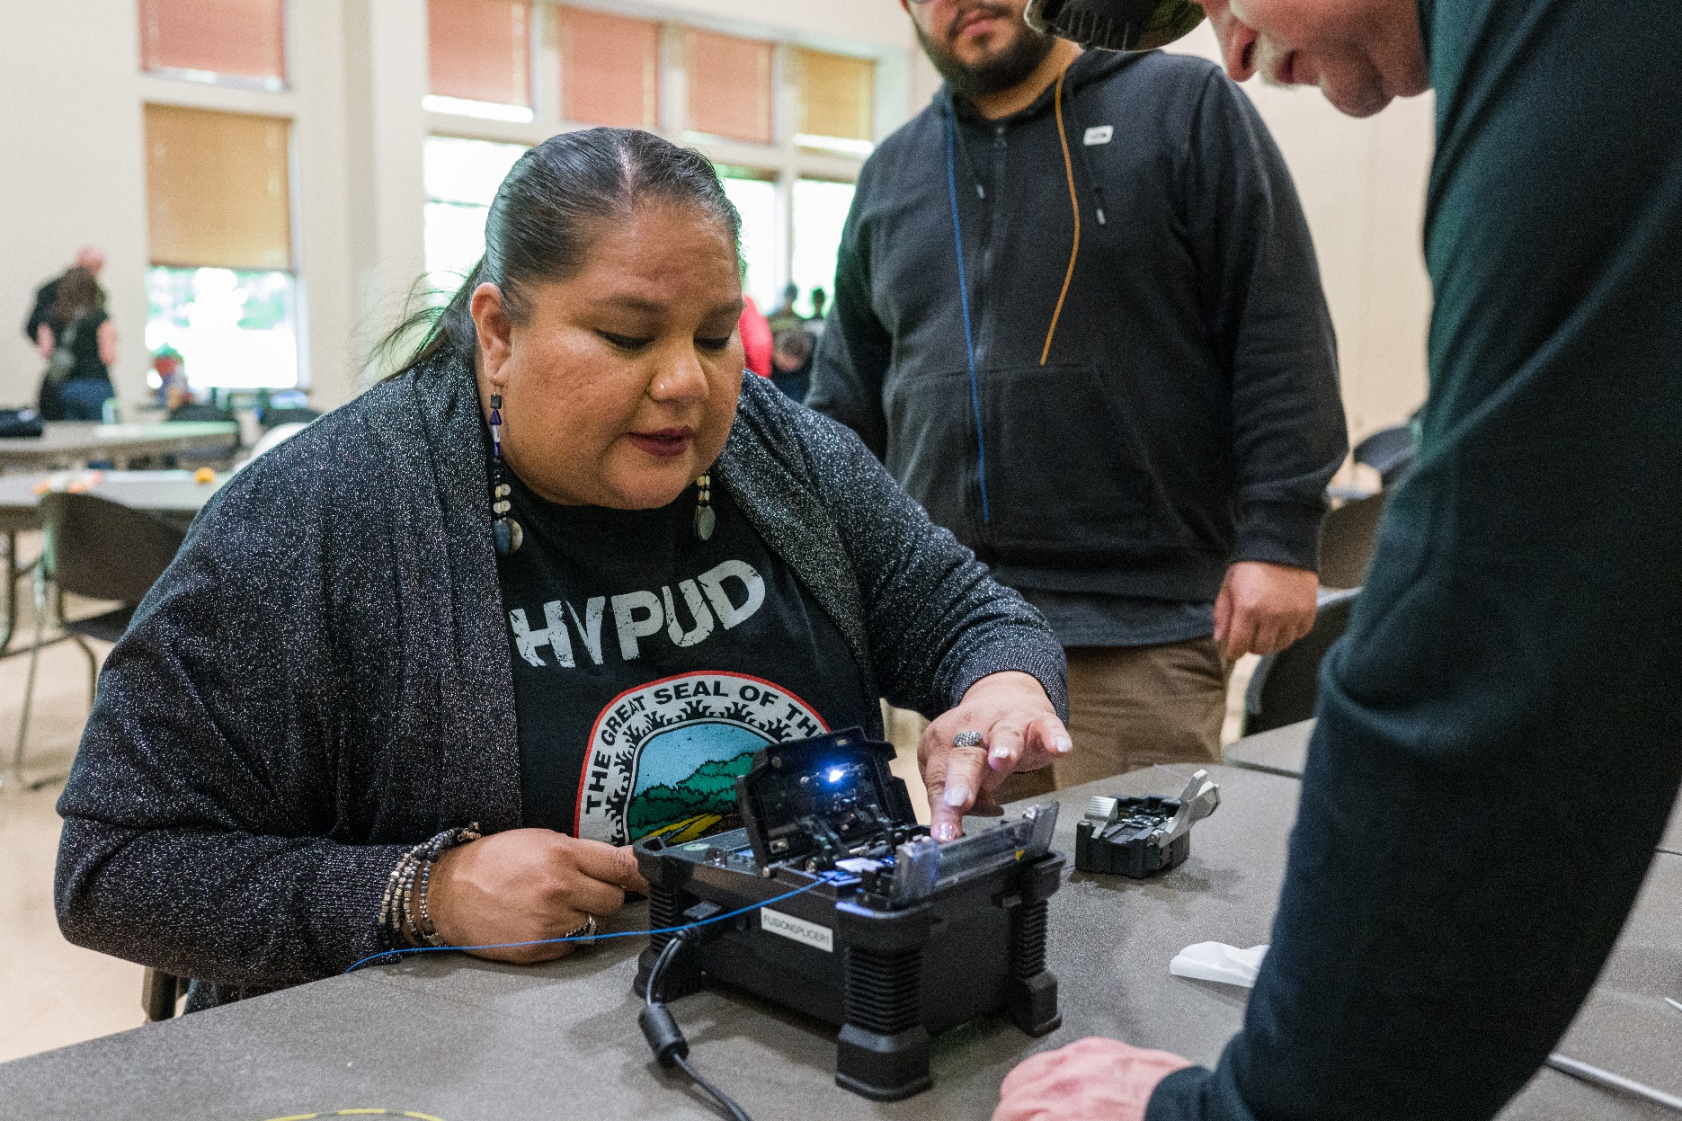
TribalBroadbandBootcamp.com

Slide 6
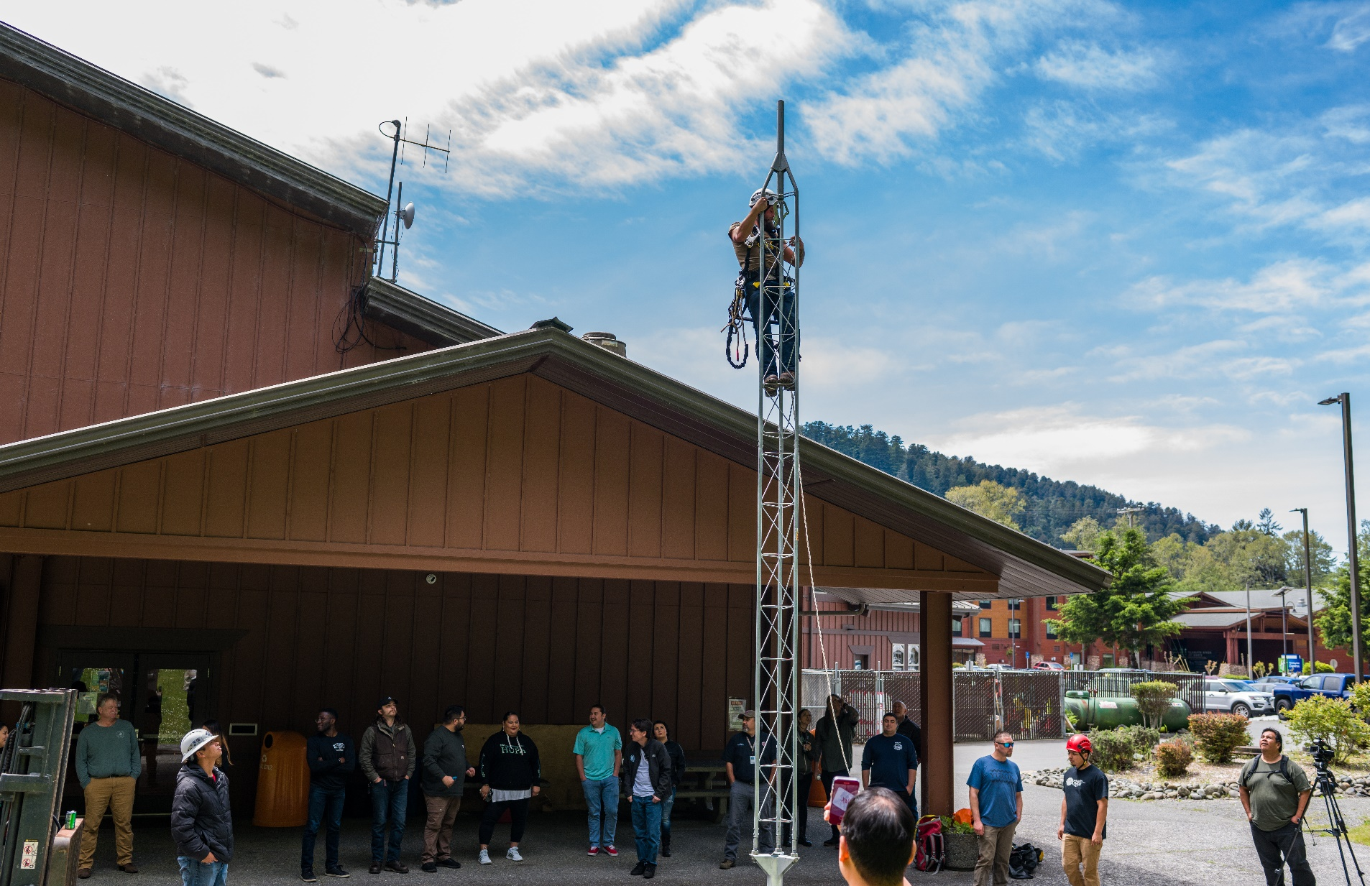

Slide 7
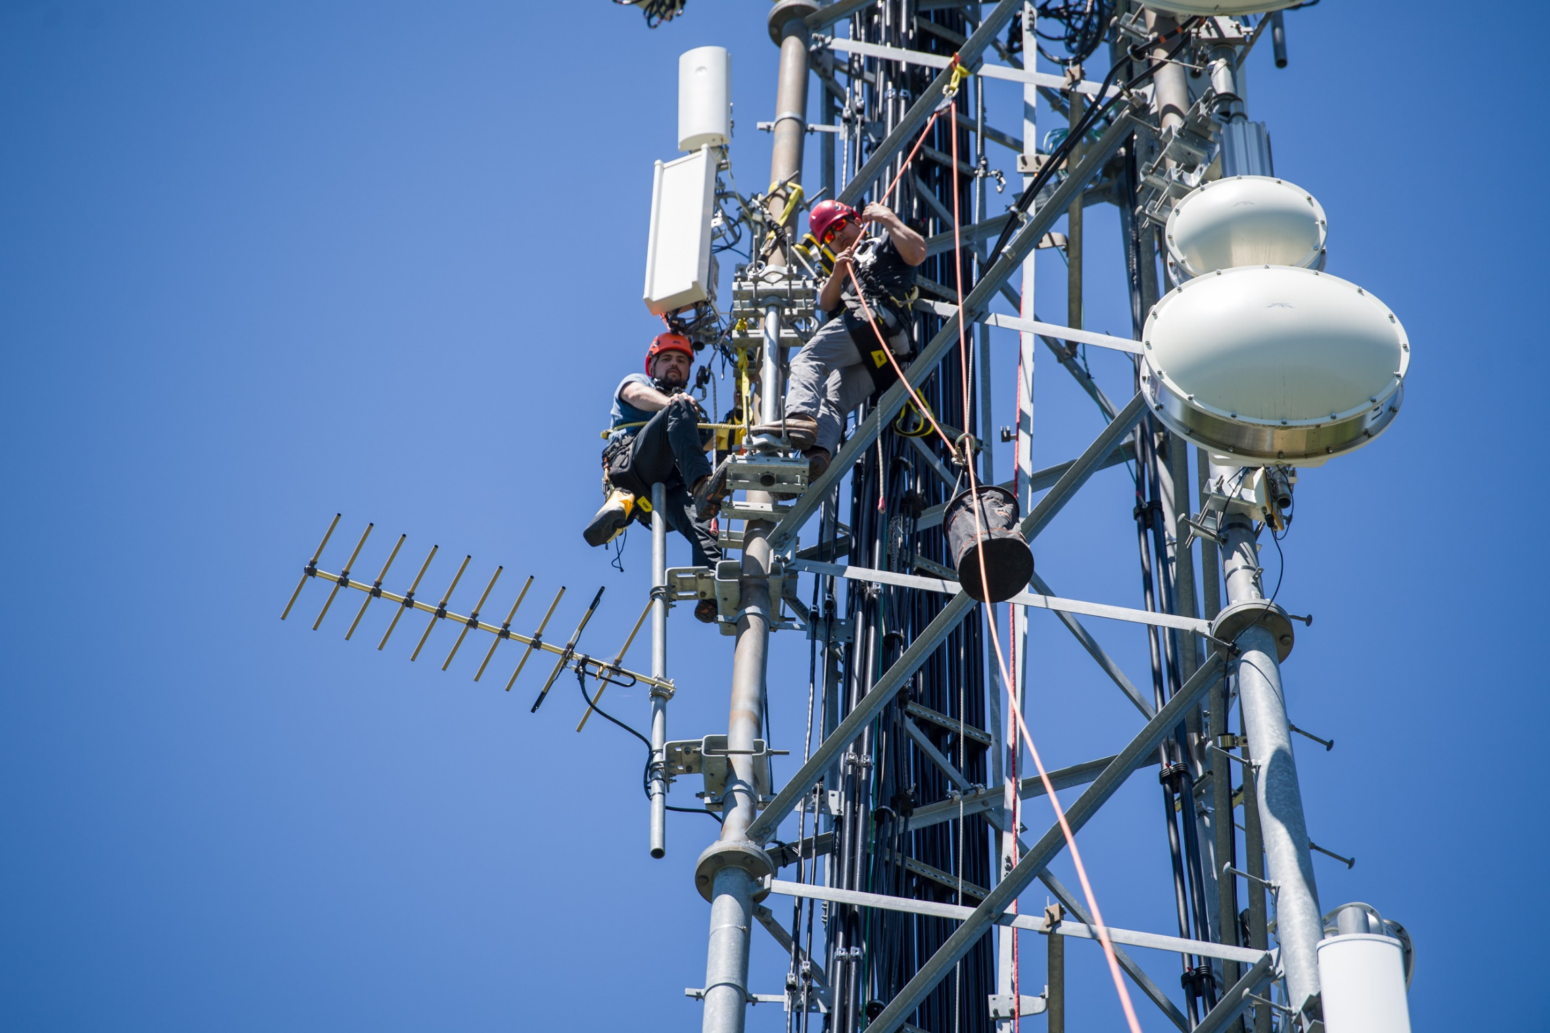
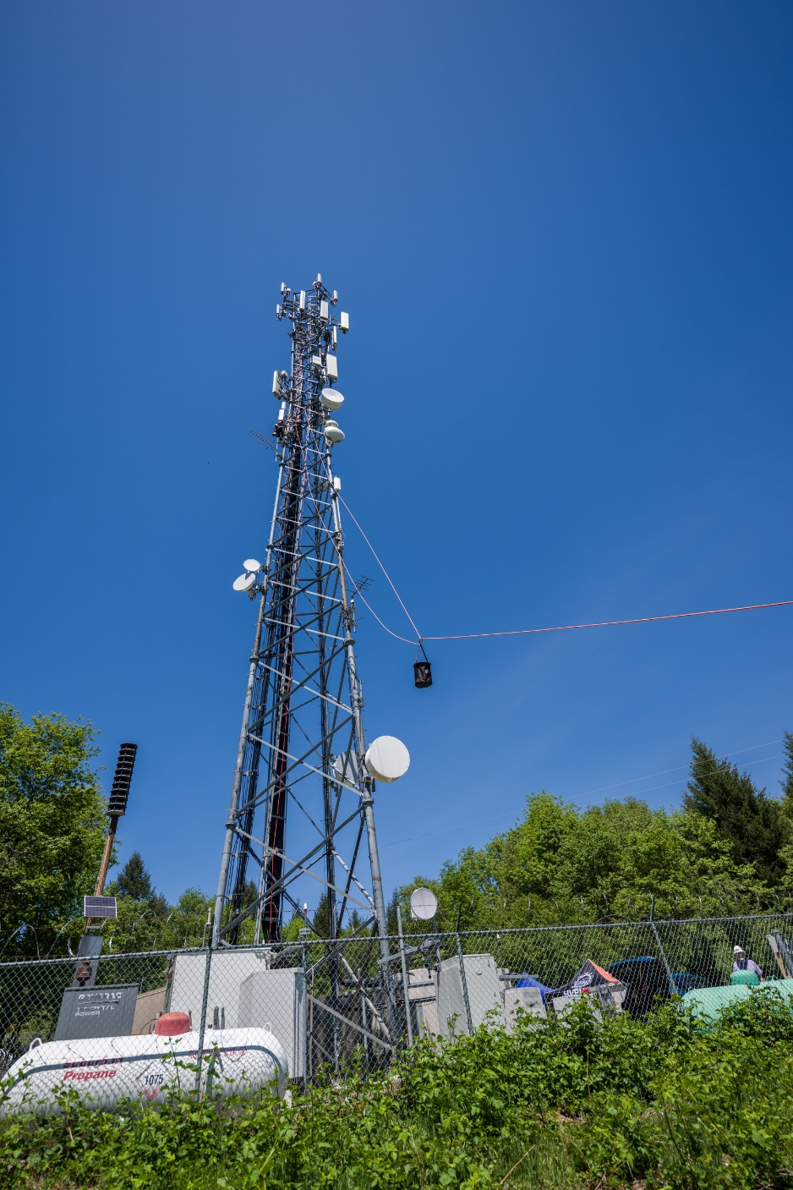

Slide 8
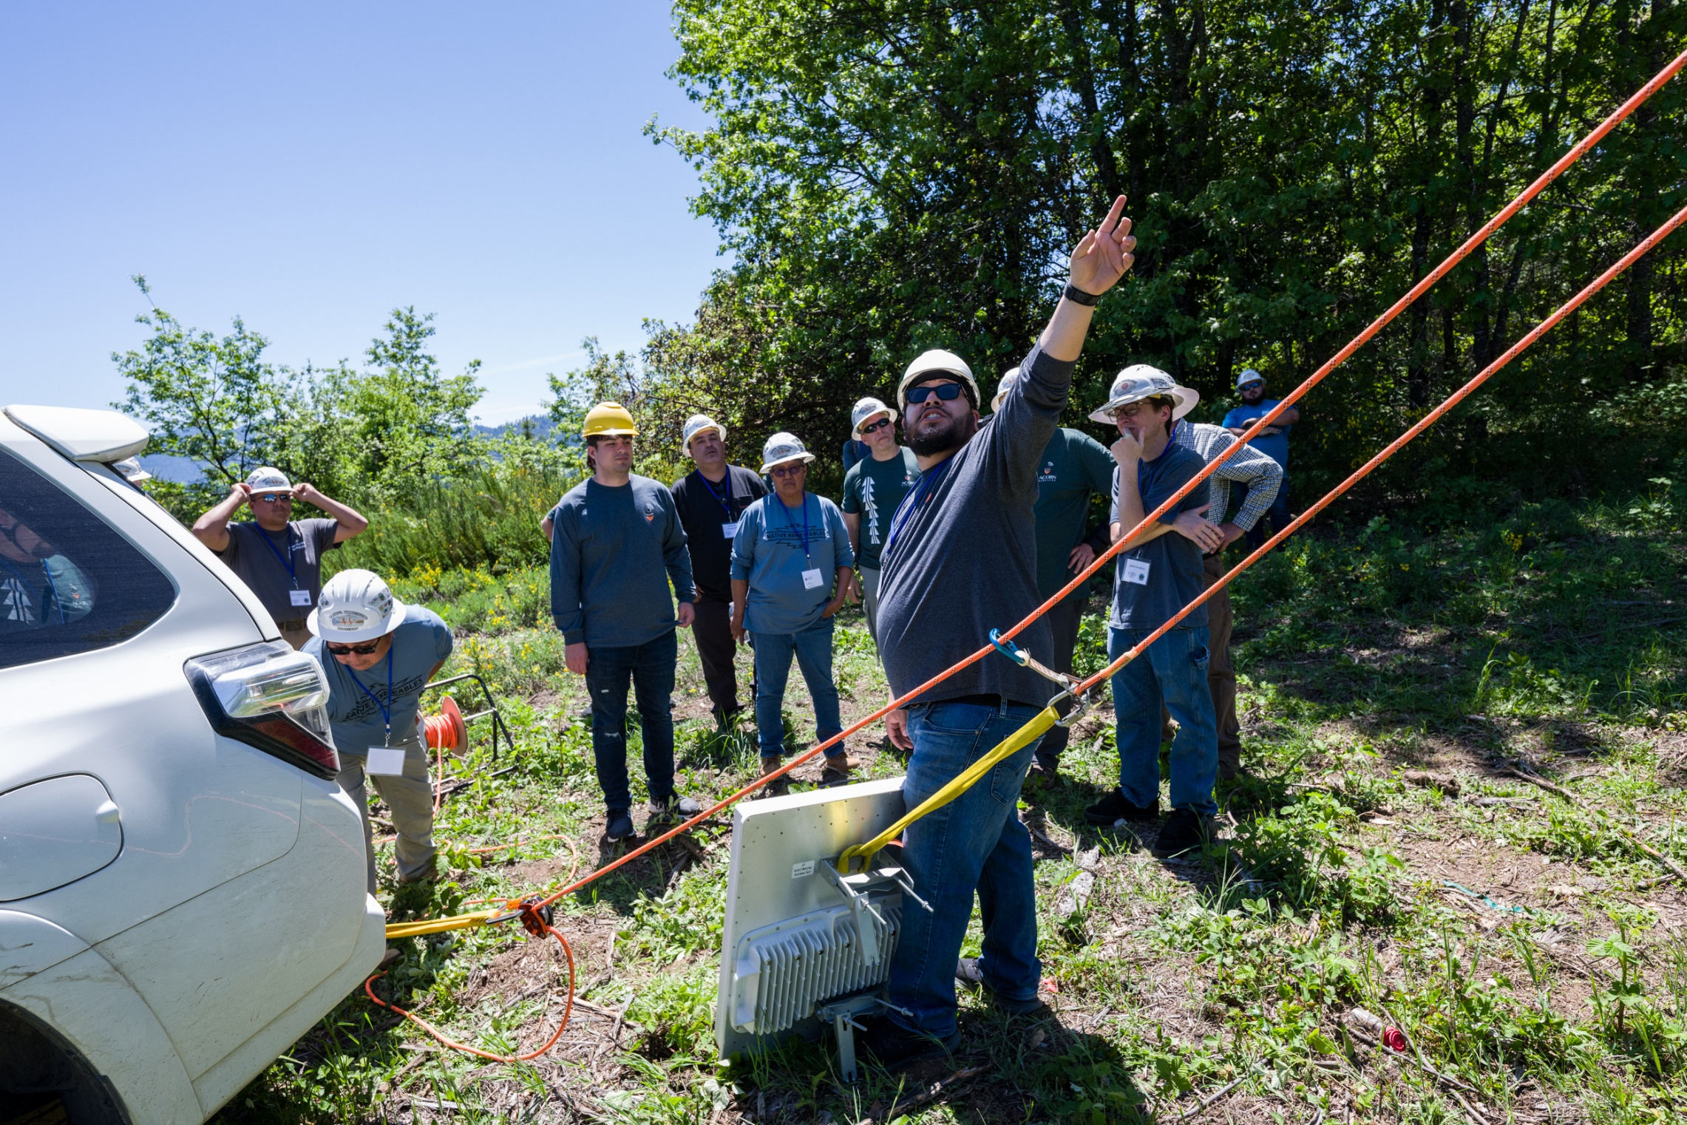
TribalBroadbandBootcamp.com

Slide 9
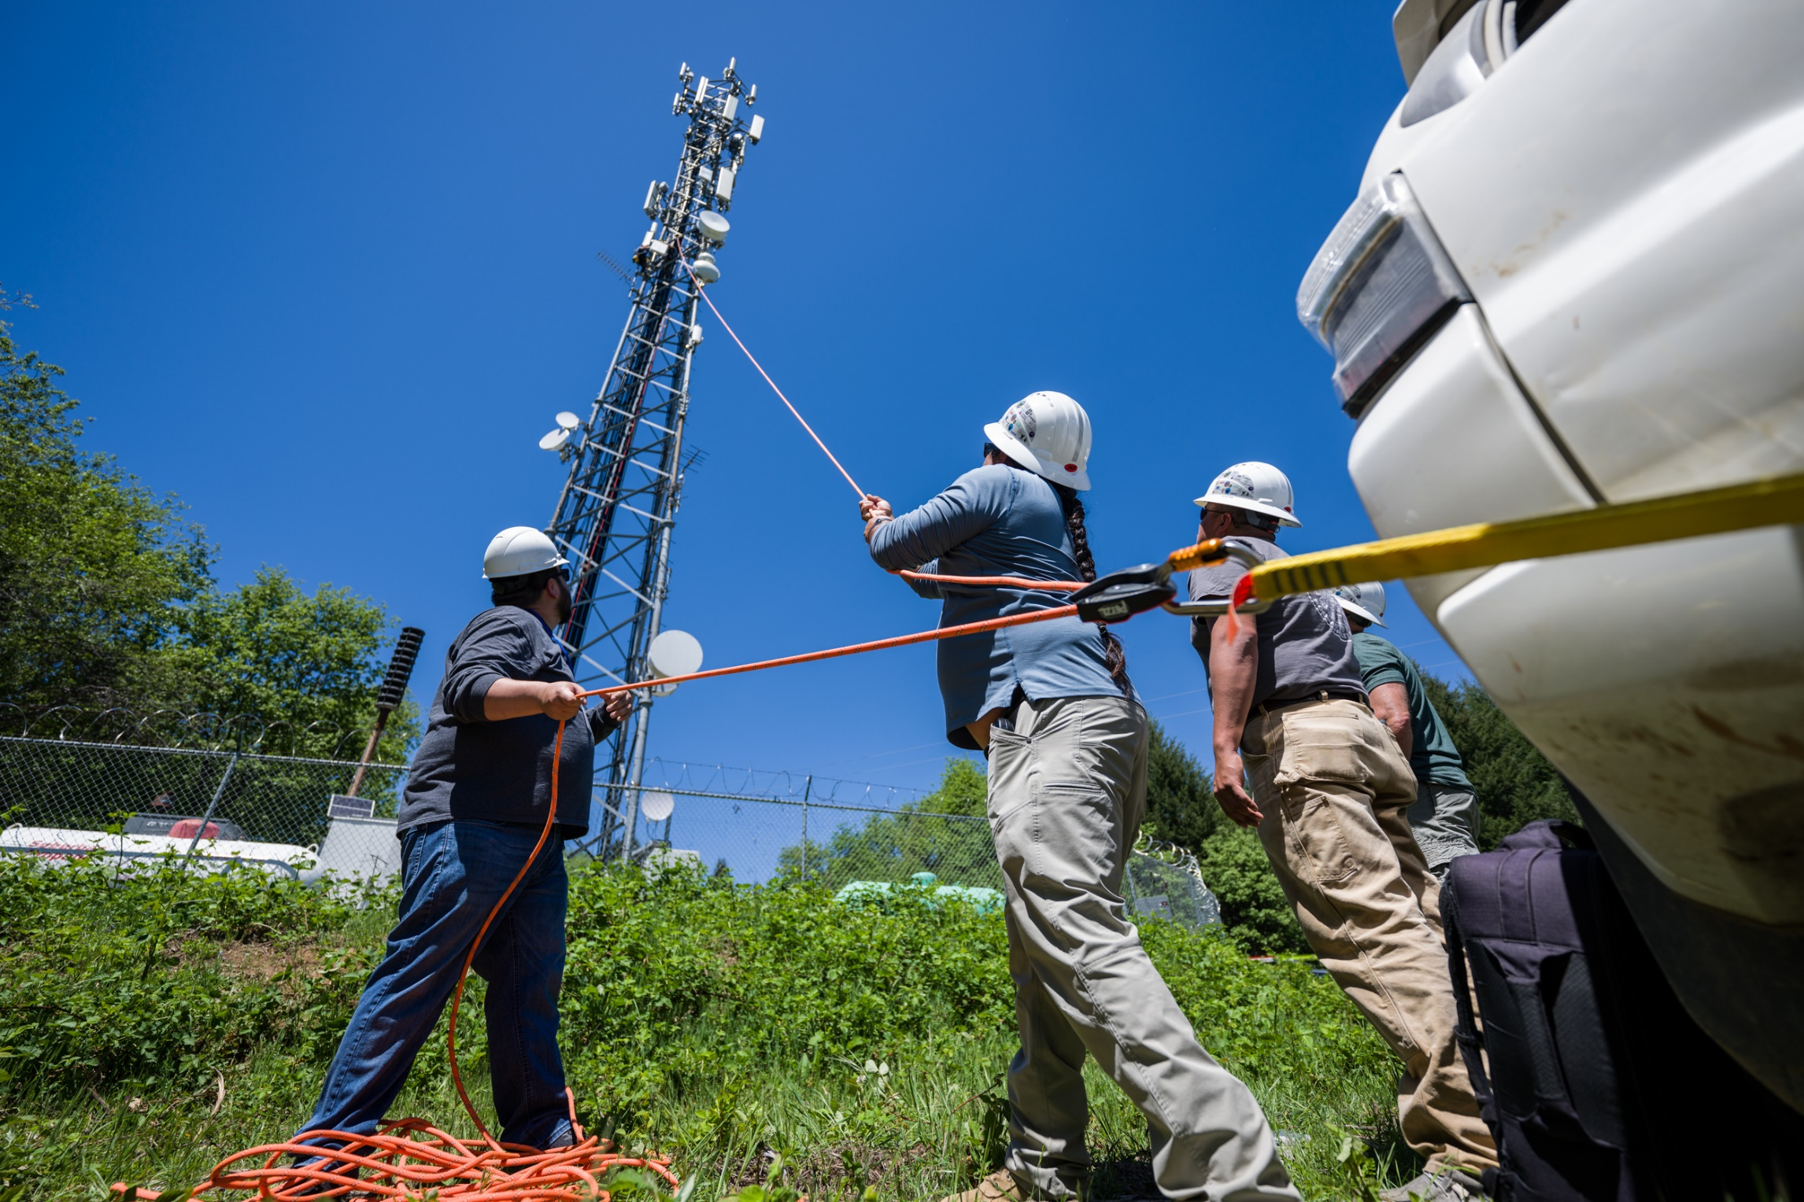

Slide 10
Tribal Broadband Bootcamp Video – Gila River
Next Tribal Broadband Bootcamp event, Akwesasne – Mohawk Networks on July 31-Aug 2 Fiber, Wireless, Digital Equity, Network Ops Center – Sign up – TribalBroadbandBootcamp.com

Slide 11
National Tribal Telecommunications Association

Slide 12
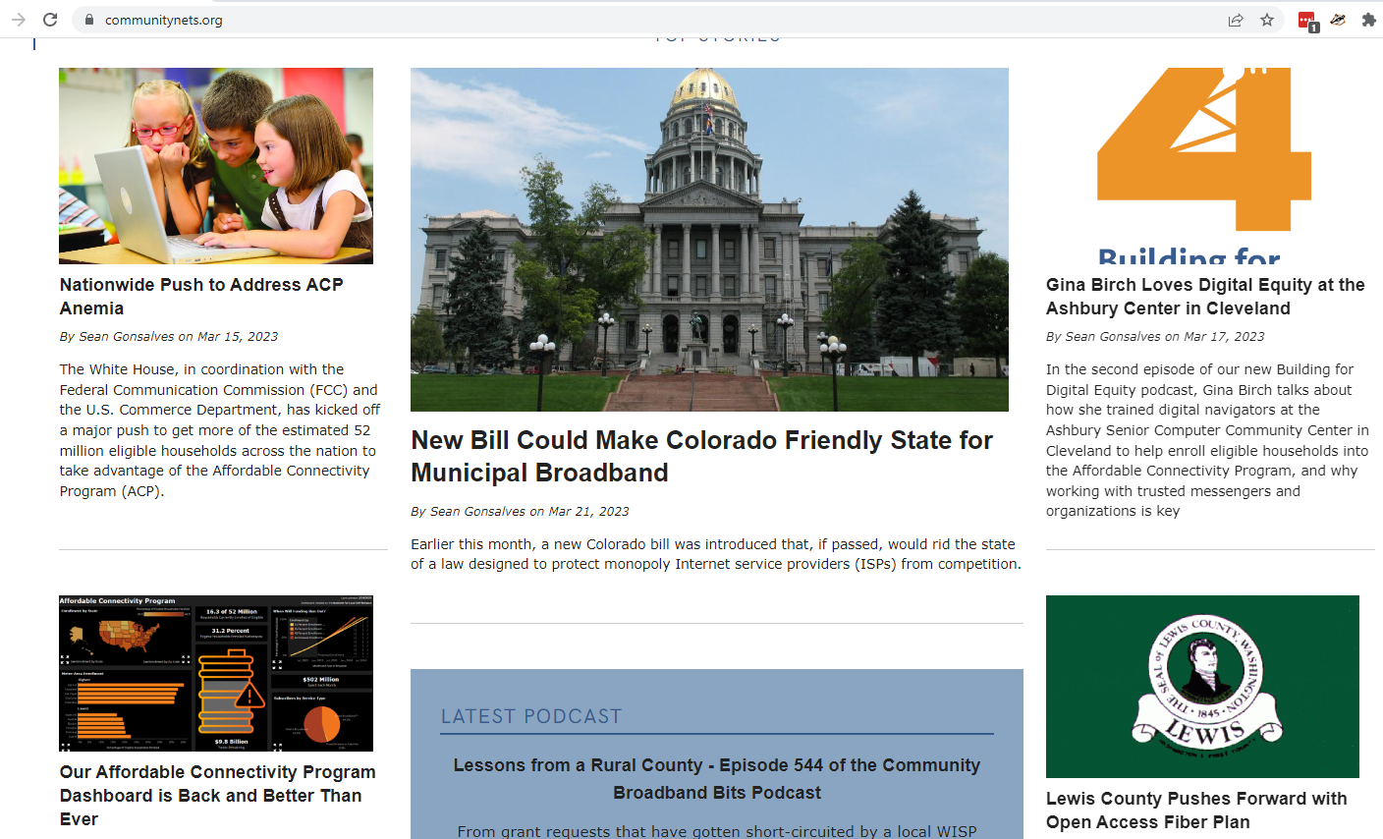
CommunityNets.org

Slide 13
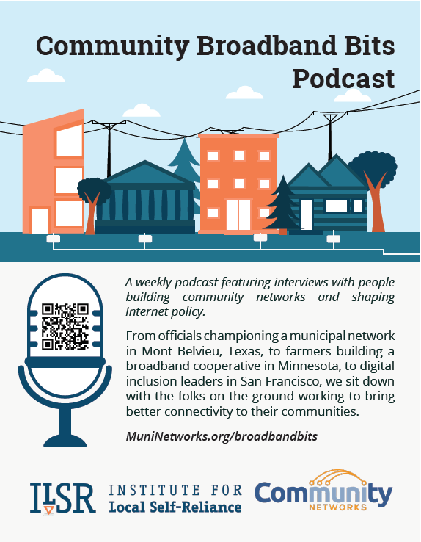
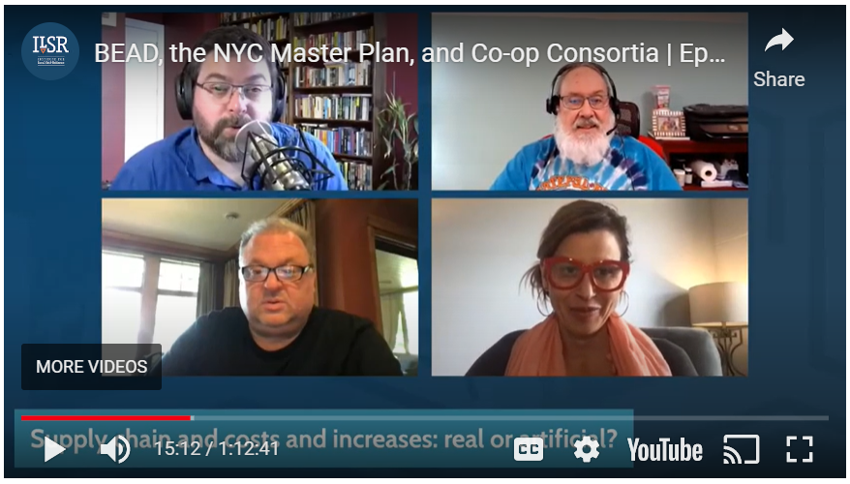
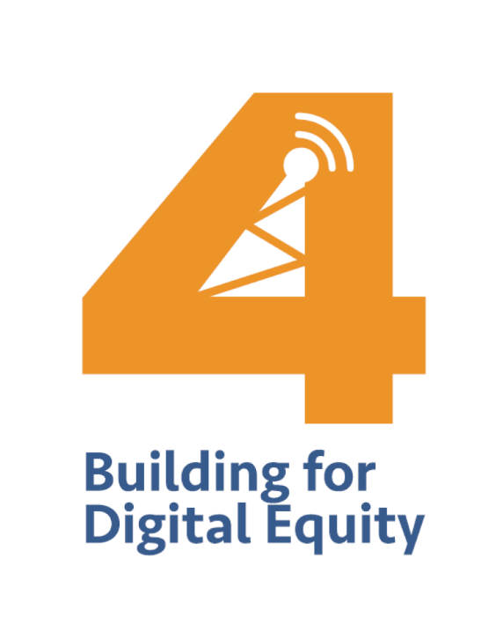
ConnectThisShow.com
BuildingforDigitalEquity.com

Slide 14
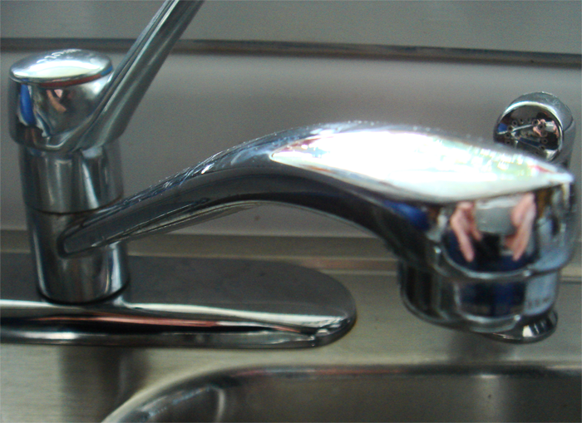
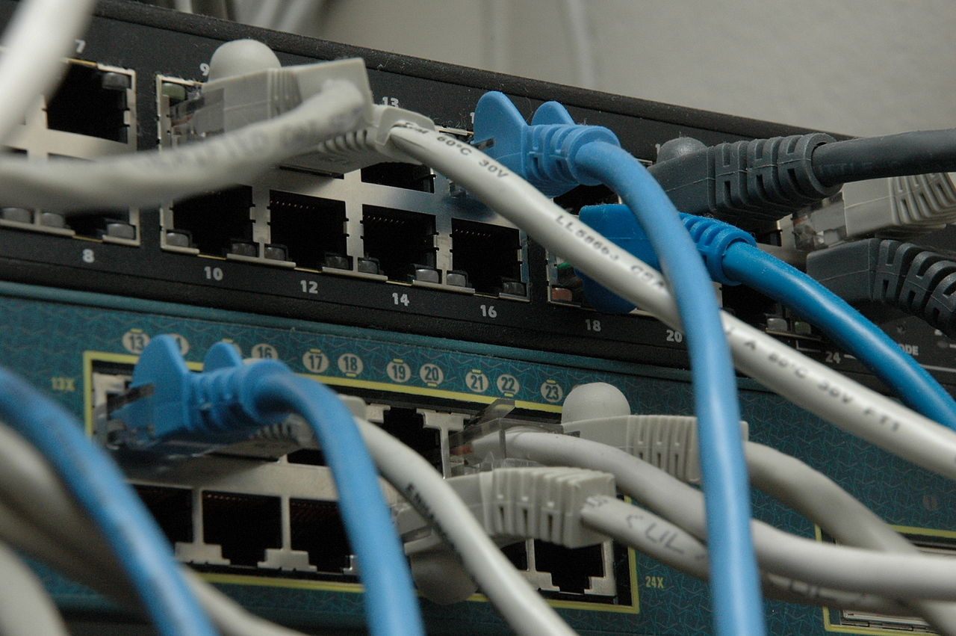
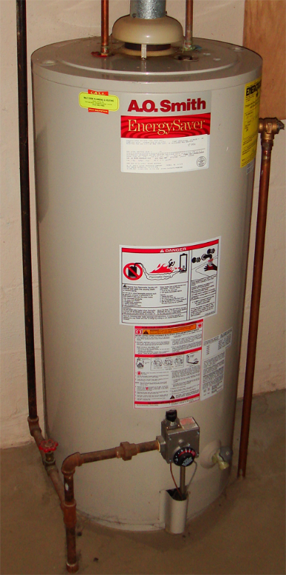
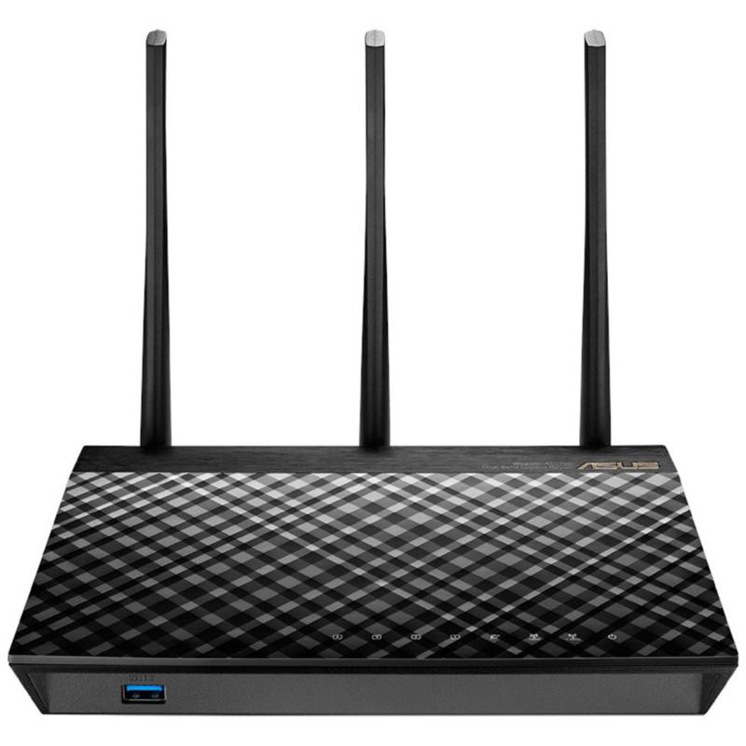
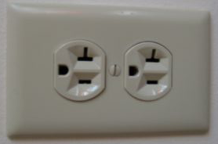
https://commons.wikimedia.org/wiki/File:Network_switches.jpg

Slide 15
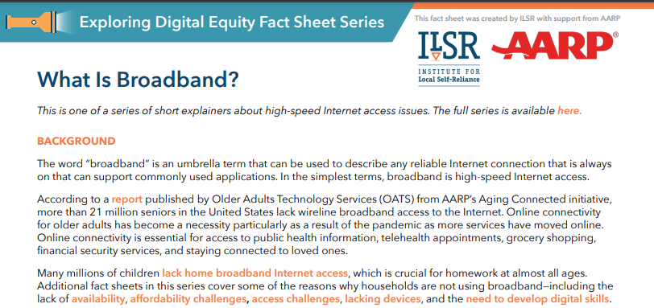
Fact Sheets!
ILSR.org/exploring-digital-equity-fact-sheets/

Slide 16
What is Broadband?

Slide 17
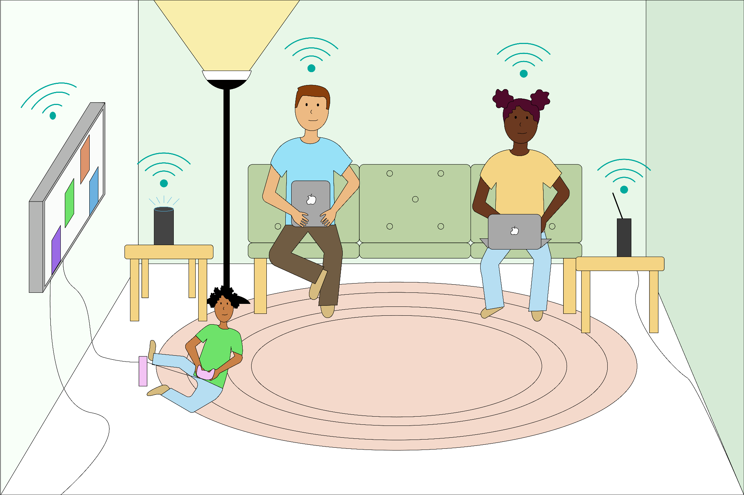

Slide 18
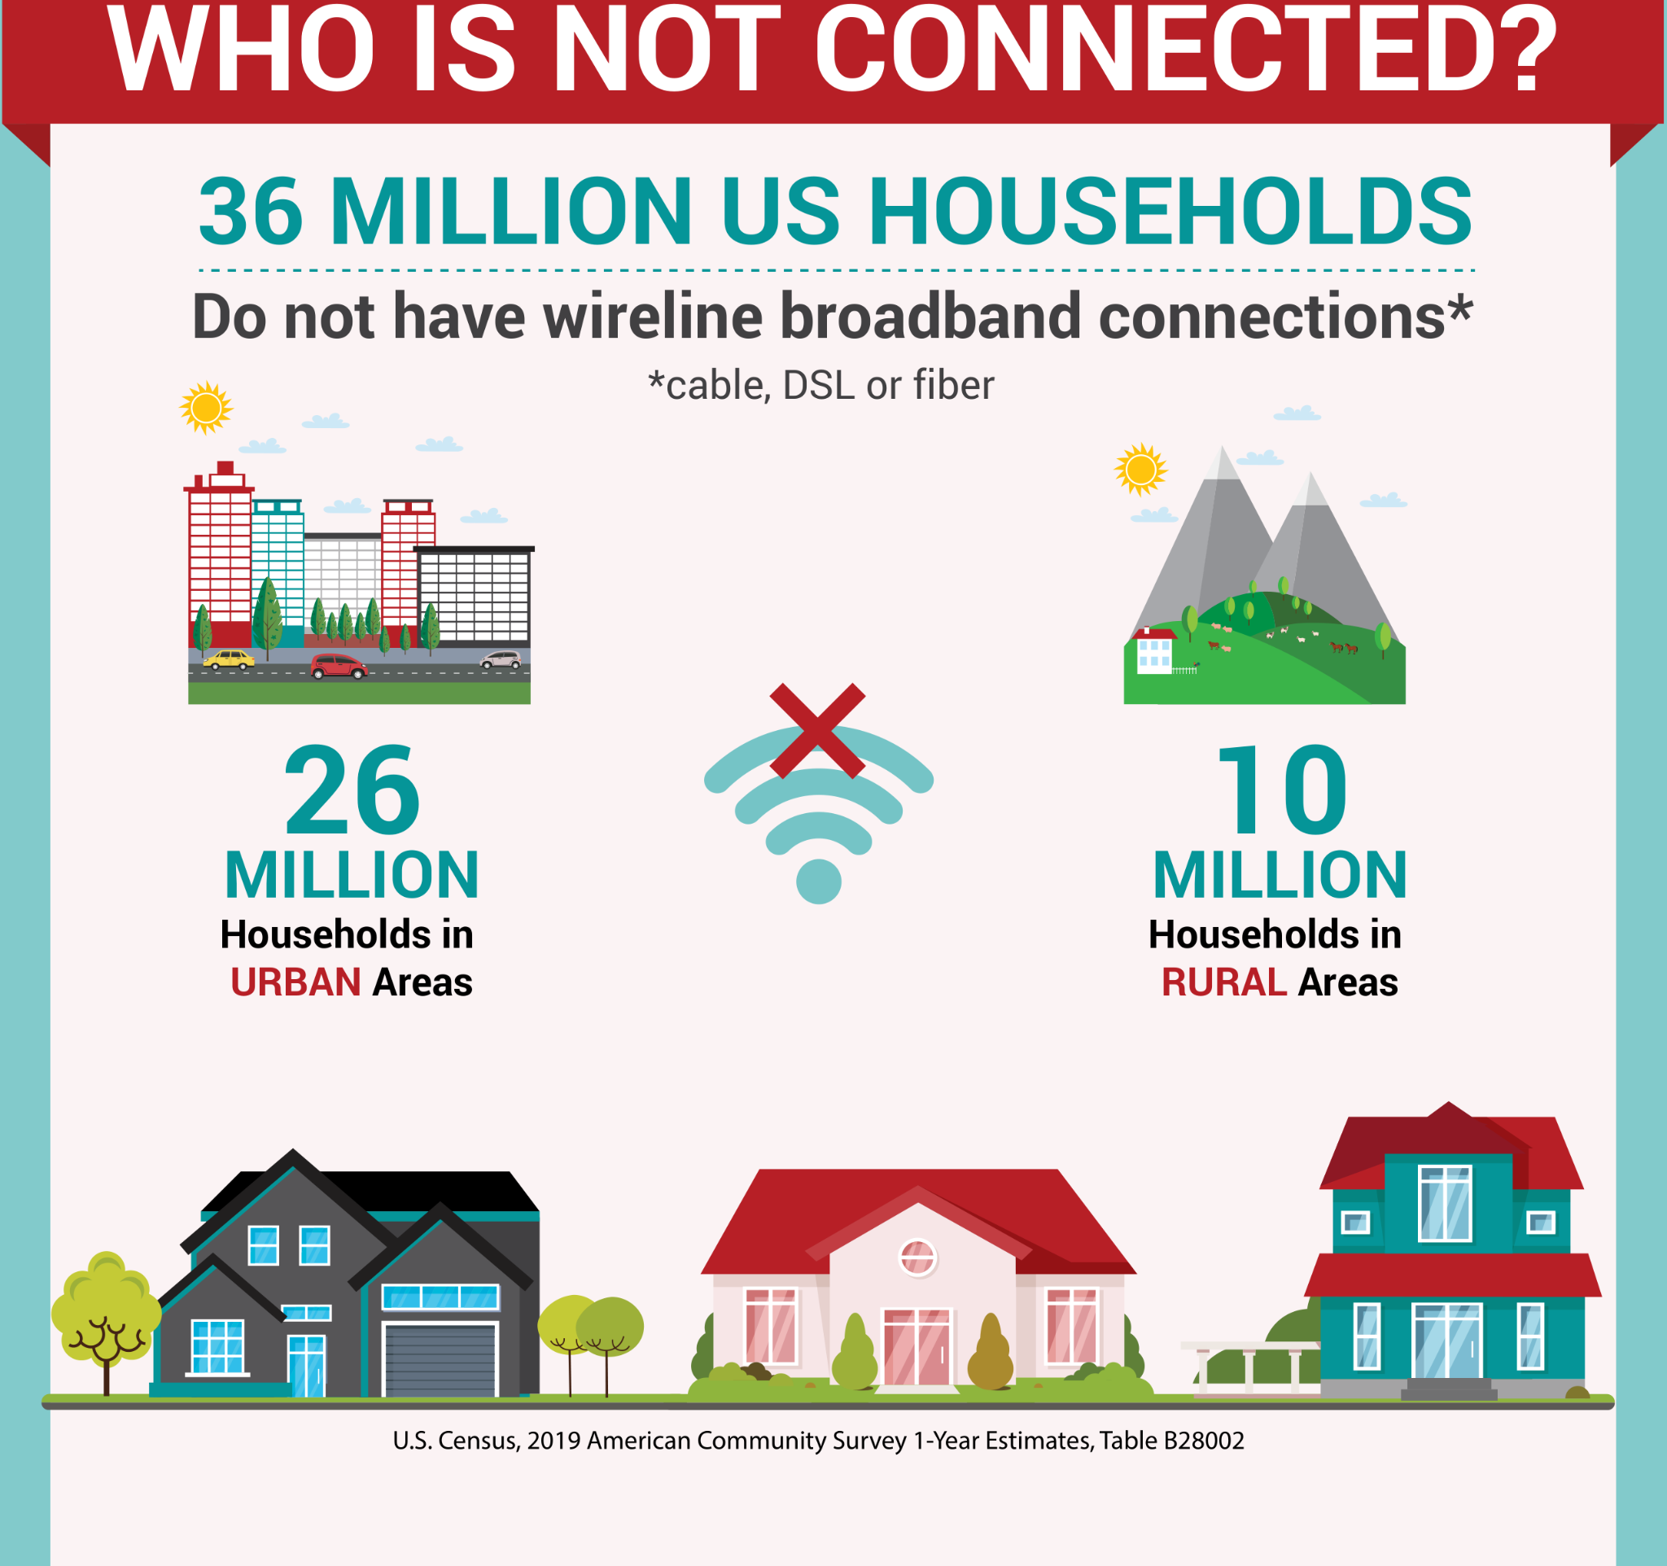
Access or Availability?

Slide 19
Power and Poverty, not Technology
Half of humanity is connected to high-quality Internet access.
The other half will not be connected by the business models that connected the first half.
ConnectHumanity.fund/report-financing-ccps/

Slide 20
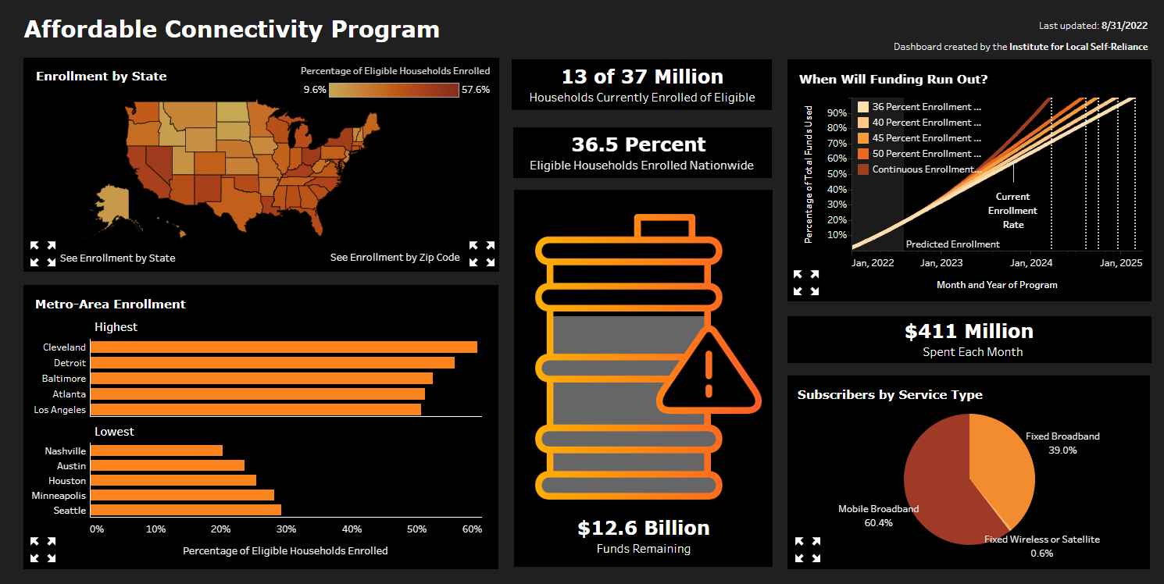
ACPDashboard.com
Soon: ACPDashboard.com

Slide 21
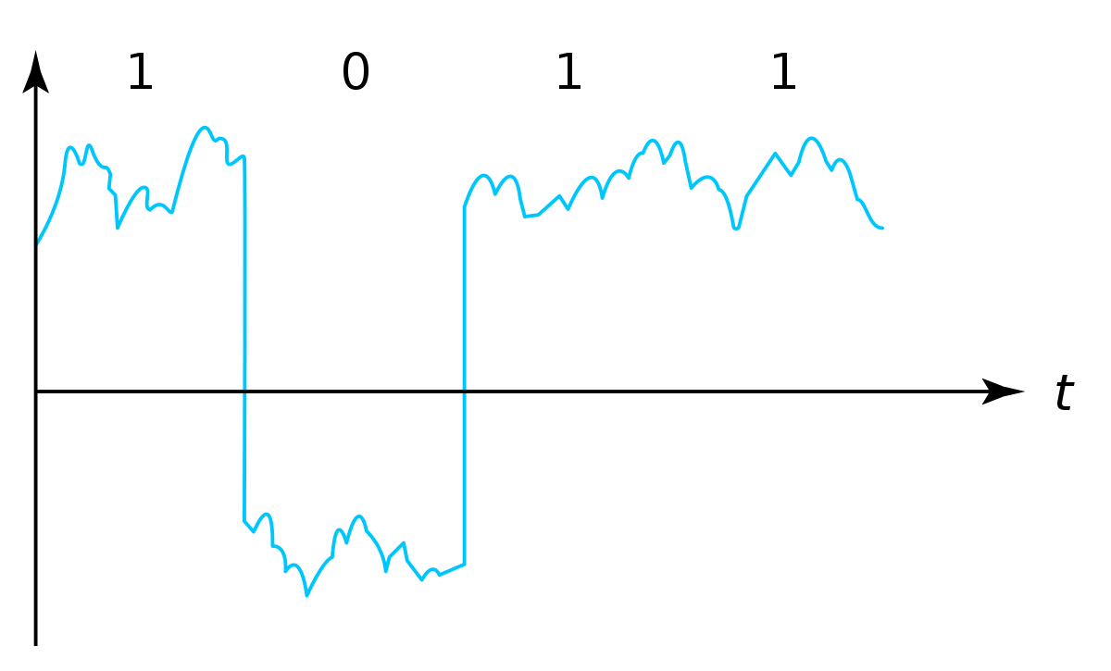
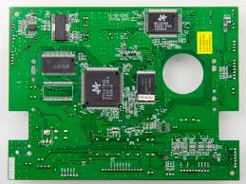
Bits
The base unit of information (data)
A bit represents a choice between 2 states or categories
1 and 0
light and dark
Yes and No
Using an electrical signal (on and off)
Ideal signal
Real signal
Attribution: Black Brilliance Research Project, Local Connectivity Lab, UW ICTD Lab (2022) Adult Digital Stewards Course Materials, Seattle Community Network - https://creativecommons.org/licenses/by-sa/4.0/
Notes:
Physically, in computers we’re using electrical signals to physically hold and manipulate this data

Slide 22
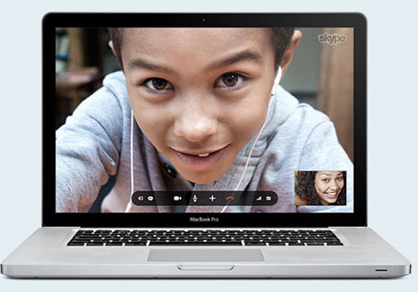
Bits: How computers send data
Network
Human- readable data
Bits
Physical signals
Physical signals
Bits
Human- readable data
Attribution: Black Brilliance Research Project, Local Connectivity Lab, UW ICTD Lab (2022) Adult Digital Stewards Course Materials, Seattle Community Network - https://creativecommons.org/licenses/by-sa/4.0/
Notes:
When we send data we have to do the same thing, in both directions- first break down the data into bits and translate it into physical signals, then send those signals physically over some kind of physical medium, whether it be light, electricity on a copper wire, radio waves in the air, etc. Then it gets received as a physical signal and translated back into the bits and then the human-readable format we like to see on our computer.

Slide 23
What is a “network”?
A network is a connection between devices that allows them to communicate and send information to each other.
Attribution: Black Brilliance Research Project, Local Connectivity Lab, UW ICTD Lab (2022) Adult Digital Stewards Course Materials, Seattle Community Network - https://creativecommons.org/licenses/by-sa/4.0/

Slide 24
What is a “network”?
A network can be very big or very small.
Attribution: Black Brilliance Research Project, Local Connectivity Lab, UW ICTD Lab (2022) Adult Digital Stewards Course Materials, Seattle Community Network - https://creativecommons.org/licenses/by-sa/4.0/

Slide 25
What is an “internetwork”?
Attribution: Black Brilliance Research Project, Local Connectivity Lab, UW ICTD Lab (2022) Adult Digital Stewards Course Materials, Seattle Community Network - https://creativecommons.org/licenses/by-sa/4.0/

Slide 26
What is an “internetwork”?
Janice
Jenny
Janice wants to talk to Jenny...
Attribution: Black Brilliance Research Project, Local Connectivity Lab, UW ICTD Lab (2022) Adult Digital Stewards Course Materials, Seattle Community Network - https://creativecommons.org/licenses/by-sa/4.0/

Slide 27
What is an “internetwork”?
Janice
Jenny
Janice can just connect her house to the internetwork so she can talk to Jenny!
Attribution: Black Brilliance Research Project, Local Connectivity Lab, UW ICTD Lab (2022) Adult Digital Stewards Course Materials, Seattle Community Network - https://creativecommons.org/licenses/by-sa/4.0/

Slide 28
Wired Technology – Quick History
DSL – 1-30 Mbps
Unreliable
Slow
Mostly Rural
Cable – 100-1200 Mbps
Decent Download speeds
Expensive
Monopoly Problem
Urban
Fiber optics – 100-10,000 Mbps
Building
Topology!

Slide 29
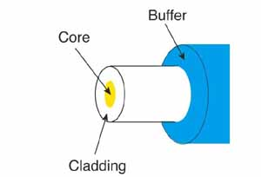
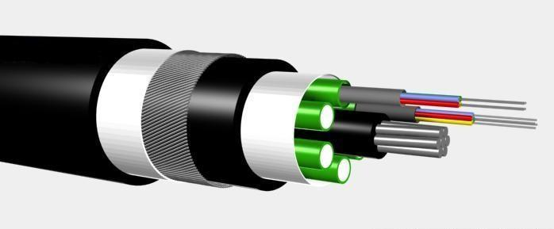
Fiber optics
Virtually unlimited speed, limited only by the equipment you place on the ends of the fiber
Can carry signals for long distances
Undersea fiber cables go all the way across the oceans (1000s of miles)
Will need to re-generate the signal every 60 miles or so
Low weight
Very Reliable
thefoa.org/tech/ref/basic/fiber.html
commons.wikimedia.org/wiki/File:Optical_fiber_cable.jpg

Slide 30
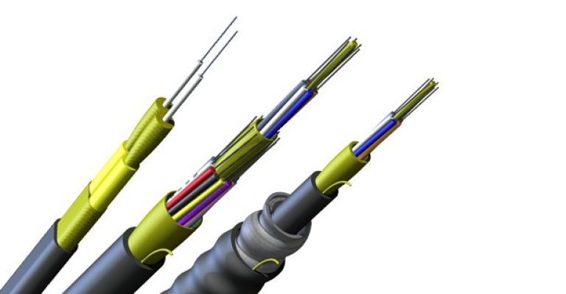
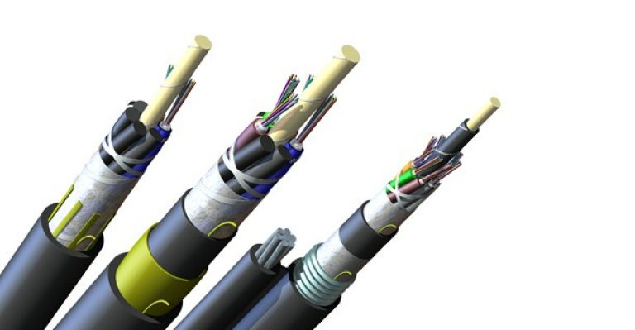
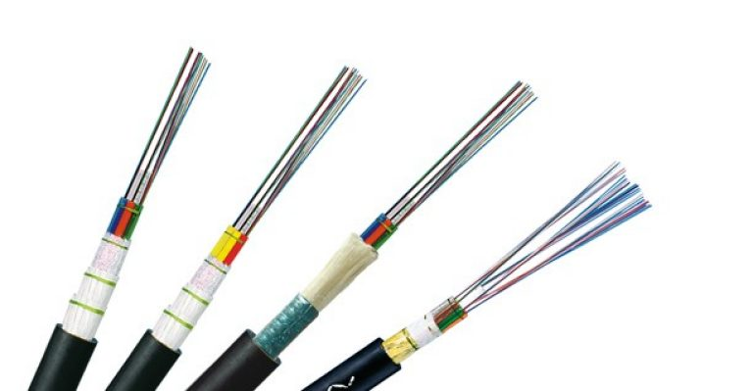
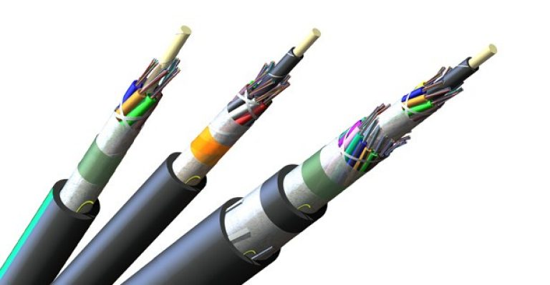
Fiber Optic Cables

Slide 31
Video – Fiber Network Overview!
YouTube.com/watch?v=qr9zjtfHR-w

Slide 32
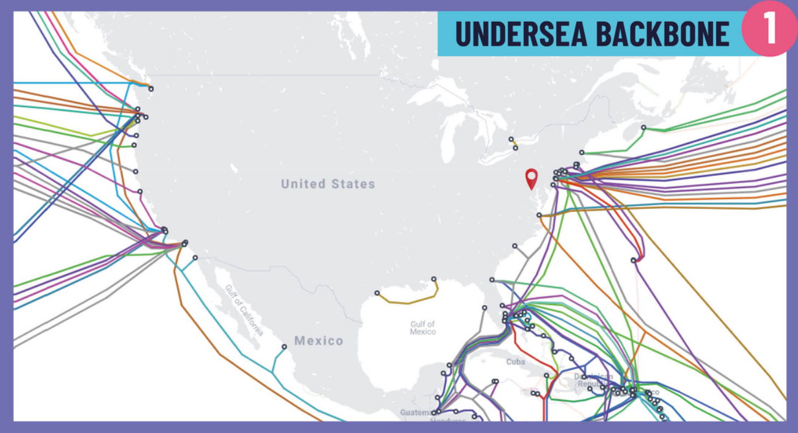

Slide 33
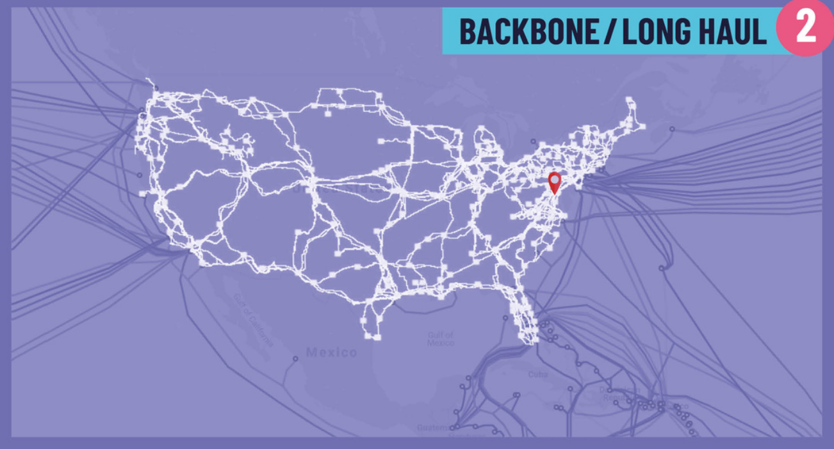

Slide 35
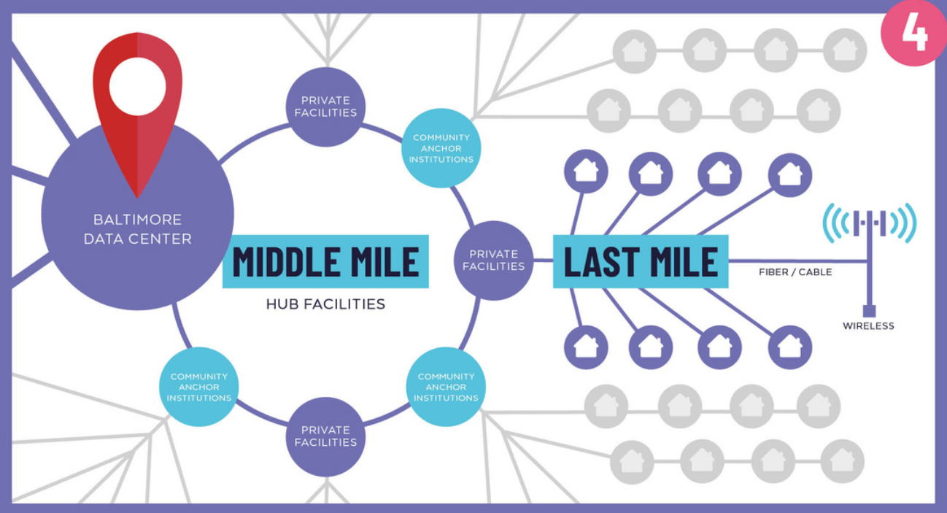

Slide 36
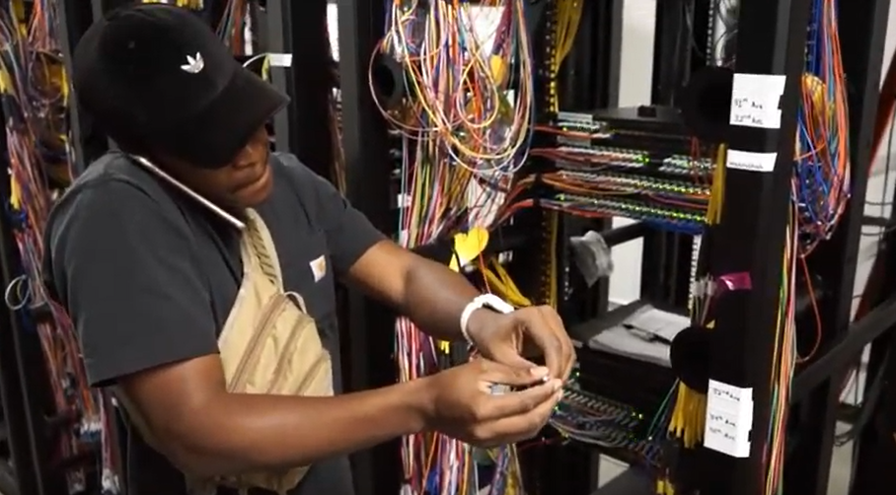
Central Office Fiber
Nestled in a south Minneapolis neighborhood…

Slide 37
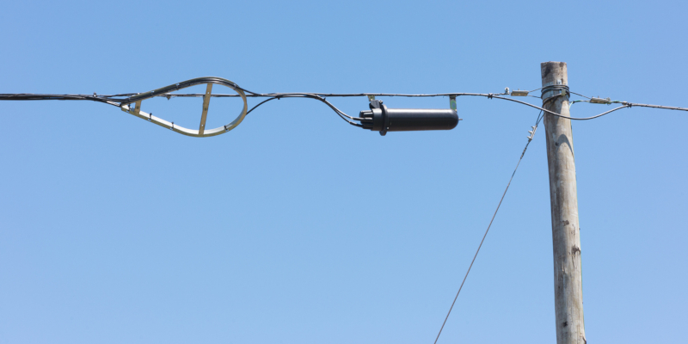
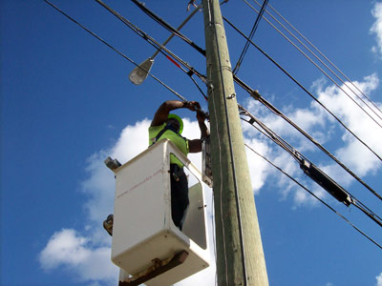
Aerial Fiber Construction
Courtesy, Dale Smith, NSRC, University of Oregon

Slide 38
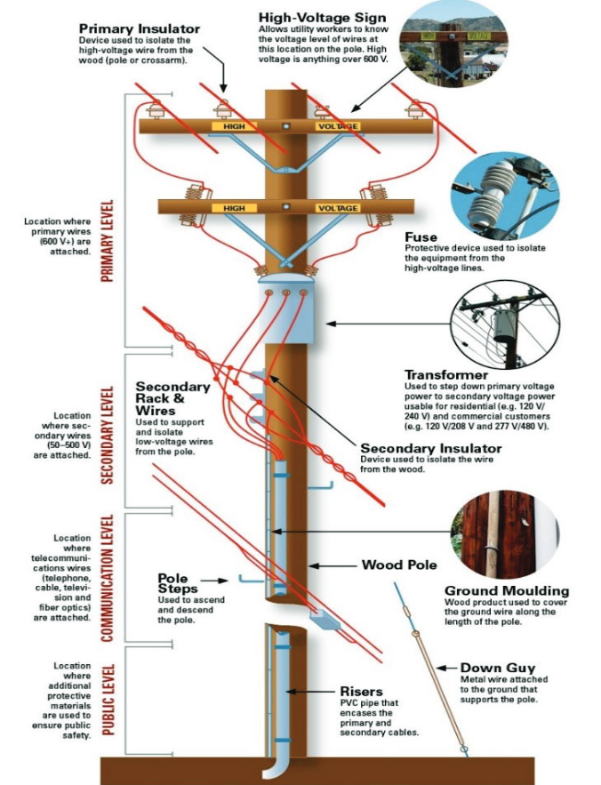

Slide 39
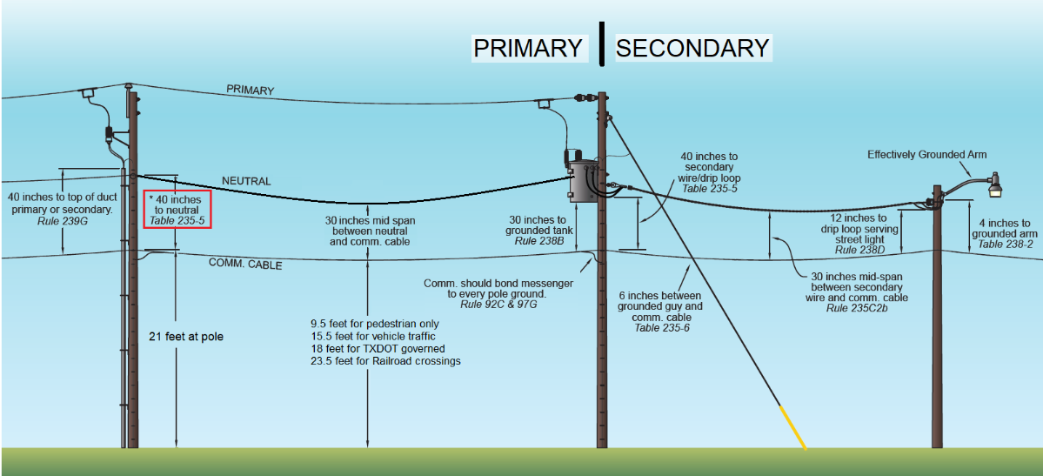

Slide 40
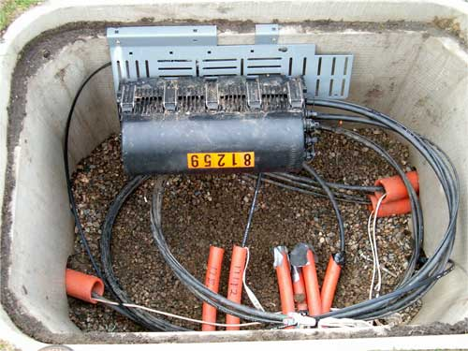
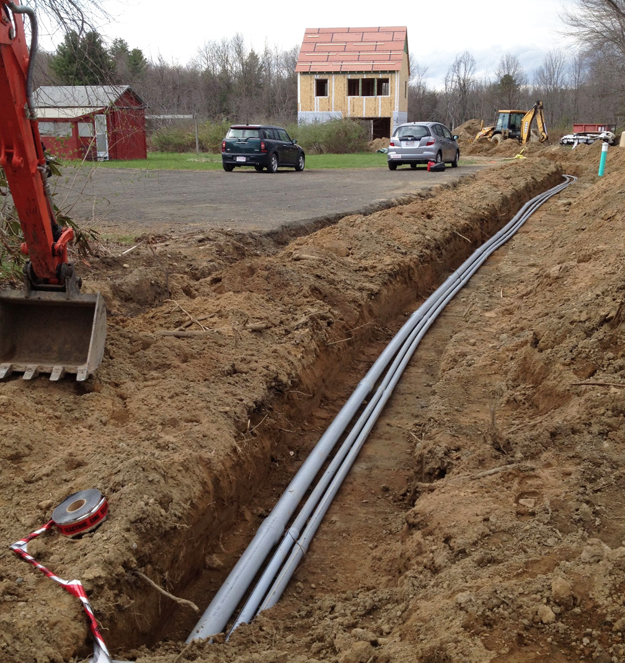
Underground Fiber Construction
Courtesy,
Dale Smith, NSRC,
University of Oregon

Slide 41
Video – Microtrenching!
YouTube.com/watch?v=ObM_bDnf9Lc

Slide 42
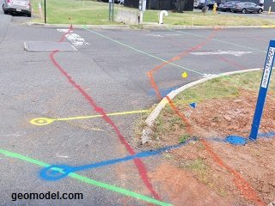
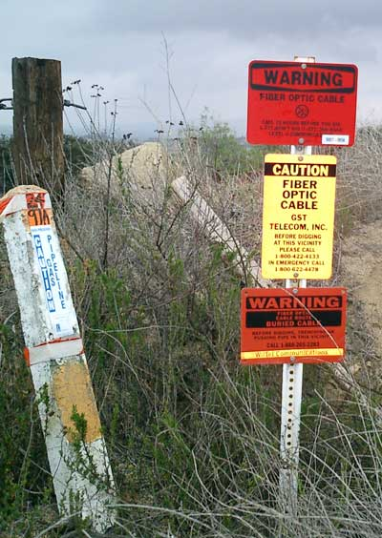
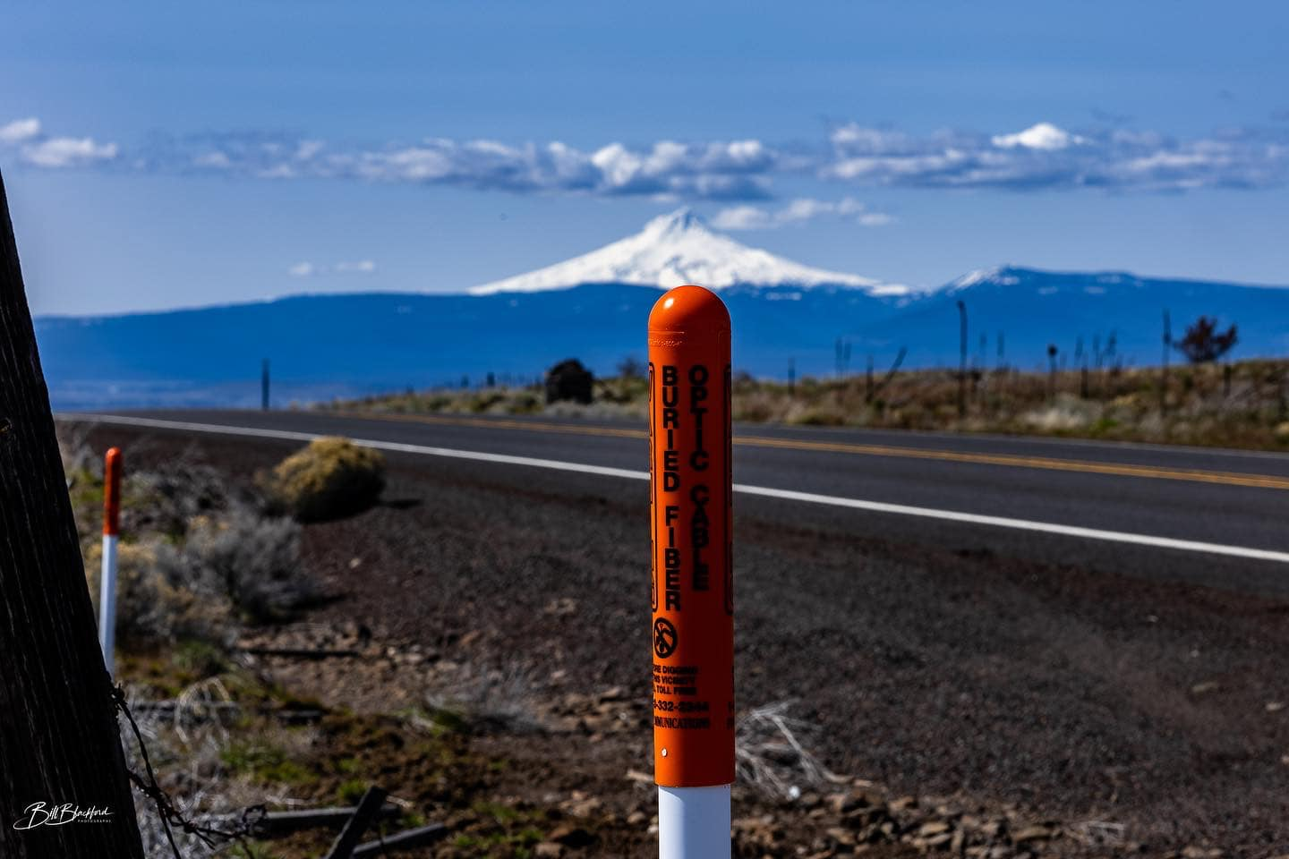
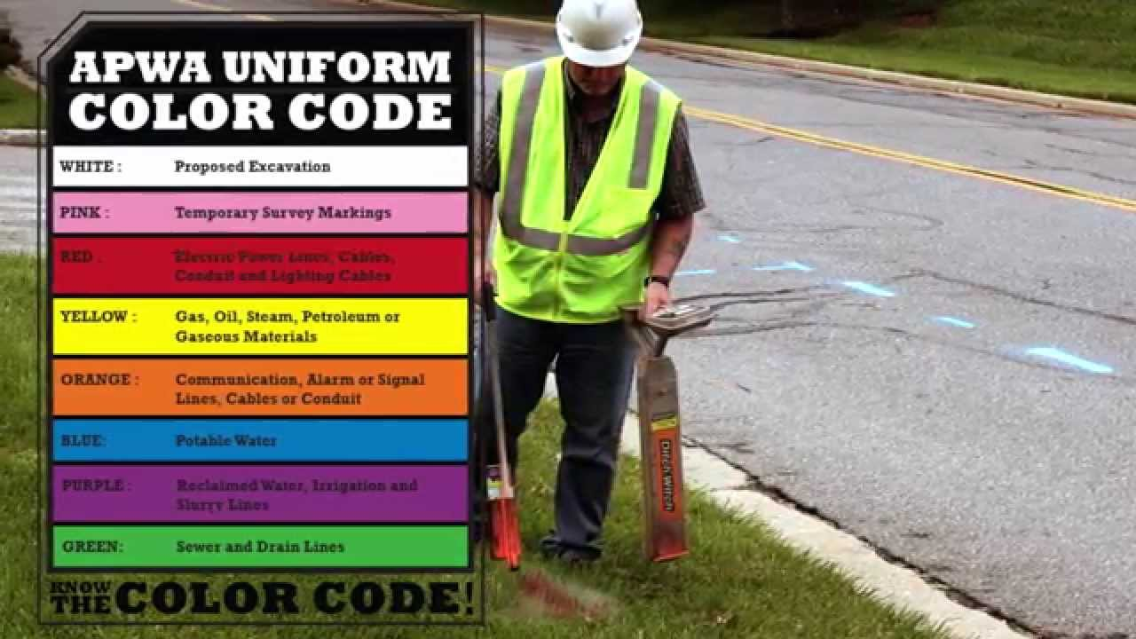
Fiber Optic System Locates
Courtesy,
Dale Smith, NSRC,
University of Oregon

Slide 43
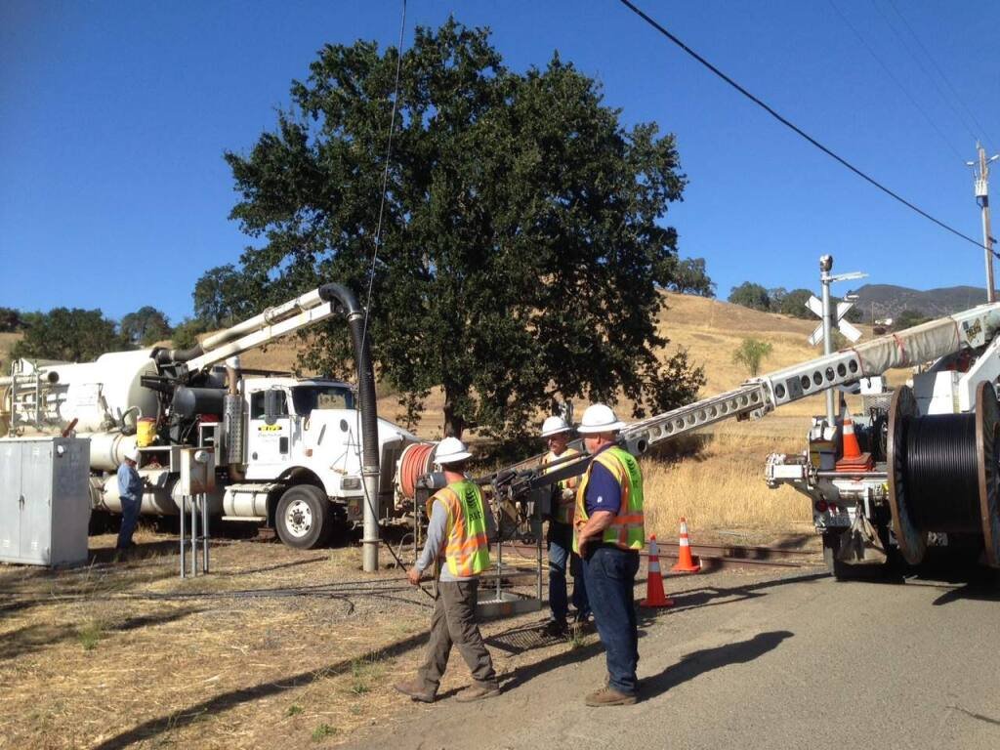
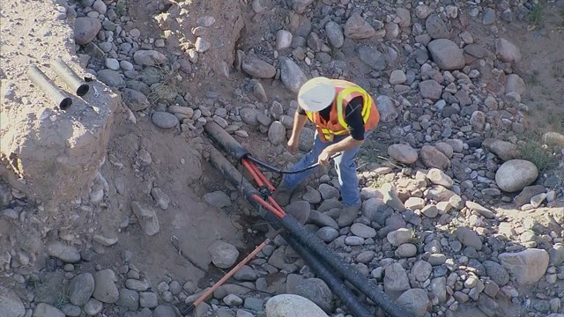
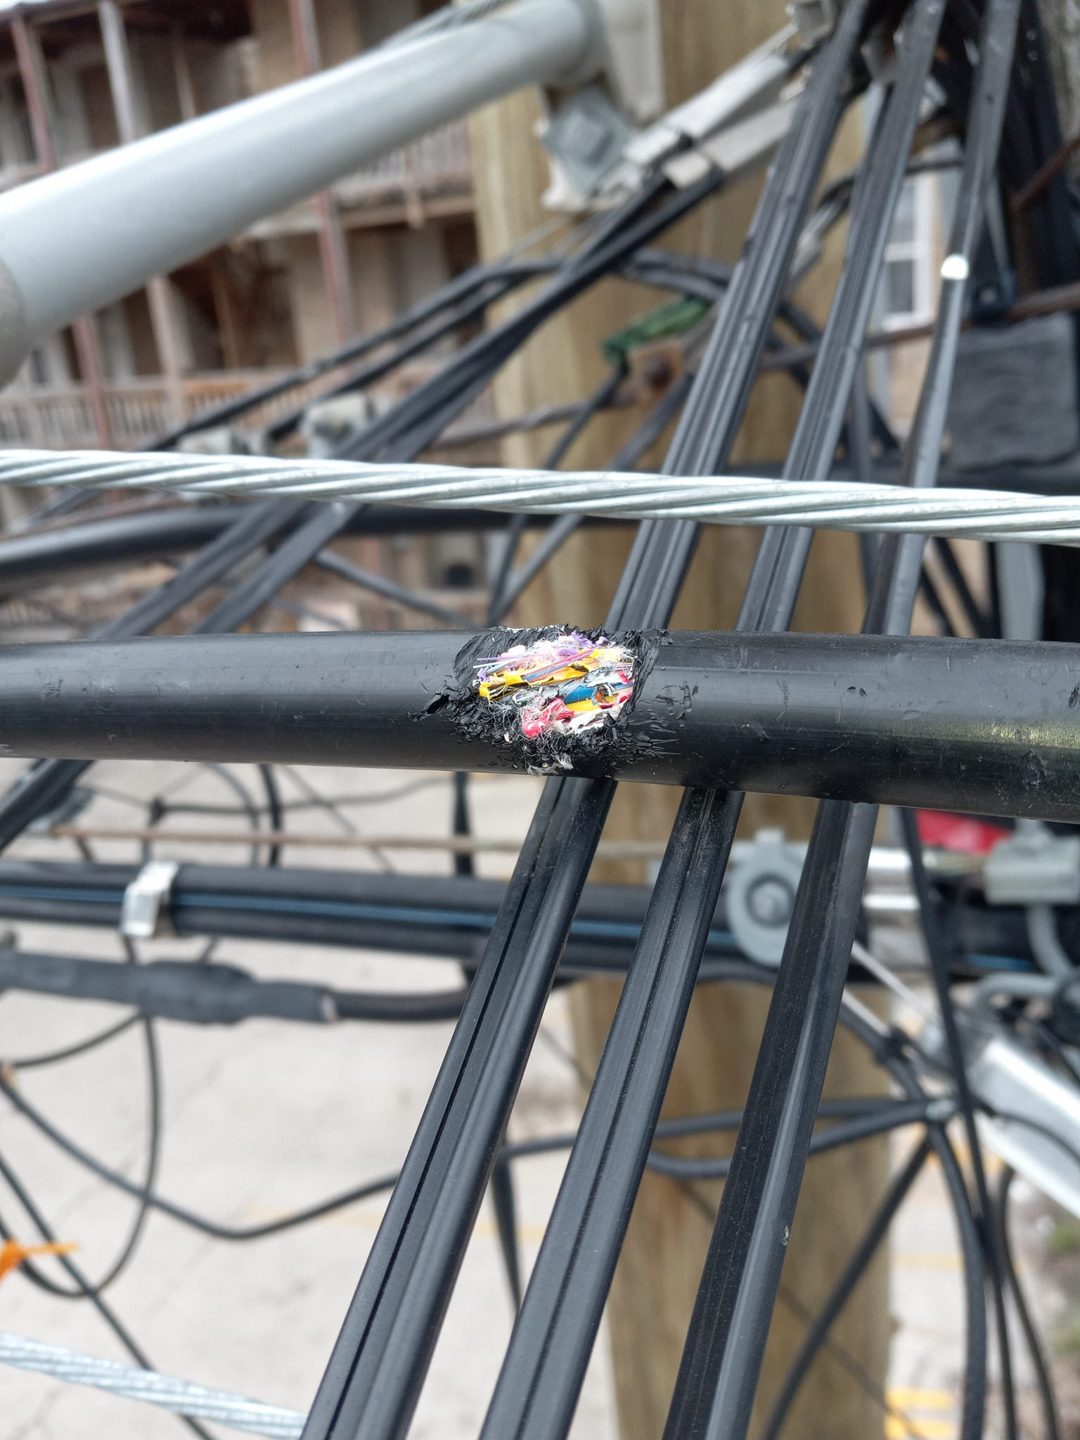
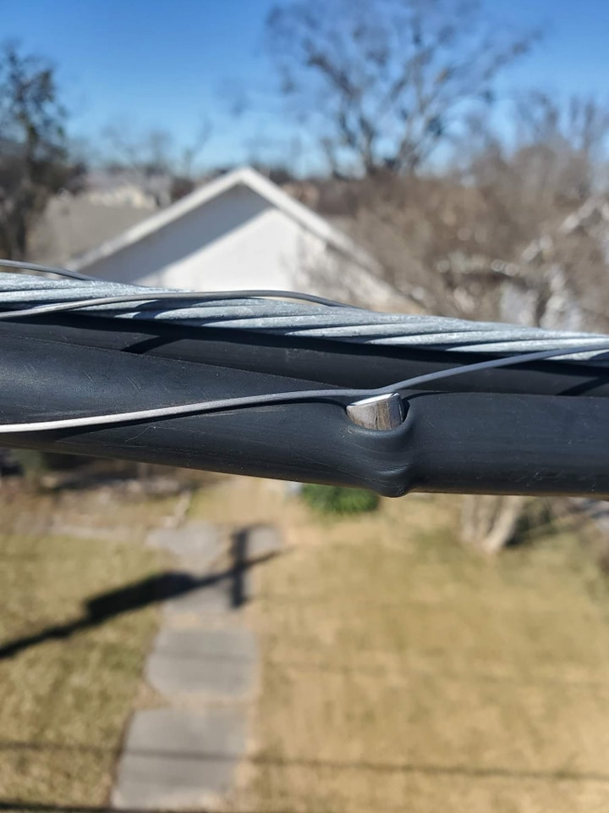
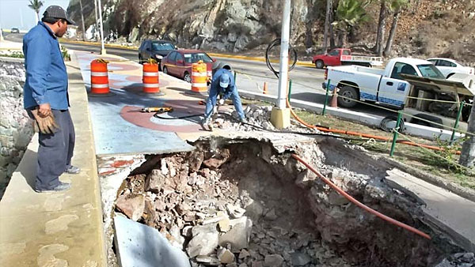
Fiber Optic Systems Outages

Slide 45
Fiber Optics Economics
High Upfront Costs
Cost to build in midwestern city, single family homes, directional boring in $/foot
Conduit $1
Labor $9-12
Fiber $1-$2
Permitting $2
Handholds, Couplers, splicing misc, locate wire $2.5
Total: $16-20 (roughly – this is a lower bound)
Low Operating Costs
Additional Cost to Connect a Home:
$1000 - urban single family
$500 – apartment / condo
$3,000 - $5,000 for many rural

Slide 47
Wireless Technology
(Still mostly wired)
Mobile
4G LTE and 5G
Fixed
Wi-Fi
Satellite
Geostationary
Low Earth Orbit
© Justin Smith / Wikimedia Commons, CC-By-SA-3.0

Slide 48
Wireless Tradeoffs

Slide 49
CBRS – Citizens Band Radio Service
Cost
Home Installation
Quality of service
Varies Significantly
Long term costs
Community Broadband Bits Podcast Episode 500
https://www.qualcomm.com/news/onq/2020/04/qualcomm-technologies-propels-cbrs-commercialization-platforms-devices-and

Slide 50
Small Cells and 5G

Slide 51
Small Cells and 5G
Photo by David McBee: pexels.com/photo/high-angle-shot-of-suburban-neighborhood-1546168

Slide 54
ilsr.org/report-indigenous-future-zones

Slide 55
christopher@ilsr.org CommunityNets.org ilsr.org
@communitynets

Slide 56
Health Care and Broadband
Is broadband expensive in high-poverty areas?
Analysis: 10 rural, Black, high-poverty counties in Georgia, Alabama, Mississippi
235k population
About $3 billion in annual healthcare spending
20% households no insurance, less than $25k/year income
Effective telehealth saves $43 million each year, half from regaining lost productivity, rest from emergency visits, readmissions, admissions
Estimated cost to connect 63k households, $80 million one time costs; $2-3 million digital equity investment per year, assumes Affordable Connectivity Plan continues
Many other benefits that are extremely difficult to quantify – ex: Chattanooga removed racial gap in parental involvement in schools
Or is lack of broadband expensive in high-poverty areas?
CommunityNets.org/reports/increased-wellness-and-economic-return-universal-broadband-infrastructure-telehealth-case

Slide 57
BEAD Basics
Unserved (less than 25/3 Mbps download/upload)
Underserved (at least 25/3 but less than 100/20 Mbps)
FCC Broadband Data Collection Broadbandmap.fcc.gov
(Ugh)

Slide 58
Submit Challenges: Communitynets.org/content/new-resource-how-submit-challenges-fcc-broadband-map

Slide 59
New Mexico Specifics
Internet for All NM Dashboard
BEAD: $675 million for mostly rural unserved locations
5 Year plan finished end of summer
Initial Proposal due end of 2023
$135 million likely available Q2, 2024
$540 million likely available Q2, 2025
Not enough for Internet for All
Digital Equity Act
Connect.NM.gov

Slide 60
Pueblos and Federal Funds
Internet for All NM Dashboard

Slide 61
Recent Development?
Adam Geisler is Division Chief for the Tribal Broadband Connectivity and Nation-to-Nation Coordination Division at NTIA – National Telecommunications & Information Administration
At California BEAD Tribal Outreach Regional consultations in the week of June 19 and on June 27, Adam Geisler said that NTIA policy for BEAD is that future broadband awards on Tribal Reservations would only happen with the consent of Tribes.

Slide 62
Survey!
https://forms.gle/EsJWxMiGh82D4H1Y8

